Slide 1
Banking Online Workshop
Presentation

Slide 2
Welcome

Slide 3

Introductions
Your facilitator today is:
Please introduce yourself to the rest of the group.
Write down one question you hope to answer by attending the workshop
Notes:
Introduce yourself and outline what qualifies you to run the course. ​
Emphasise that this is a safe space to ask questions about money, and to check understanding of financial language and practice. ​
Ask the learners to introduce themselves – if the training is being delivered to a larger group, then ask the delegates to introduce themselves to the person on their right. ​
As part of their introduction, ask the learners to name one objective they'd personally like to get from the workshop.

Slide 4

Banking Online workshop
Objectives
This workshop aims to help you to manage your bank account online.
By the end of this workshop, you should be able to:
list the benefits of banking online
set up an online account
feel confident about managing your account online.
Notes:
Talk through the slide:
This workshop aims to help you to manage your bank accounts online.
By the end of this workshop, you should be able to:
list the benefits of banking online
set up an online account
and feel confident about managing your account online

Slide 5

Today’s session
Health and safety briefing
Agenda
Welcome.
What are the benefits?
Setting up online banking.
Using online banking.
Disclaimer: Everything that is discussed today is for guidance and is not financial advice. Any websites, tools etc. are examples of what's available.
Notes:
Run through basic health and safety (fire exits, trip hazards etc). ​
Run through the agenda. ​
Read out the disclaimer: ​
Everything that is discussed today is for guidance and is not financial advice. Any websites, tools etc. are examples of what's available ​
Hand out the workbook and explain it's for the learners to make notes as we go through the workshop and has some useful links to further information. ​
​

Slide 6
What are the benefits?
Notes:
First, we’re going to take a look at the benefits of banking online
Explain:
And by the end of this section, you should be able to:
list the benefits of banking online.

Slide 7

Mary’s story
Meet Mary.
Mary has been thinking about setting up online banking.
What do you think the benefits will be?
Notes:
Ask:
Mary has been thinking about setting up online banking after her daughter suggested she gave it a try. What do you think the benefits will be?
Look for:
Bank from anywhere
Checking balance
Moving money
Statements
View and make and change payments
Manage direct debits
Updating your personal information
Access to safety features such as freezing your card
Explain:
Most large banks now offer really secure, sophisticated online banking
You can still go to your bank branch as normal, but internet banking makes it easy to access your account and move money around with it, whenever you like and wherever you are
If you are asked about branches closing, empathise with the learner and say something like:
The way people are choosing to bank is constantly changing and evolving and as a result, sometimes decisions are made to close branches. This can be unsettling and upsetting but unfortunately, it’s not something that is in my hands. There is an extensive process in place before the decision is made and alternative means of support are offered when a branch does close.

Slide 8

Mary’s story
What concerns might Mary have about banking online?
Notes:
Ask:
What types of concerns might Mary have about setting up and using online banking?
Explain:
It's understandable to have concerns, but the banks have strong protection in place to help stop this.
Banks see how you use your account normally. They’ll let you know if they see anything unusual, for example, an unusually large payment or your card being used in a different country.
Banks react quickly in these situations and will help you set things right. This does mean that occasionally they may ask about one of your transactions to check if it's really you. Once you confirm this, they will let that transaction go through.
Remember, your online bank details – things like passwords and PINs - are for your eyes only. Never share these details with anyone or write them down in a note or email.
If anyone is concerned about fraud point them to the Stop Fraud website (the link is in the workbook, page 5) which can help you to understand how to be aware of fraud.

Slide 9
Setting up online banking
Notes:
Now we’re going to look at how you go about setting up online banking.
Explain:
So by the end of this section, you should be able to:
Set up an online account

Slide 10
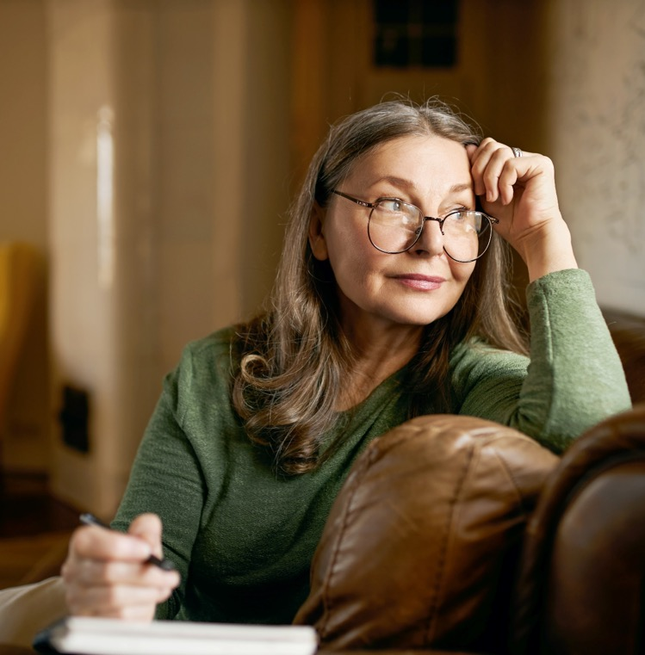
Mary’s story
Mary is wondering about the best way to access the internet. What would you advise her to do?
Notes:
Ask:
Mary is wondering about the best way to access the internet, what would you advise her to do?
THEY CAN WRITE A FEW NOTES IN THEIR WORKBOOK HERE (PAGE 6) – OR CALL OUT / USE FLIPCHART
If required, prompt: what could Mary use, if she wants to use the internet?
Explain:
To use online banking, Mary will need to have access to the internet.
She might use her mobile phone, a computer or a laptop linked to her home internet, or she may have someone she visits – maybe her daughter - who would let her use their internet access.
There are also lots of ways to access the internet in public too, Mary could try her local library or businesses such as local pubs, cafés and restaurants.

Slide 11
App vs browser
Feature | Browser | App
Check your balance |  | 
Pay bills and send money |  | 
Manage direct debits and standing orders |  | 
Transfer money between accounts |  | 
Pay in a cheque |  | 
Freeze your card |  | 
Report a missing card and order a new one |  | 
Update your details and manage settings |  | 
Notes:
Explain:
Now Mary has access to a device such as a mobile phone or computer, and she’s connected this to the internet. So she’s all ready to set up her online account.
Ask:
Before she goes ahead, her daughter explains that she can access online banking through a browser, or she can download an app onto her mobile phone. Mary asks her daughter what the difference is.
Explain:
Mary's daughter explains that a banking app is something you can download onto your phone. It gives you access to most features. But using your internet browser to connect to the online banking website will give you access to more information, as well as being able to do more activities.
Pause here, and prompt them to jot down these differences in their workbook (page 6), if this helps them
You can see here the main features that you can access from both the website and the app. Bear in mind that if you want to pay in a cheque online, you’ll need a device with a camera for this.

Slide 12

Mary’s story
Mary is wondering how she can set up an online account.
Where and how would you advise Mary to set up an online account?
Notes:
Ask:
Mary is wondering how she can set up an online account. Where and how would you advise Mary to set up an online account?
Look for:
You can go online.
You can go into a branch.
You can phone your bank.
Explain:
You can go online – if you feel comfortable, you can use a web browser to visit your bank's website. From there you can find out how to register for online banking. Some will let you do it online, others may ask you to go into a branch or phone them.
You can go into a branch – they can help you understand how to get started with their online banking services.
Or you can phone your bank – from there, they should be able to help you get started.

Slide 13

Setting up Mary’s account
What type of information will Mary need and which activities should she carry out in order to set up an online account?
Notes:
Ask:
What type of information will Mary need, and what will she need to do, to set up an online account?
Look for:
Personal details
Log in details
Confirm she's read the terms and conditions
Undergo some security checks
If face-to-face training and you have a whiteboard or flipchart, use these to note their suggestions
Explain:
To find Mary's account, the bank asked for some personal details, like her name, date of birth, postcode and account details.
Mary was given a customer number to help her to log on to her online banking. Mary was also asked to fill out some other details. These details are how Mary, and only Mary, will be able to unlock her account.
Some banks do this by asking the person to create a username and password. Others will ask you to set up other types of protection like a PIN, or some memorable information.
Others may also ask you to set up a different kind of authentication, like a fingerprint or face identification. These all act as an extra layer of protection, to make sure Mary is the only one who can use the account.
Mary was asked to read and agree to some terms and conditions. When setting up your account, you should read these and make sure you're comfortable with what you're signing up to.
Some banks will add extra security checks into the process. This is just to make sure it really is Mary who is setting up online banking. This can sometimes be a phone call with the bank, or Mary may need to record a short video of herself so the bank can check she is who she says she is. Because most banks will require Mary to do a security check via call or message, Mary will need some kind of phone number.

Slide 14
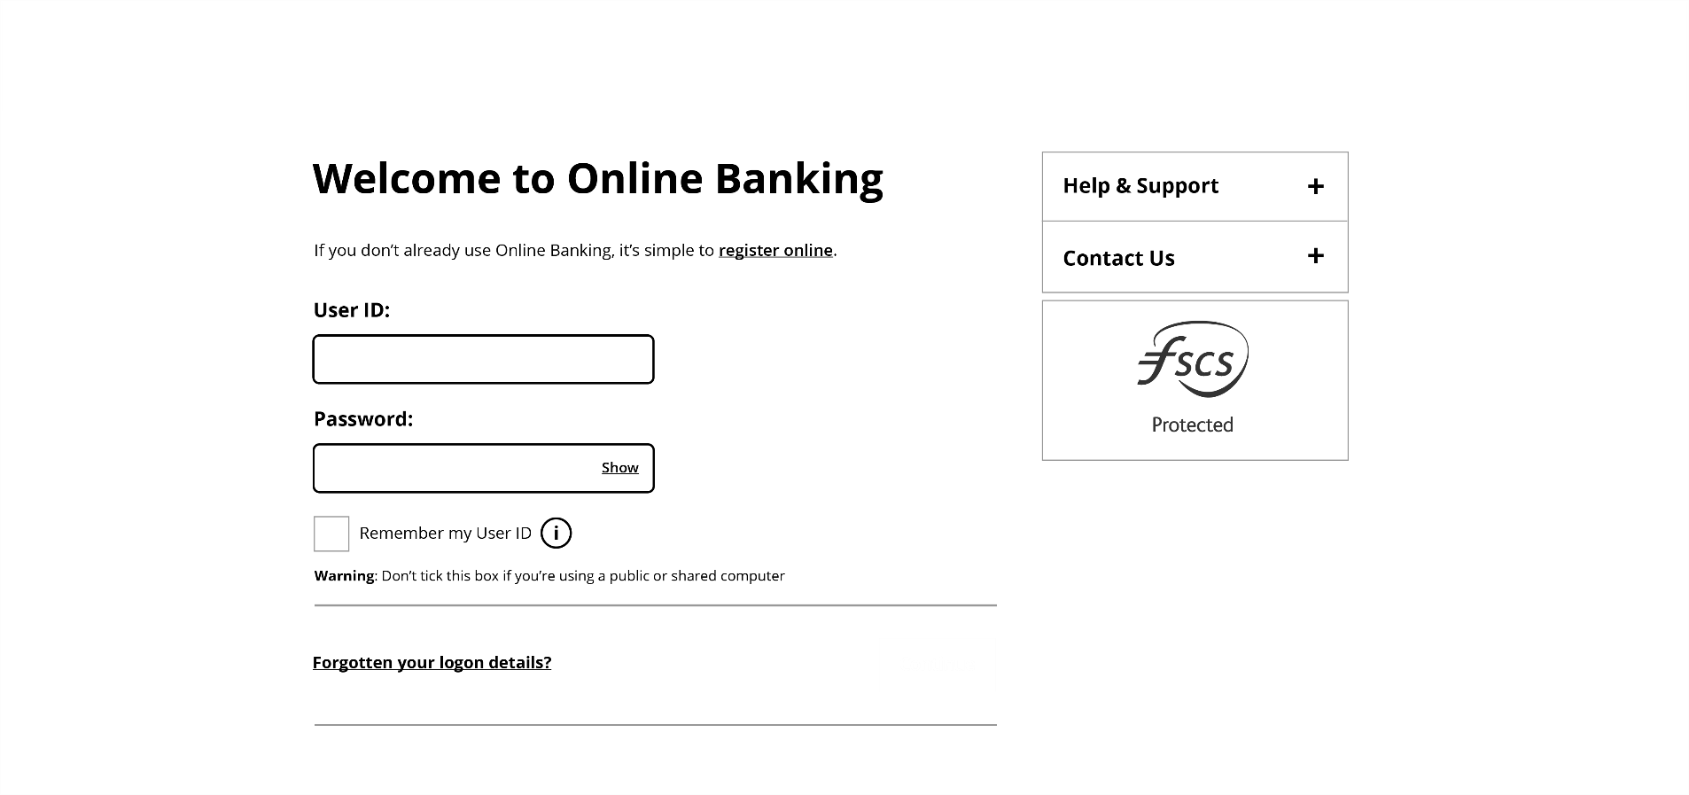
Browser log in
Notes:
Explain:
Now that Mary is registered for online banking, she goes to her bank's website and clicks where it says 'log in'
She now needs to enter her unique details, given to her when she registered

Slide 15
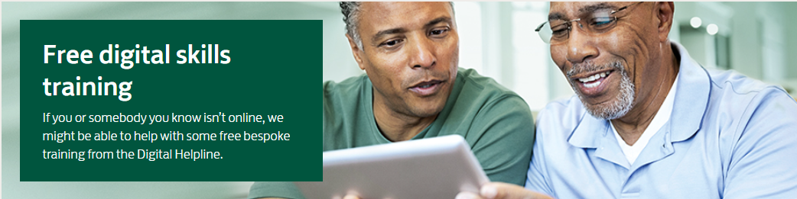
Help downloading the app
0345 222 0333
Free digital
skills training
If you or somebody you know isn’t online, we might be able to help with some free bespoke training from the Digital helpline
Notes:
Explain:
Mary wants to set up the app on her phone for quick, easy access to her online account.
First, she'll need to download her bank's app from Google Play or the Apple App Store
Mary isn’t sure how to do this, so she calls the Digital Helpline on 0345 222 0333.
This is a free service and she doesn't need to be a customer.
It is open Monday to Friday, 9am – 5pm.
These details are in your workbook. The Digital Helpline can give free one-to-one support with digital skills to anyone over 18.
Or of course, Mary could contact her bank for support
Mary finds she can also get a link to download the mobile banking app through the bank's website.
Once she has downloaded and opened the app, she can log in using the details given to her when she registered.
PAUSE HERE AND CHECK HOW THE LEARNERS ARE FEELING – SO YOU CAN ADJUST THE TRAINING AS NEEDED

Slide 16
Using online banking
Notes:
So now Mary has got into her bank account online, let’s explore the kind of things she can do with it.
Explain:
And by the end of this section, you should be able to:
Set up an online account

Slide 17

Logging in online
Security questions and information you might come across when logging in:
Passwords
Multi-factor identification
Pins
Memorable information
Face scan
Fingerprint
Notes:
First, let's chat a bit more about logging into online banking.
Ask:
What types of information might Mary's bank ask her for in order to access her new online account?
Look for:
Passwords
Multi-factor identification
PINs
Memorable information
Face scan
Fingerprint
If training face-to-face and you have access to a whiteboard or flipchart, use this to note their suggestions (and add any that they don’t get, as you talk through them).
Facilitator note:
Explain the different options and what they mean
Passwords – this is where you choose a set of letters, numbers and symbols which you will enter when you log in
Multi-factor authentication – this is a type of security used to lock and keep your accounts safe. It means using two or more types of lock. So, if someone gets your password, for example, they will still need to get through a different kind of lock.
PINs – you would select four or more numbers. You mainly use this with a password as a second type of lock in case someone gets through the first.
Memorable information – this is usually the answer to a question, it should be something meaningful to you. It is often used with a password as an extra lock. It is also sometimes used to help unlock your account, if you forget your password.
Face scan – a type of security where you use your device's camera to scan your face.
Fingerprint – another type of security lock, but this time using your fingerprint to unlock your account. You will need to have a fingerprint scanner on your device. Most modern smartphones will have this built-in.
PAUSE THE SLIDES HERE, FOR THE CARDS-BASED ACTIVITY

Slide 18
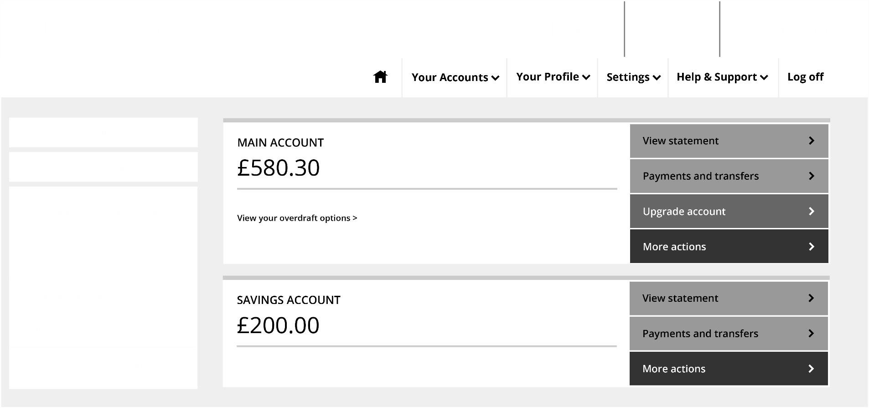
Example of what you might see
CARD MANAGEMENT
Notes:
Check everyone can see the details here – if not, point them to the image in the workbook.
Exercise:
Point out the image of a generic internet banking screen on the screen / in the workbook and discuss with the learners what features they can see. Discuss each of these areas and their functionality with the learners.
top area:
Search – you will usually see some kind of search bar. This will allow you to look for help or find something in your accounts.
Your accounts – you will be able to see a tile or list of all the accounts you have with the bank. You can see in the main part of the screen that Mary has two accounts – a main account and a savings account.
Settings – you will usually see a link to manage your account settings. This might look like a cog or gear symbol.
Support – there will usually be some kind of help or support button or section. You can use this to get help with your banking or how to bank online.
On the left:
Spending – you will find some kind of representation of your spending or a link to see this information.
Card management – there will often be some kind of card management section, especially on apps. These allow actions like seeing your card details, cancelling and ordering new cards, reporting a card lost or freezing/unfreezing a card.
Our products and services – there will usually be some way to apply for new products, so you can set up new accounts. With most banks, you won't be able to set up all of their products online, so you might be referred to speak to someone via phone or branch
On the right:
Pay and transfer – you will usually have some kind of pay or transfer button or tab. This lets you see accounts you have paid previously or set up new payees and make a payment. It will also usually include your list of direct debits and standing orders.

Slide 19

Using your online account
Pay new and existing payees
Transfer money between accounts
Manage direct debits and standing orders
Review and cancel upcoming payments
Notes:
Explain:
There are lots of ways Mary can use online banking to make payments and send money.
She can pay new and existing payees. (this is a good point to check if they recall / understand the term ‘payee’)
She can also move money between her accounts. This means she can pay and move money from anywhere.
Online, Mary can manage direct debits and standing orders. She can cancel them and review upcoming payments.
Mary may even be able to send money outside the UK. Who she can pay and how she can pay will depend on the bank; if Mary needs any help with this she can speak to the bank or look in the help section online.

Slide 20
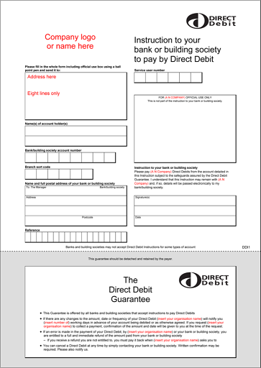
Direct debits – how do they work?
Set up by the company you are paying
Always make sure you have enough money in your account to cover the payment
You can cancel direct debits using your online banking
Notes:
Explain:
Direct debits automatically pay a company once a month from the money in your account. Lots of companies like you to use this payment method, as you don't have to remember to pay your bill – the bank will automatically do it for you each month.
Ask:
Who is responsible for setting up a direct debit?
Explain:
Direct debits are set up by the company you are paying.
It's still important that you check your direct debits, to make sure they're set up right.
It's also important you make sure you have enough money in your account to pay your direct debits, or you may be charged a fee for missing a payment.

Slide 21

Standing orders
Mary wants to send a monthly payment to a local charity by standing order.
Who would be responsible for setting up the standing order?
Notes:
Standing Orders
Ask:
Mary wants to send a monthly payment to a local charity by standing order. Who would be responsible for setting up the standing order?
Explain:
Mary, because standing orders are set up by the account holder
The first thing Mary will need to do is set up the person/organisation she wants to pay as a 'payee'. To do this, Mary will need to know their name, bank account number and sort code.
Once she has these details, she is ready to start.
Most banking services will have a 'pay and transfer' section. It might not be called this, but it will be something similar.
In this menu, there is usually a button or link that will say 'Add new person' or 'Create new payee'.
After clicking on this, Mary will be able to fill in the details of the charity.
Mary can review and manage her payments online at any time, giving her control over her spending.

Slide 22

Standing orders – how do they work?
Set up by you
Always make sure you have entered the correct details
Set the frequency and amount of the payments
Enter the reference details
Review, change and cancel using your online banking
Notes:
Ask:
•Why should you always double-check the details of the person or company you are paying?
Explain:
•Always double-check that the details you enter are correct - or you could end up sending the payment to the wrong account.
•Some banks will now have a step where they will check with you whether the details you have entered match what they have on file. So, for example, if you want to pay John Smith with the account details 01234567, sort code 00-00-00, but the bank has a record that shows that this bank account belongs to James Wright, then they may encourage you to check.
•You will also need to set an amount and the date you want the payment to go out on – for example, the first day of the month. You will also need to say how regularly the payment needs to be made – weekly, once a month and so on. You will also need to add a reference. The reference shows how it will appear on your statement and the statement of the payee, so it might be something like 'holiday deposit'. Some companies will ask you to put something specific as the reference to help identify the payment when it comes into their account.
•Once you’re sure all these details are correct, you can confirm and finish setting up the standing order. Some banks will ask you to re-enter your password at this point, or go through an extra layer of security to make sure it's you.

Slide 23
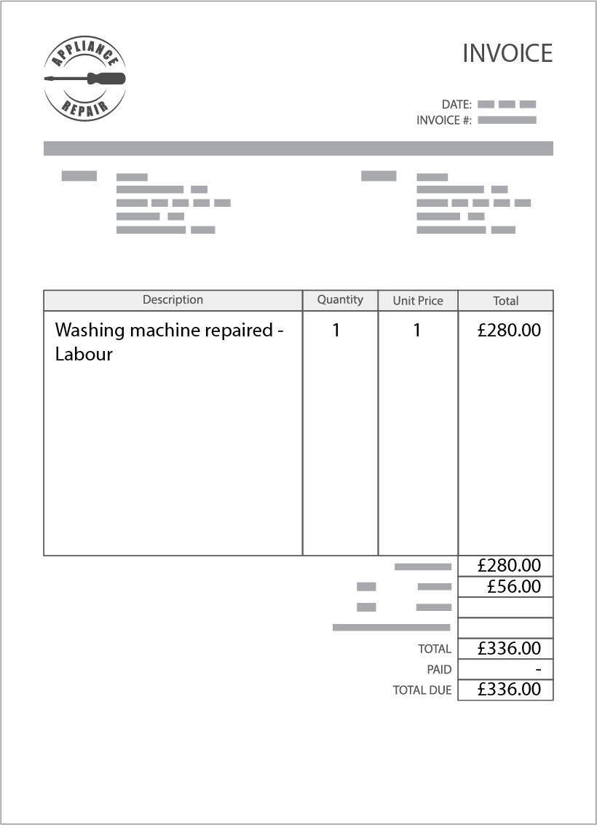
One-time payments
Mary's washing machine broke down.
A repair man came and fixed it and asked Mary to send the payment through to his bank account.
He gives Mary an invoice with the payment details.
Notes:
Talk through:
Mary's washing machine broke down. A repairman came and fixed it and asked Mary to send the payment through to his bank account. He gives Mary an invoice with the payment details.
Explain:
The way you set up a one-time payment is similar to setting up a standing order, except you need fewer details and the payment is usually made there and then.
Once you set up or find the payee in your list of payees, you can enter how much you want to pay and add a reference. Some banks will also allow you to schedule the payment for a later date.
Bear in mind that all banks will have some kind of limit on the amount you can pay in a one-time payment or in a period of time. For example, they may say no more than £10,000 in one payment, or no more than £10,000 in one day.

Slide 24
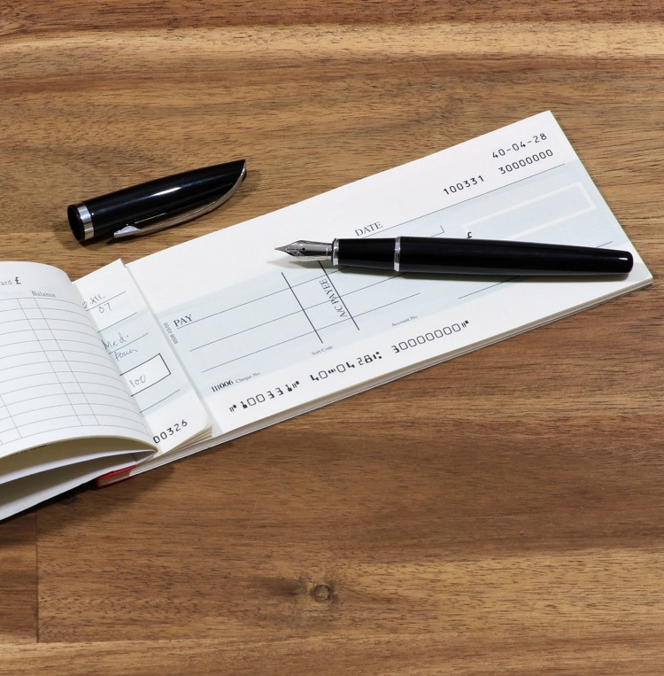
Cheques
Mary logs in and chooses the account
She selects ‘cheque deposit’
She enters the cheque amount
She gives the app permission to use her camera
She puts the cheque, face up, on the table then holds the camera over the cheque until the green box appears
She turns the cheque over and repeats the process
She selects ‘Review’, checks and confirms
Notes:
NOTE – THIS SLIDE IS ANIMATED TO SHOW EACH STEP IN TURN
Mary decides to pay in the cheque online – this is how she did it:
(THIS IS THE START OF THE ANIMATION – CLICK AND TALK THROUGH EACH STEP IN TURN)
Mary logs onto his app and chooses the account she wants to pay it into.
Next, Mary selects the Cheque deposit option.
Mary enters the amount shown on the cheque.
Next, she selects the front of the cheque and gives the app permission to use her camera.
Then she places the cheque on a dark, flat surface. Mary uses her dining table. She holds the camera over the cheque until the green box is shown around the cheque. The app then scans the cheque.
Next, Mary selects the back of the cheque, turns the cheque over and repeats the process.
Finally, she selects Review your deposit and checks that the details are correct and confirms the deposit.

Slide 25

Online activities
List the types of actions you expect to be able to do online to help you manage your money.
Notes:
Exercise:
Split the class into groups.
Ask each group to list the types of actions they expect to be able to do online to help them manage their money.
Once the groups have come up with their lists ask them to share their findings with the rest of the class.
Walk them through each answer as follows:
Look for:
Check your statements – you can see these as soon as they are created, so you don't need to wait for them in the post.
Download your statements for your records. You can also send them to, for example, a landlord to prove your income etc.
Search for specific payments and learn more about them. You can also see all your spending within a certain date range.
See the details of purchases – it can be easy to forget you bought something, so you might be worried when you see something on your account you don't recognise. With online banking, you can see the details of your spending so you can find out when you spent the money and where. This can help reassure you that all the money from your account was spent by you.
With everything you need online, at your fingertips, you can go paperless and receive all your letters from the bank online. This can save paper and time waiting for messages in the post.
Change your personal details like your address and mobile number in your account settings in an instant. This helps to make sure changes happen quickly.
(CONTINUED ON NEXT SLIDE)

Slide 26
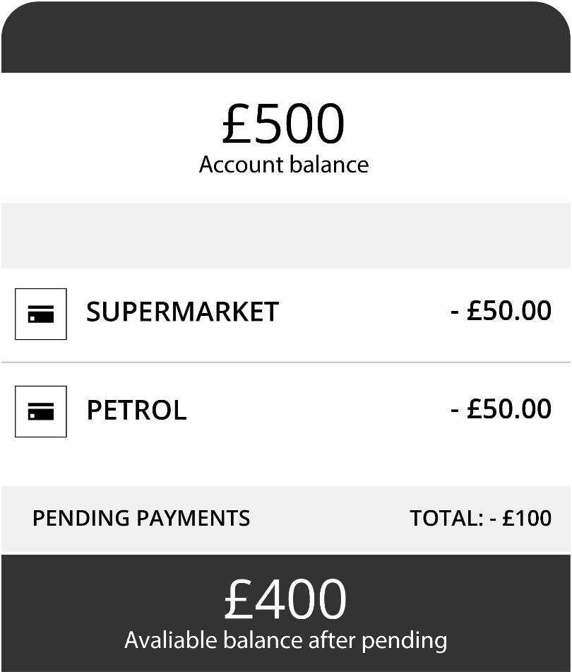
Pending payments
Notes:
See your pending payments – when you make a card payment, they don't automatically go out of your account. This can make it hard to know how much you have left to spend. This is why online banking usually shows you your 'available funds' which is the amount you will have to spend once your pending payments have left your account. They're a better indication of how much money you currently have.

Slide 27
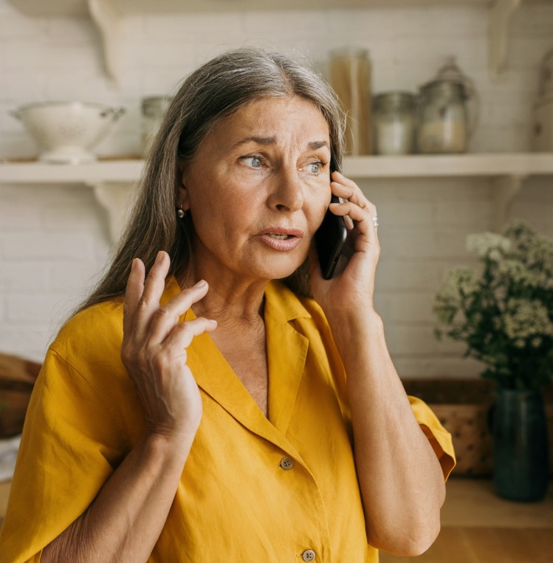
The lost card
Mary lost her card yesterday morning.
After ringing her daughter, Mary discovered that she could use her online account to freeze the card whilst she looks for it.
This means that no-one can use Mary's card whilst it's frozen.
Luckily, she found the card later that day and went back online to unfreeze the card.
What other services relating to your bank card do you think you can do online?
Notes:
Talk through the slide text
Ask:
What other services relating to your bank card do you think you can do online?
Explain:
You can usually use online banking to manage your card and card's PIN.
You can order new cards.
You can report cards lost or stolen or you may be able to freeze your card while you try to find it to stop it from being used.
You can also sometimes see your details like your card details, your PIN and your card's contactless limit.
PAUSE SLIDES HERE, FOR THE SAFETY AROUND ONLINE BANKING (MULTI-CHOICE) EXERCISE

Slide 28

Essential banking skills review
You should now be able to:
list the benefits of banking online
set up an online account
feel confident about managing your account online.
Notes:
Review the workshop with the delegates by running back through the objectives on the slide here, and asking them if the question they wrote down at the start of the workshop has been answered.

Slide 29
Any questions?
Notes:
Ask the learners if they have any questions about what's been covered. Encourage learners to help and support each other.

Slide 30
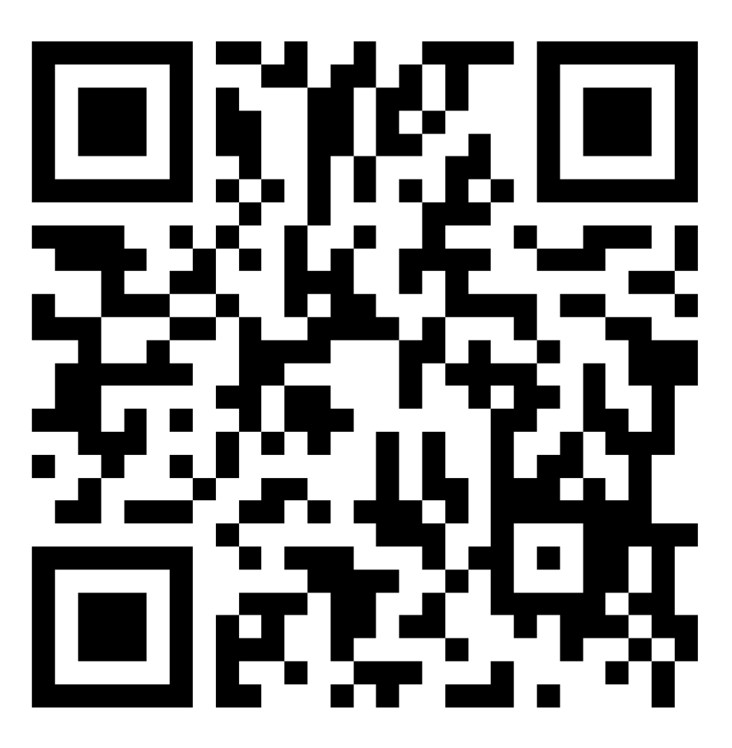
Thank you!
Let us know what you think
Notes:
Encourage learners to scan the QR code here and complete our short post-session survey around levels of confidence now they have completed the training, plus any other comments or feedback about the session

Slide 31
Notes:
Explain:
This is the end of this workshop. Thank you for attending – we hope it's been useful.
Please keep your workbooks so that you can refer back to your notes.
The workbook also contains helpful links to information on the internet as well as an explanation of financial terms to help you understand the terminology of banking.

