Slide 1
Saving Essentials
Workshop
Presentation
Notes:
Before you start this session, check you have printed and cut out sets of the Account security match cards, for the exercise on the different savings accounts.

Slide 2

Pre-session survey
Notes:
Encourage learners to scan the QR code here and complete our short pre-session survey around levels of confidence in the session’s topics today, plus what they would like to get out of the session

Slide 3
Welcome

Slide 4

Introductions
Your facilitator today is:
Please introduce yourself to the rest of the group.
What is it you want to save up towards?
Notes:
Introduce yourself and outline what qualifies you to run the course
Emphasise that this is a safe space to ask questions about money and a safe space to check understanding of financial language and practice
Ask the learners to introduce themselves – if the training is being delivered to a larger group, then ask the delegates to introduce themselves to the person on their right
Ask the learners what they want to save up for – for example, emergency money, a holiday, a deposit for a house…

Slide 5

Saving Essentials Workshop
Objectives
This workshop aims to help you understand how to select and use saving accounts.
By the end of this workshop, you should be able to:
list the benefits of saving
make informed decisions around interest rates
choose a type of saving account that best suits you.
Notes:
Explain:
This workshop aims to help learners understand how to select and use savings accounts.
By the end of this workshop, you should be able to:
list the benefits of saving,
make informed decisions around interest rates, and
choose a type of saving account that best suits you.

Slide 6

Today’s session
Health and safety briefing
Agenda
Welcome
What are the benefits?
Interest rates
Types of saving accounts
Disclaimer: Everything that is discussed today is for guidance and is not financial advice. Any websites, tools etc. are examples of what's available.
Notes:
Run through basic health and safety (fire exits, trip hazards etc).
Run through the agenda.
Read out the disclaimer:
Everything that is discussed today is for guidance and is not financial advice. Any websites, tools etc. are examples of what's available.
Hand out the workbook and explain it's for the learners to make notes as we go through the workshop and has some useful links to further information.

Slide 7
What are the benefits?
Notes:
So, first we’re going to look at the benefits of saving.
And by the end of this section, you should be able to:
list the benefits of saving.

Slide 8

Question
What are the benefits of saving and why should you do it?
Do you have to have plenty of money in order to be able to save?
Notes:
Use the following question to facilitate a discussion on the benefits of saving.
Ask:
What are the benefits of saving and why should you do it?
Look for:
Feeling in control of your finances
Having money for emergencies
Saving for big purchases such as a washing machine, car or a holiday
Saving for your future
Deposit for a house
Saving for retirement
You may want to note these ideas on flipchart or whiteboard if available. There’s also space in the workbook for this.
Ask:
Do you need lots of spare money to be able to save?
Explain:
Even if you can only save a few pounds a week, you'll be surprised by how quickly your savings will grow. There are schemes that will help you save – we'll look at those in more detail later in the workshop.

Slide 9
Quick quiz
Notes:
Exercise:
Split the class into small groups and run through the following quiz with them. Keep it fun and light-hearted.
Mention that these questions are also listed in their workbooks – they might want to read them there, and use the workbooks to note the answers.
Let’s have a quick quiz: see how many of the following you can guess correctly:
How many people in Britain have no savings at all?
1 in 10 (correct)
3 in 10
5 in 10
7 in 10
In 2020, how much did the average person have saved?
£550
£2,010
£6,750 (correct)
£15,328
A third of Brits have less than £600 in savings.
True (correct)
False
What % of Brits don’t have enough savings to live for a month without an income?
9%
16%
35%
41% (correct)
What is the recommended amount of savings to have, to live without an income?
1 month of expenses
3 months of expenses (correct)
6 months of expenses
1 year of expenses
Discuss this further with the class; were there any answers that surprised them?

Slide 10
Understanding interest rates
Notes:
Explain:
Now we’ve looked at the benefits, let’s find out about interest rates.
And by the end of this section, you should be able to:
make informed decisions around interest rates.

Slide 11

Interest rates
When people are talking about savings accounts they often mention the interest rates – what are they?
Notes:
Read out the question on the slide.
Ask:
So, what are interest rates?
Explain:
Basically, it is how much your bank will pay you for saving with them, given as a percentage.

Slide 12

Calculating interest
Susan has £1,000 that she wants to put into a saving account.
The account she has chosen pays a 2% interest rate.
If she doesn’t spend any of the money in her saving account, how much will she have after one year?
On a calculator type in 1000 x 2 then press the % button
Notes:
Talk through this scenario (also mention it’s in their workbooks):
Let's take a look at Susan – she has saved £1,000 but doesn't have it in a savings account. She's decided she should put it into a savings account as she's heard that the bank will pay her an interest rate.
Say the interest rate on the account Susan is looking at is 2% per year. Let’s work out together how much she’ll have in total, if she keeps her money in the savings account for the whole year?
On a calculator type in 1000 x 2 then press the % button. The answer is 20.
So after a year, Susan will have her original £1,000 plus £20 in interest, making a total of £1,020.
This means the bank has paid her £20 for keeping the money in the savings account and not spending any.
Explain:
The interest you earn could be different if the rate of interest changes or the balance in your savings account changes during the period that the interest is calculated.
If you're a UK taxpayer, you'll probably have to pay income tax on the interest you earn on your savings.
But, don't worry about that too much, because most UK adults have a personal savings allowance.
This allows them to earn up to £1,000 interest (this amount is correct as of 2021 but is subject to change annually) on their savings without paying tax if they're a basic rate taxpayer.
Higher-rate taxpayers can earn £500 interest tax-free.
Discuss:
Why is it important to look at the interest rate on a savings account before you choose which one to go with?
Explain:
Before you open a savings account the bank will tell you how much interest you can earn on an annual basis. It's worth shopping around and looking at different banks to see who offers you the best deal.
PAUSE HERE AND CHECK HOW THE LEARNERS ARE FEELING – SO YOU CAN ADJUST THE TRAINING AS NEEDED​

Slide 13
Types of saving accounts
Notes:
Explain:
Now we know that one of the benefits of having a savings account is that the bank pay us interest to save with them, let’s take a look at the different types of savings account that there are.
So by the end of this section, you should be able to:
choose a type of saving account that best suits you.

Slide 14

Saving account types
Jam Jar
ISA
Easy Access
Notice Accounts
Fixed Rate Bonds
Help to Save
Credit Union
Notes:
*** ANIMATED SLIDE – CLICK TO REVEAL EACH TYPE OF SAVINGS ACCOUNT ***
Activity:
There are lots of different types of savings. Which ones have you heard about? I'll read them out then please raise your hand if I mention one that you've heard of.
Jam Jar
ISA
Easy Access
Notice Accounts
Fixed Rate Bonds
Help to Save
Credit Union (THIS IS THE LAST ONE TO APPEAR AS PART OF THE ANIMATION ON THIS SLIDE)
Explain:
We'll walk through these types so that we can discuss them in further detail to help you choose the type that is right for you.
Remember: different banks will have different savings accounts, but we're walking through the general types that most banks offer.
If you have access to the internet, you can research these further by visiting various bank websites to see who offers you the best value for your needs.

Slide 15
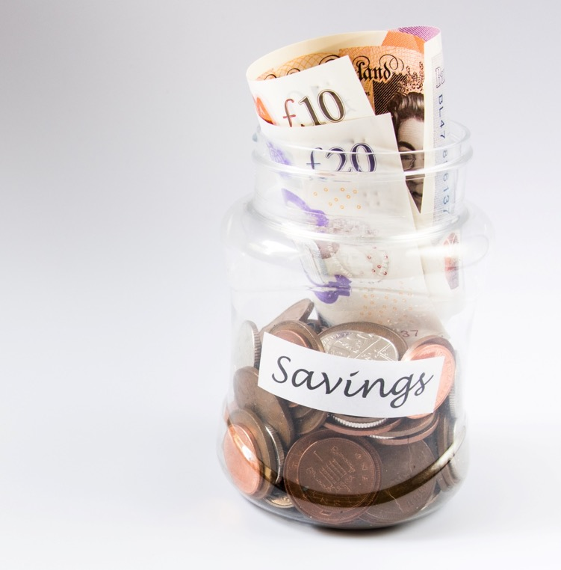
Jam Jar accounts
Key features:
Lets you split money from the same account into different 'pots' or 'jars'
This helps to keep money for bills aside
The money can be set aside for things other than bills
Notes:
Explain:
Marius likes to keep his money in separate 'pots'. One for bills, one for shopping and one to save money towards a car.
A Jam Jar type of account would work well for him.
Ask:
Has anyone heard of Jam Jar accounts? What do they offer?
Explain and discuss:
Jam Jar accounts (which are also known as saving pots) are a type of bank account that lets you split the money from the same account into different 'pots' or 'jars'.
This helps to keep the money for bills aside so you can budget the rest of your money without worrying.
The money can be set aside for things other than bills – a holiday or a house deposit, for example.

Slide 16

Cash ISA
Key features:
The term ISA stands for 'individual saving account'.
Cash ISAs are just savings accounts you don’t pay tax on.
Everyone in the UK aged 16 or over gets an ISA allowance at the start of each tax year.
Notes:
Explain:
Martina wants to save up a deposit so she can move out of her parents' house. A friend suggests she sets up an ISA account and pays her saving there.
Ask:
Has anyone heard of Cash ISA accounts? What do they offer?
Does anyone know what ISA stands for?
Explain and discuss:
The term ISA stands for 'individual savings account'.
Cash ISAs are just savings accounts you don’t pay tax on.
Everyone in the UK aged 16 or over gets an ISA allowance at the start of each tax year – for 2022/23, which ends on 5 April 2023, it's £20,000.
ISA accounts are offered by banks, building societies, insurers, asset managers and a company called National Savings and Investments (NS&I).

Slide 17

Easy access
Key features:
Easy-access saving accounts allow you to take money out of your account quickly and easily.
Easy-access accounts may limit the number of withdrawals you can make each year without losing interest, so remember to check.
Notes:
Explain:
Bob wants to set up a savings account where he can save emergency money. Because it's money for an emergency, he needs to know that he can access that money at any time should something happen.
Ask:
Has anyone heard of Easy Access savings accounts?
Explain and discuss:
Easy-access savings accounts allow you to take money out of your account quickly and easily.
Easy-access accounts may limit the number of withdrawals you can make each year without losing interest, so remember to check.
Remember: interest is the money you earn from the savings you have in your account.

Slide 18

Notice accounts
Key features:
These earn more interest than an easy-access accounts.
You’ll have to tell your provider in advance that you want to make a withdrawal.
These accounts are unlikely to suit you if you may need to access your savings unexpectedly.
If you do make an emergency withdrawal, you're likely to lose some interest.
Notes:
Explain:
Rachel inherited a pot of money after her aunt passed away. She wants to save the money in an account where she can earn higher interest and won't be tempted to spend it. She'll want to still be able to take money out if needed, but is willing to give the bank notice in advance; this will stop her impulsively spending the money.
Ask:
Has anyone heard of Notice savings accounts?
Explain and discuss:
These earn more interest than an easy-access account.
Instead of having quick access to your money, saving it in a notice account means you’ll have to tell your provider in advance that you want to make a withdrawal. And in return, you’ll usually get more interest than you would when saving in an easy-access savings account.
Some notice accounts demand that you let them know you intend to withdraw money 30, 60 or 90 days ahead – so these accounts are unlikely to suit you if you may need to access your savings unexpectedly.
If you do make an emergency withdrawal from a notice savings account, you're likely to lose some interest.

Slide 19

Regular savers accounts
Key features:
If you'd like to save little and often, regular saving accounts can offer top rates for feeding them every month.
Regular saving accounts or 'regular savers’ usually require you to deposit money each month – so they are ideal for savers who are just starting out, or who wish to slowly add cash into their account regularly.
Notes:
Explain:
Will wants a savings account where he can pay in £30 each month to build up his savings.
Ask:
Has anyone heard of Regular Saving accounts?
Explain and discuss:
If you'd like to save little and often, Regular Savings accounts can offer top rates of up to 7% for paying into them every month
Regular Savings accounts or 'regular savers' require you to deposit money each month, without fail – so they are ideal for savers who are just starting out, or who wish to slowly add cash into their account regularly.

Slide 20

Fixed rate bonds
Key features:
These are savings accounts that offer a fixed interest rate on your cash for a set period of time.
They usually offer higher interest rates than easy-access accounts.
Fixed-rate bonds can extend over one year, two years or even longer.
If you need to get your money out, it's likely you'll pay a penalty for doing so.
Notes:
Explain:
Sara has received an insurance payout. She wants to put some in a regular savings account for emergencies, but the rest she wants to put away where it will earn some interest.
The best interest she can earn on her money is by paying it into a Fixed Rate Bond.
Ask:
Has anyone heard of Fixed Rate Bonds?
Explain and discuss:
These are savings accounts that offer a fixed interest rate on your cash for a set period of time.
They usually offer higher interest rates than easy-access accounts, but your money will be tied up for a set length of time, known as the "term".
Fixed-rate bonds can extend over one year, two years – even three, four or five years.
Generally, the longer you're prepared to lock your cash away for, the more interest you will receive.
While it may be possible to get your money out of a fixed-rate bond in an emergency, you'll likely pay a penalty for doing so.
So tying up your cash in a fixed-rate bond is only a good idea if you're confident you won't need that money for a few years.
Ask & discuss:
Would this type of account benefit you?
Explain:
Generally, this type of account is best if you already have a lump sum of money to put in at the start – for example, you may have received an inheritance.

Slide 21

Help to save
Key features:
Designed to help you save if you are on a low income or receive benefits
Allows you to save between £1 & £50 each month
You could receive a bonus payment from the government of up to 50% on savings paid into the account after two years and four years
You also need to be living in the UK
Notes:
Explain:
Jane wants to start saving but is struggling as she is on a low income and relies on Working Tax Credits; she doesn't have a lot of spare money. Her friend tells her about a savings account called Help to Save which is specifically for people in her situation.
Ask:
Has anyone heard of Help to Save?
Explain and discuss:
These are designed to help you save if you are on a low income or receive benefits.
Help to Save accounts offer a bonus payment from the government of up to 50% on savings paid into the account.
You can open this account if any of these apply:
Either: You receive Working Tax Credit
Or you are entitled to Working Tax Credit and receive Child Tax Credit
Or you are claiming Universal Credit and you earned £617.73 or more from paid work in your last monthly assessment period
You also need to be living in the UK.
You can save into the account for four years and you will get a bonus payment of up to 50% on your savings after two and four years. If you close your account, you won’t be able to reopen it or open a new one. (This information was correct in 2023).
Get help with savings if you’re on a low income (Help to Save): Eligibility - GOV.UK (www.gov.uk)

Slide 22

Exercise
Match each scenario card with the best saving account for the situation.
Notes:
Pause the slides at this point, for the exercise
Split the class into groups of around four people and hand out the match cards (from the back of Facilitator Guide for you to print and cut out).
Each group will be given two sets of cards – one set will have the names of the different account types on and the other will have scenarios on.
The group will need to work out which type of account is most suited to which scenario.
Discuss the correct answers with the whole class.

Slide 23

Saving Essentials recap
You should now be able to:
list the benefits of saving
make informed decisions around interest rates
choose a type of saving account that best suits you.
Any questions?
Notes:
Review the workshop with the delegates by running back through the objectives and reminding the learners what they want they said they wanted to save up for at the beginning of the workshop.
You should now be able to:
list the benefits of saving
choose a type of saving account that best suits you
make informed decisions around interest rates.
Ask the learners if they have any questions about what's been covered. Encourage learners to help and support each other.

Slide 24
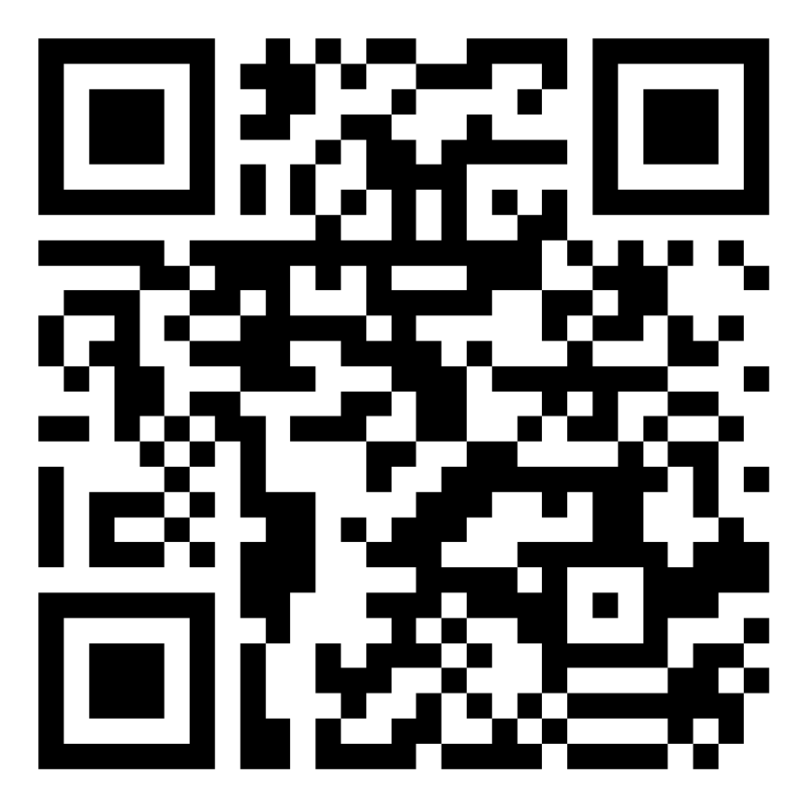
Post session survey
Notes:
Encourage learners to scan the QR code here and complete our short post-session survey around levels of confidence now they have completed the training, plus any other comments or feedback about the session

Slide 25
Notes:
Explain:
This is the end of this workshop. Thank you for attending – we hope it's been useful.
Please keep your workbooks so that you can refer back to your notes.
The workbook also contains helpful links to information on the internet, as well as an explanation of financial terms to help you understand the terminology of budgeting.

