Slide 1

Getting started on your device
Notes:
Trainer notes
Welcome people into the room
Introduce yourself
Make sure everyone is comfortable
Go to the next slide when you’re ready to start the lesson
For Chromebook-specific sessions, here are some useful webpages for you and your learners:
https://www.laptopmag.com/articles/chrome-os-chromebook-touchpad-gestures
https://www.google.com/chromebook/howto/
https://support.google.com/chromebook/answer/3438631?hl=en&ref_topic=3403353&sjid=660175068350711320-EU

Slide 2
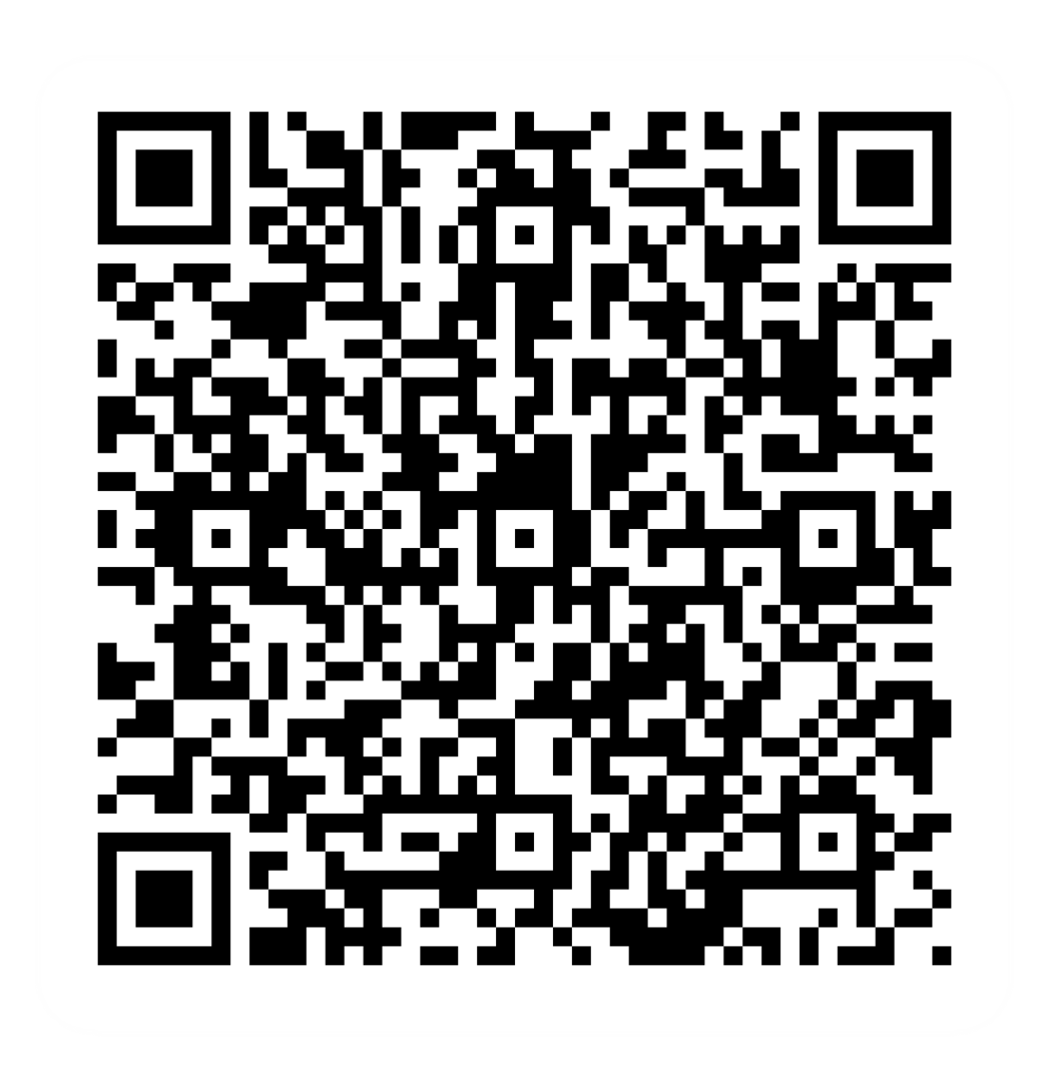
Pre-session survey
Notes:
Encourage learners to scan the QR code here and complete our short pre-session survey around levels of confidence in the session’s topics today, plus what they would like to get out of the session

Slide 3

Welcome
Notes:
Trainer notes
If this lesson marks the start of a programme, welcome people to the programme
If it is not, then welcome people to the lesson or programme
Introduce yourself and anyone else in the room who is there to support
If there’s only a few people in the room, it may be a good idea to get the learners to introduce themselves to each other
Suggested script
Welcome to today’s lesson, my name is _ and I’m here to help you today. In the room we also have _
Today, we want to help you get started with your device. It’s okay if you don’t have yours with you today, you can still learn what you can do when you next use one.
If you do have your device, we will help you through the steps as you go.
As we go through today’s lesson, please do ask questions and let us know if you need anything. If we can’t help today we’ll make sure you get the help you need after the session.
Let us know if we’re going too fast or too slow, or if you need a break. We want you to get the most out of today, so I’ll be guided by you.

Slide 4
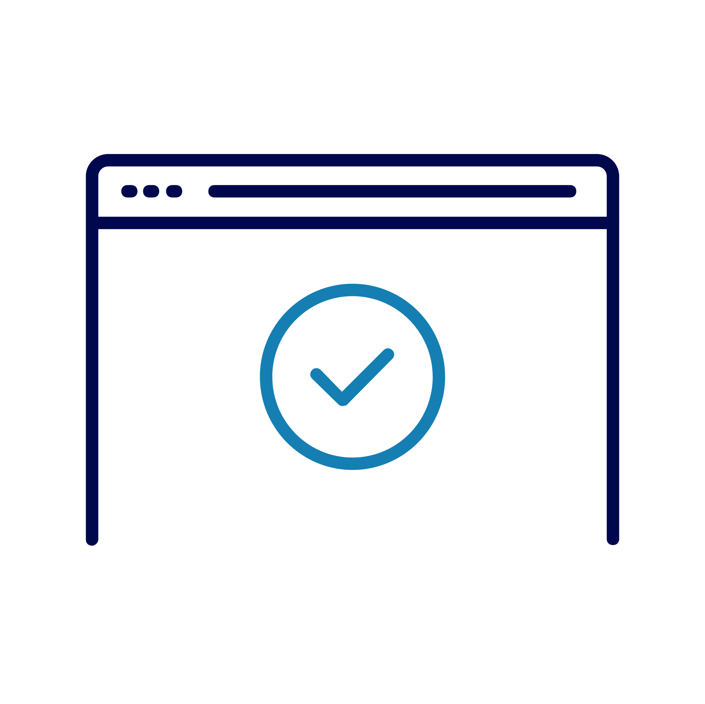
Today we want to help you:
Turn on a device
Use the controls
Make it easier to use
Use the home screen
Keep it safe!
Notes:
Trainer notes
Remember to make clear that all devices are different. Explain that we’ll be covering the general steps to help them today, but if they need further help, we will share resources at the end.
Suggested script
So, what will you get out of today? By the time we finish, you should feel able to turn on your device and you’ll be able to start using it.
We’ll help you set it up so it suits your needs, and we’ll make sure you can change your settings in future if your needs change.
There are lots of different devices out there. So, today we’ll cover off the general steps and information you need to get started.
If you need further help with your type of device, we have other help and resources we can share with you at the end of the session.
If you want more help doing any of the steps on your device as we go through. Please just let us know and we’ll try to help.

Slide 5

Power up!
Find the power button
What you see next
Notes:
Suggested script and Trainer notes
Let’s start by looking at your device and finding the power button. The symbol on this slide shows what it will usually look like on your device.
If you’re using a phone or a tablet, it will usually be a button on the top or right edge of the device. If you’re not, then take a look at your keyboard or the side of your device and see if you can find the button.
If you’re on a phone or tablet, you might need to press and hold the button for it to work.
If you already have your device set up, you can help others to do the same.
Trainer NOTE - Give learners time to find this on their device and press it. Help anyone who can’t find it.
What can you see on your screen now?
Remember, every device is different, so there’s no wrong answer. We’ll work through the next step together.
Trainer NOTE - What they see at this point will depend on the device. If it’s their first time using the device, it may work through a number of initial setup screens, including: language selection, connect to a Wi-Fi network. Spend the rest of this slide explaining and supporting the learner to get to the ‘sign in’ screen. Below are some questions and notes you can work through in this process.
If this is a new device, it may ask you what language you want to use. Trainer NOTE - Check if this is the case, and support learners to set their preferred language.
It might also ask you other questions – like what Wi-Fi you want to connect to. We’ll skip these for now, and come back to them once we’ve signed in.
Is there anything else it’s asking for? Trainer NOTE – It may include Terms and Conditions confirmation, explain that this is useful info; allow them time to read and check the box to continue
Trainer NOTE – You can move onto the next slide once everyone who has a device has made it to their sign in screen.

Slide 6

Sign in
Make your device safe
Notes:
Suggested script:
To keep your device safe, we need to ‘sign in’. By doing this, you make sure that you, and only you can access your account on the device. Some devices can be used by more than one person. For example, at home, you might share your computer with family. Having an account for each person to sign into tells the laptop it’s you. So, when it starts up and you log in, it will show only your space and items. This means you can easily return to what you were doing and find all your stuff in one place.
Some devices – like those in a library or an internet café – have lots of people using them, so this also is a way to keep your account safe.
The way you sign in might change between devices. If you have a phone, it might be a security code or number – a PIN. Or it might be a fingerprint. Laptops are more likely to ask for a username and a password
It’s important to keep your sign in details safe and remember them. Don’t share your details with anyone. This way, you’re helping to keep your device – and what you do on it – private.
We’re going to sign in now, using our own details
Trainer NOTE – Support learners to sign in and/or set up an account. If they haven’t set up an email account or are unable to set up details to help them log-in, then you may want to use your own device or a device to help them set this up, otherwise advise them to use someone else’s to do this when they get home or a public device, like one in a library.
CHROMEBOOK NOTE: If learners are unable to set up an account (e.g. if they don’t have a mobile phone with them for the verification step), show the ‘browse as guest’ option and explain that this doesn’t require an account to be set up, and they can still search and use the device today.

Slide 7

Take control
Finding your way around
Notes:
Suggested script and Trainer notes:
You’ve used some controls already – like the power button to switch your device on, and your keyboard to sign in.
Let’s see what else you can do to use your device.
Trainer NOTE: If you have learners with touchscreen devices:
If you have a touchscreen, you’ll be using this a lot. You can tap on it to use and move around your device. So, for example, you can use it to get into different apps. Then to get back to the main screen, you can use your Home button – that’s the big button at the bottom of your phone or tablet screen. You may have used this button to power up your device. We often use it to wake our devices up if we haven’t used them for a while.
You can also use movements called gestures on your touchscreen. This is when you move your finger up, down or across the screen. Each of these do different things. The best way to find out is by trying, if you have a touchscreen. Let’s try these now
Trainer NOTE – Give time and support for learners to explore touchscreen options. Show how to use the touchscreen to find and access apps, and use the Home button to return to the Home screen. Learners can use this time to practise touching / tapping and swiping gestures. Use the words ‘tap’ and ‘swipe’ and help your learners use these and understand their meanings for these devices
Trainer NOTE: If you have learners with other devices:
If you have a mouse or a touchpad, you can use this to find your way around the screen and go into different apps too. (‘Applications’ or ‘apps’ for short)– let you do things like check the weather, watch videos, call your friends and lots more.
These apps usually look like small symbols on your screen that give you an idea of what the app does. Like a speech bubble representing where you send and receive messages.
To find your way around, just move your mouse – you’ll see an arrow shape on your screen. This is called the cursor. It moves around as you move the mouse. If you’ve got a touchpad, use your finger and slide it over the touchpad to move this around.
When you find an app, you want to go into, move the cursor over it. quickly. On a mouse, you’ll need to use the left button and click it twice, quickly. This is called a double click. On a touchpad, do the same, but double tap. On a phone or a tablet, you usually just have to touch once with your finger on the app. Try this out now.
Trainer NOTE – Give time and support for learners to explore their mouse/touchpad. Show them how to use these to navigate around the screen and access applications. Learners should practise moving, clicking/pressing. Use the words ‘mouse’, ‘cursor’, ‘click’, ‘double-click’ and ‘scroll’ (as applicable); help your learners use these and understand their meanings for these devices
CHROMEBOOK NOTE: Talk about moving the mouse pointer by single-finder movements, ‘clicking’ using the lower half of the touchpad and scrolling using two fingers ‘top to bottom’ plus ‘side to side’ for horizontal scrolling.

Slide 8

Take control
Typing words and taking photos
Notes:
Suggested script and Trainer notes:
You’ve used the keyboard already, to sign in.
This is there when you need to type something in – for instance, if you want to find something on the web, or write an email. If your device only has a touchscreen, the keyboard will appear on the screen when you go into an app that you need to type in.
Has your device got a camera? You can find out by looking for a little camera symbol on your home screen or in your apps. Try and find this now and go into it. If you can’t find this, feel free to ask and we can show you how to search on your device for an app.
Trainer NOTE – give time and support for learners to find and explore the camera function – encourage them to take a photo
CHROMEBOOK NOTE: Show learners where the actual camera is, and how to use the app to take photos (Launcher/Search key → Camera app)

Slide 9

Take control
Turn up the volume!
Notes:
Suggested script and Trainer notes:
There are many ways you can use your device that require sound. If you’re calling someone or watching a video, you may want to turn the volume up or down. On a phone or tablet, you can find the volume control buttons on the side edge (or the top, for tablets). On other devices, look for the sound icon – it’s usually a speaker with soundwaves coming out of it. There’s usually one with less sound waves, one with more sound waves and one with a cross next to it. The one with less lowers the volume, the one with more, raises it and the one with a cross can be used to make sure not noise comes from your device. This is often known as ‘mute’
Trainer NOTE – Give time and support for learners to explore the volume controls
Trainer NOTE – Take time to look at the learner’s device – ask them if there are there any other buttons or symbols, they’d like to ask about on the device e.g. the back button or right clicking. State that some of these will be covered later, otherwise take time to support and explain
CHROMEBOOK NOTES: point out the volume control keys on the top row of their keyboard

Slide 10

The home screen
Notes:
Suggested script:
The Home screen is what you see when you’ve signed into your device – it’s your starting point.
Any apps you have on your device will be shown here.
If you get more apps than will fit on a single screen, it just adds another screen, so you can scroll or swipe to move through the screens and find the app you’re looking for.
You can put your favourite apps in a ‘quick access’ area – this is often at the bottom of the screen.
For laptops and PCs, the home screen is sometimes called the ‘desktop’. The area at the bottom of the screen is called a ‘taskbar’ or ‘tray’. This is where we found the settings. You can also see useful information like battery status, network / Wi-Fi settings and the date and time here.
On phones and tablets, the battery and Wi-Fi status is usually at the top of the screen.
Try it out now – go into your Home screen and see what you can find there
Trainer NOTE - Give time and support for learners to explore the home screen. (e.g. hopping in and out of apps, swiping to see more) and find key info (e.g. battery status, the apps that are pinned to their quick access bar, etc)

Slide 11

Make it work for you
Find the settings
How they can help
Notes:
Suggested script with Trainer notes:
Now we’ve seen the controls and what they do, it’s time to use them to make your device work for you.
First, have a look at your screen. Can you see this symbol (or something like it) anywhere? If you have a touchscreen device, it’s likely to be on your Home screen.
If it isn’t then from your home screen, you can go to your menu, either by clicking on a menu button or by using your finger to swipe on your screen. On most mobiles you will need to swipe up. Once you are in this menu, you can usually either scroll the apps by swiping up or you can use the search bar to look for 'Settings’.
One other common way is swiping down at the very top of the screen. This will bring up a small window where the gear icon will be one of the options.
For Chromebooks, click the bottom right corner of the screen (where the time is) to see it. To find it on other devices, click the icon on the bottom left corner of the screen (this is also known as the start button). Try it out now
Trainer NOTE - Give time for learners to find and access their settings
There are lots of things you can change in settings – we’re going to look at just a few now, but feel free to explore others later.
You can change what you see – to make the screen brighter or darker, or change size of text and icons
You can change what you hear – so you can set different sounds for different alerts or actions, or set it so the device reads screen content aloud to you
You can change how you control your device – for instance, you can switch ‘voice control’ on, or adjust touch sensitivity if double-clicking is tricky or you find you’re pressing a button for longer than you need to
Try these settings out now
Trainer NOTE - Give time for learners to find and access their settings. The ones they use will depend on device type and their own needs / preferences. If they have no preference / need ideas or encouragement, suggest:
For mobile phones – explore display/brightness and sounds
For Chromebook – high contrast mode and text-to-speech
For laptops – display and audio settings
For all – There are switches and adaptive technology that can be used to help operate a device. If you have a learner who could benefit, you could cover what these are in more detail

Slide 12

Keep it safe
Locking your device
Keeping it up-to-date
Other ways to keep it safe
Notes:
Suggested script and Trainer notes:
As with all your belongings, you’ll need to keep your device safe. There are plenty of ways to do this, beyond just keeping it with you or locked away when you’re not using it.
You can lock the device, so that if it gets lost or stolen, it’s harder for anyone to get into it. Most devices can be set to auto-lock after a certain amount of time – you can change that amount of time by going into the settings.
Chromebooks have a lock option that you can access by clicking the time at the bottom right-hand corner of the screen – look for the padlock icon.
You can lock laptops and PCs by pressing two keys at the same time – the ‘Windows’ key (it looks like the Windows logo which looks just like a window– a square made up of four little squares) and the second key you will need is the letter L.
For Chromebooks, use the search key with the letter L
Try it out now
Trainer NOTE - Give time and support for learners to lock their device and sign back in.
Another way to keep it safe is to make sure the software that keeps it running is all up-to-date. Most devices will let you know when it’s time to update this software – called the Operating System. You do this to keep the device running smoothly. These updates include making sure you’ve got all the latest security fixes, so it’s important to apply them as soon as possible.
There are other ways to keep it safe. You might want to get anti-virus software to protect it. It’s good to think about what you’re after and how much you’re prepared to pay when you’re deciding which software to get. Friends or family might have recommendations. When you start to look around, check the reviews to see what others think, too.
Trainer NOTE – If appropriate and you have time, how learners how to search for software in the device’s app store and run through some of the things to consider like reviews, cost and features.
If you want to know more, we run a staying safe online lesson which talks you through online safety and has plenty of hints and tips.

Slide 13
Power down
When to power down
How to power down
Notes:
Suggested script and Trainer notes:
Some devices don’t need to be powered down every time you stop using them for the day. Devices like phones and tablets will go into a ‘sleep’ mode which means the screen goes dark and they’re not using much power, but when you pick them up and unlock them, they’re ready to use.
There may be times when you want (or need) to power these devices off, though. Sometimes, phone problems can be fixed by ‘switching it off then switching it on again’.
To power down a touchscreen device, you will usually need to press and hold the power button. You may be asked to swipe or press to confirm that you want to switch the device off. There are some devices that differ, so do check your instructions.
For non-touchscreen devices, people usually sign out and power down when they’re done using it – though they too have a ‘sleep’ mode. In general, if you don’t use your device for a little while, it goes to sleep, then wakes up when you press any of the keys on the keyboard.
To power these kind of devices down, find the power icon on the screen. It’s often at the bottom of the screen, near the left or right corner. You can shut down or restart (which shuts the device down then starts it up again) or you can choose to ‘sleep’ which uses low power and means you can restart to what you had open much easier.
CHROMEBOOK NOTE: Explain ‘sleep mode’ is when you don’t interact with the device for a while (6-8 mins) – just press any key on the keyboard to ‘wake it up’. Sleep mode is also what it goes into when you just close the lid (Trainer note: get them to explore by shutting the lid, re-opening, then powering down by pressing and holding the power key OR by using the mousepad to access the power option from the home screen)
Trainer NOTE - Give time and support for learners to power down their device or try one of the options.

Slide 14
Today you've seen how to:
Turn on a device
Use the controls
Make it easier to use
Use the home screen
Keep it safe!
Notes:
Suggested script and Trainer notes:
So let’s just take a look at what you’ve done with your device:
You’ve turned it on – and off
You’ve used the controls to sign in, find your way around and explore
You’ve explored some of the settings that will help make it easier for you
You’ve seen what’s on the home screen and how to get there
You’ve locked your device and heard about other ways to keep it safe

Slide 15

Any questions?
Notes:
Trainer NOTE – Ask if they have any questions, comments or feedback that you can help with. You could consider this as an opportunity to check level of confidence in doing these in future, ask what they found most useful, anything they’d like to know more about (or to go through again before the lesson ends) and where they think they’ll need more practice.

Slide 16
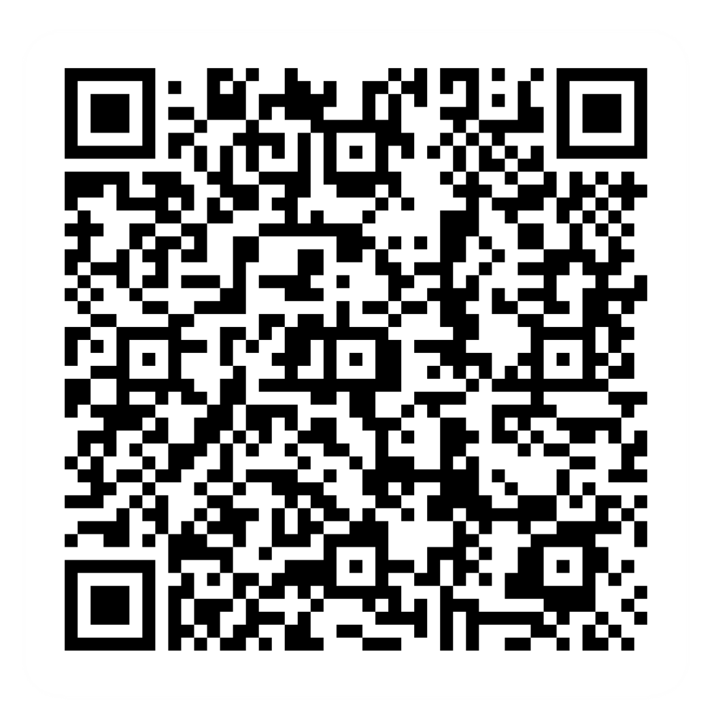
Post-session survey
Notes:
Encourage learners to scan the QR code here and complete our short post-session survey around levels of confidence now they have completed the training, plus any other comments or feedback about the session

Slide 17
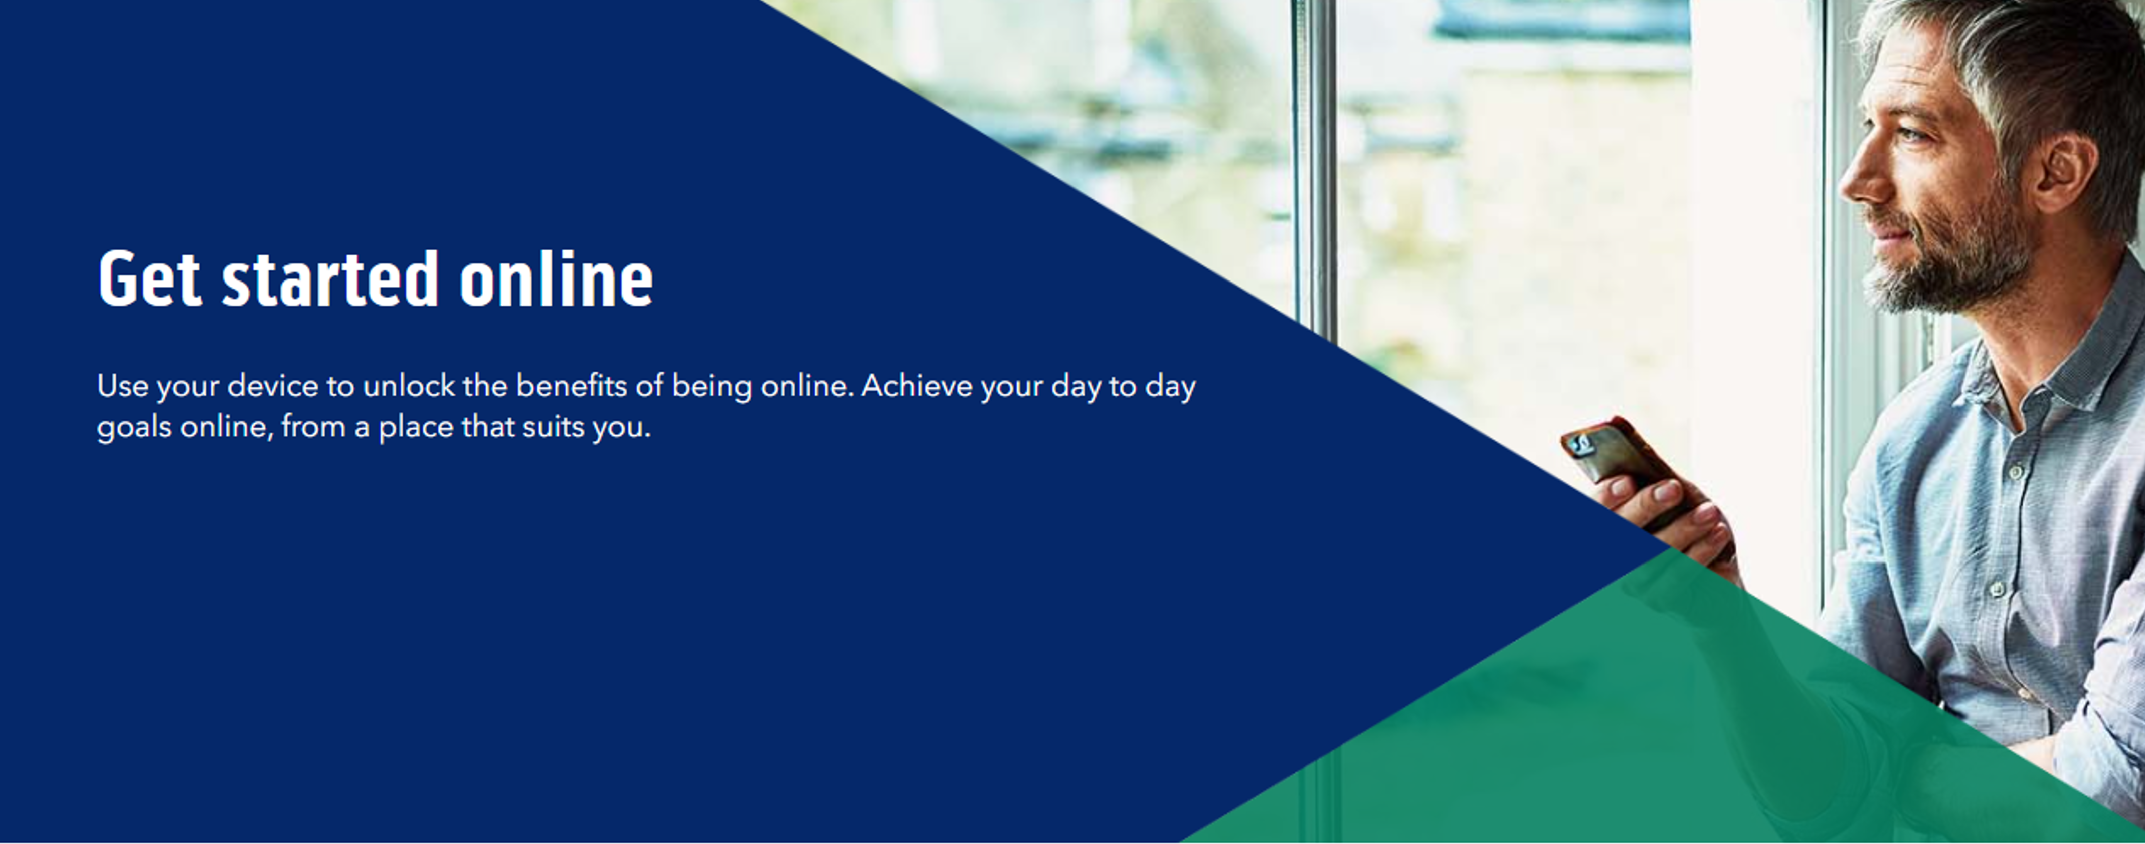
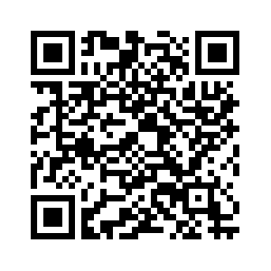
Notes:
Trainer notes
Signpost related content on the Academy website https://www.bankofscotlandacademy.co.uk/learn-for-life/get-started-online/
Alternatively, they could use their phone cameras to scan the QR code here.
If they don’t feel comfortable using this yet, then suggest they take our other lessons: “Connecting to the internet” and “ Stay safe online”, if you don’t know the next dates for these or how to help them sign up then speak to the Academy team before your session.
If part of a programme, share the date and topic of the next session

