Slide 1
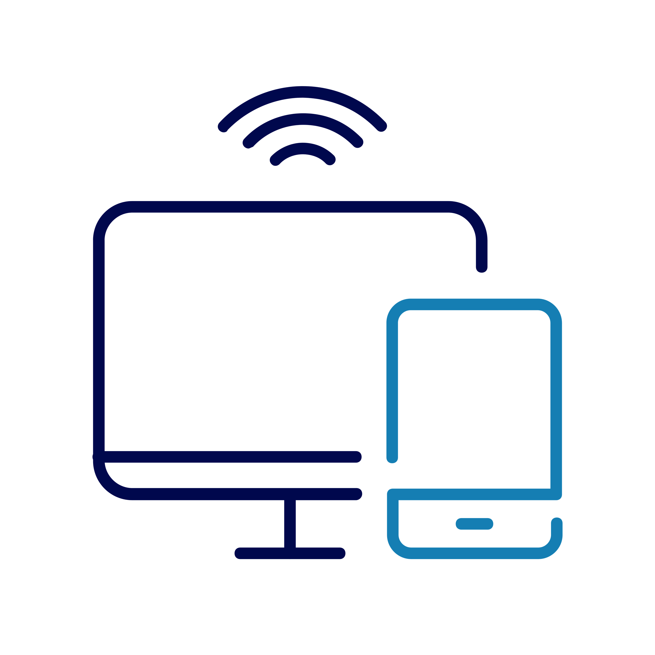
Connecting to the internet
Notes:
TRAINER NOTES -
Check what Wi-Fi network is available, its name and any password required; write up / make available to the learners
Welcome people into the room
Introduce yourself
Make sure everyone is comfortable
Go to the next slide when you’re ready to start the lesson
USEFUL SITES / LINKS TO HAVE UP FOR THIS SESSION:
https://www.signalchecker.co.uk/
https://stopthinkfraud.campaign.gov.uk/how-to-spot-fraud/how-to-spot-a-fake-website/

Slide 2
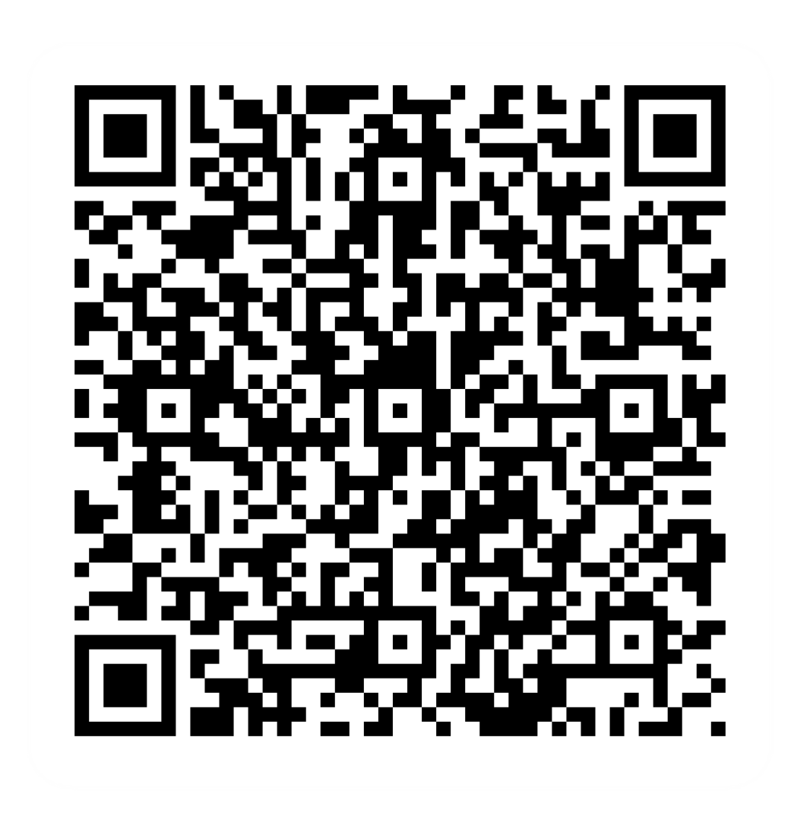
Pre-session survey
Notes:
Encourage learners to scan the QR code here and complete our short pre-session survey around levels of confidence in the session’s topics today, plus what they would like to get out of the session

Slide 3

Welcome
Notes:
TRAINER NOTES –
If this lesson marks the start of a programme, welcome people to the programme
If it is not, then welcome people to the lesson
Welcome to today’s lesson on understanding the internet.
My name is _ and I’m here to help you today.
We're excited to be here with you as you start to explore the Internet
We want to make this learning experience practical, relatable, and, most importantly, helpful to you.
In the room (or virtually) we also have [Any Co-Presenter's Name] who is here to help you during this session.
TRAINER NOTE – for small groups / virtual sessions, learners could introduce themselves at this point
So in today’s session, we'll explore what the Internet is and how you can connect to it securely.
You’ll be learning how to find your way around the online world.
If you have your device with you, we’ll help you through the steps as you go.
If you don’t have a device with you today, you can still learn what you can do when you use it next.
As we go through today’s lesson, please do ask questions and let us know if you need anything. If we can’t help today, we’ll make sure you get the help you need after the session.
Let us know if we’re going too quickly, too slowly, or if you need a break. We want you to get the most out of today, so I’ll be guided by you.

Slide 4
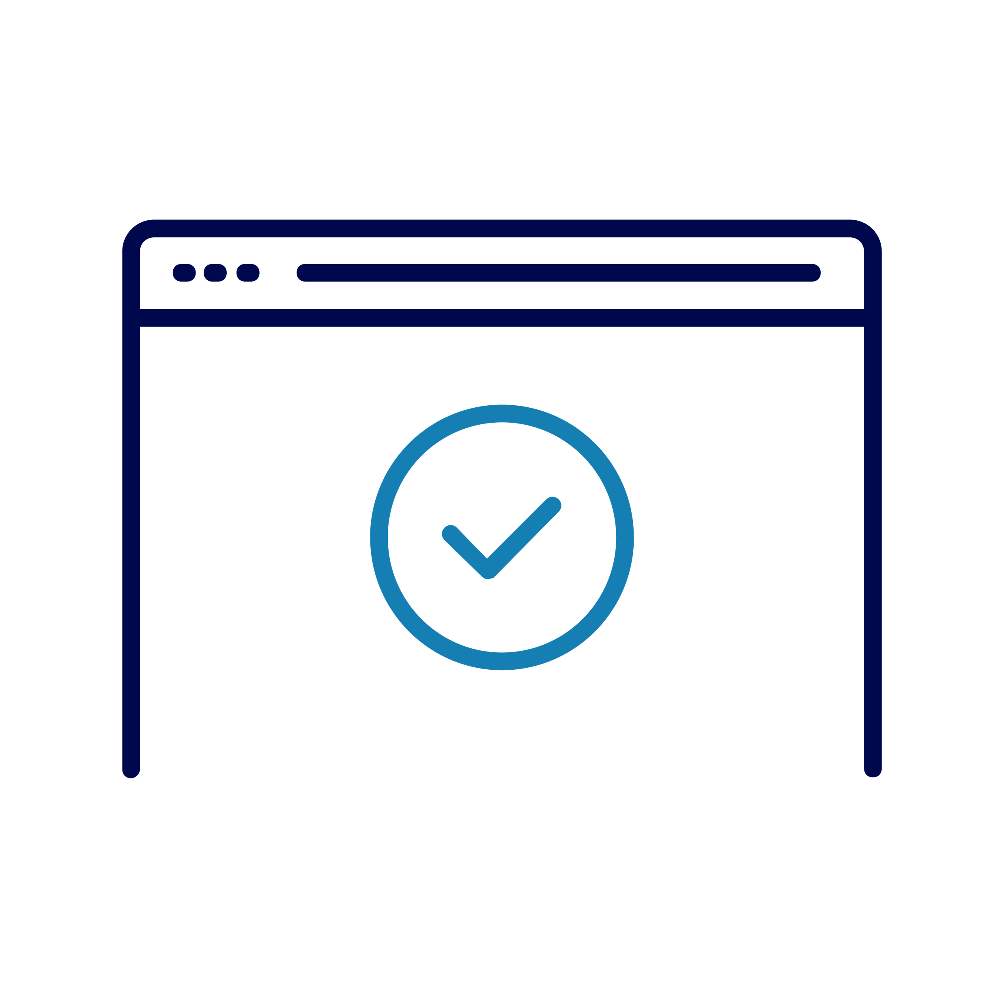
Today we want to help you:
Explain what we mean by 'the internet’
Connect to the web
Open and use a browser
Search for information
Keep safe when you're browsing and searching
Notes:
So, here’s what we’d like you to get out of today. We want to help you:
Explain what we mean by 'the internet,’
Connect to the web through Wi-Fi or mobile data
Open and use a web browser,
Search for information online – we’ll give you hints and tips on how to do this
Keep safe when you're browsing and searching.
Now, every device is slightly different, so today we’ll share general steps, tips and what to look for
If you want more help doing any of the steps on your device as we go through, just let us know and we’ll give you a hand
And if you need more help with your type of device, we’ll share some useful resources at the end of the session

Slide 5

What’s the Web?
Internet / ‘The Web’
Broadband
Wi-Fi
Mobile data
Browser
Search engine
'Smart’ technology
Notes:
Let’s start by introducing some key terms that are important to understanding the internet and the web.
TRAINER NOTES –
For each item, ask: “does anyone know what we mean by …?”
Expand on people’s answers to ensure everyone understands each term
The internet is also known as ‘the web’. It helps people to connect with each other all over the world. It’s also a huge source of information. And it can help you with everything from shopping online to finding a job or video calling with friends and family.
Broadband – This is how most homes and businesses connect to the web. Broadband providers like BT, Sky and Virgin Media have networks of wires and cables that connect to our homes and offices
Wi-Fi – This is how our phones, tablets and laptops can all connect to the internet without physical cables.
Mobile data – This is another way we can connect to the internet wirelessly – phone providers like O2, Three and Vodaphone have towers all across the country to provide this wireless option
Web browser – This is what you use to see and use websites.
Search engine – These let you find information on the web quickly, just by typing in a few words or a question
‘smart’ technology – This includes smart meters for our gas and electricity, smart speakers like Hey Google and Alexa, heating systems like Hive and Nest, Ring doorbells … all of these are connected to the web, to make them faster and easier to use
TRAINER NOTE – Check understanding before moving to next slide

Slide 6



Broadband and Wi-Fi
Notes:
TRAINER NOTE: TOPIC INTRO SLIDE
Now we’ll look at how broadband, and Wi-Fi work together to connect us to the internet
We’ll start by looking at broadband, and how this feeds into our homes to give us internet access. Then we’ll cover how Wi-Fi works in our homes to give wireless connection for our phones, our laptops and all our smart devices

Slide 7
Broadband basics
What is broadband?
Choosing a provider
Notes:
So, what is broadband? – Basically, broadband is our way to connect to the web, fast.
It can be wireless, but most often it comes into our homes through wires or cables.
When you sign up to broadband, you get a box called a hub or a router. This lets you connect to the web
There are different types of broadband - you may hear of terms like fibre, cable and DSL. These are just the types of connection used – wire, cable or phone lines. Some of these types are faster or more reliable than others, but they’re not all available everywhere. So if you’re thinking of getting broadband, it’s a good idea to check what you have in your area.
Choosing the right broadband provider is important, so it’s important to take your time.
If you contact a provider directly, you might not get the best deal. So it’s good to shop around. Ask friends or family what they use - or check out comparison sites.
These sites show you all the different providers with key information about them, all on the same page. So you can see how they compare. For instance, one might be a lot cheaper but not as fast or reliable as another one. Having all the info in one place can help you decide what’s most important for you

Slide 8
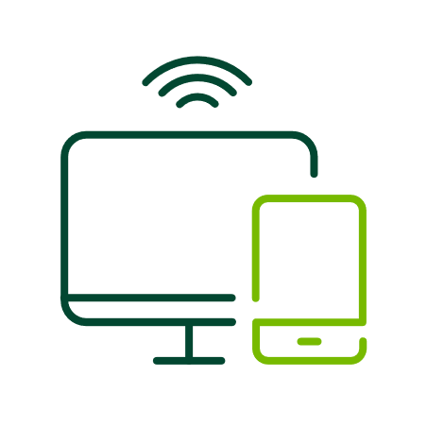
Get started with Wi-Fi
What is Wi-Fi?
Setting up your router
Notes:
What is Wi-Fi? We know now that Broadband brings internet into your home and attaches to your router. Wi-Fi is a way to connect your devices to this. Most devices and routers will now let you connect wirelessly. But you may need to first connect using something called a network cable between your router and your device.
Setting up your router
Once you’ve picked your broadband provider and they’ve sent you a router, you’ll need to set it up. Some providers do this for you. Others send you the router with instructions. This might depend on whether your place already had any internet connection before.
Once the router’s set up, you can turn it on and begin you connection.
Before you use it to connect your devices, make sure you change your Wi-Fi name and password. The router will come with a standard name and password to start with. This is usually either on the router itself, or on the box it comes in. The name is what you’ll look for when you’re connecting your device. The password helps to keep it safe. So it’s a good idea to change the name and password to something that’s hard for anyone else to guess. Try and avoid names like ‘Flat number 14’s network’. And make your password long and strong. Try thinking of 3 or 4 random words, all joined together with some letters swapped for numbers

Slide 9

Activity: connect to Wi-Fi
Go to your device's settings
Select Wi-Fi.
Choose a Wi-Fi network
Type the password
Start browsing
Notes:
TRAINER notes:
Share the Wi-Fi information with the learners (if not already done so)
Encourage the learners to follow along:
So we’re going to connect to the Wi-Fi here, just to give you a feel for how to do this.
TRAINER NOTE: IF THEY’VE ALREADY DONE LESSON 1 OR HAVE EQUIVALENT KNOWLEDGE, YOU CAN FIRST ASK: WHO REMEMBERS WHERE THE SETTINGS ARE?
First, go to your device's settings and select Wi-Fi.
What networks can you see? When you’re using your home network, you’d look for the name you changed when you set up the router.
Choose the Wi-Fi network you want to connect to.
It will ask for a password – again, for your home network, this is when you put that long and strong password in. When you connect to your home network, you don’t usually have to do this every time – it will remember the network name and password and automatically connect in future. And it will do this for most other networks you connect to for that device – so you just need to give the password the first time you connect.
Now you’re connected! You can check by looking for that Wi-Fi symbol on your device screen

Slide 10

Staying safe on Wi-Fi
Make your home Wi-Fi safe
What is ‘public Wi-Fi’?
Keep your data safe
Notes:
So, let’s talk about how to stay safe with Wi-Fi
First, you need to keep your home Wi-Fi safe. The best way to do this is what we’ve suggested today – when you get your router, be sure to change the name and password for your home network. That will help stop anyone else using it
Now let’s talk about public Wi-Fi. This is any Wi-Fi connection provided by other people or businesses. For instance, your local coffee shop might have free Wi-Fi for their customers. Or your local trains might offer you a Wi-Fi service. When you see the Wi-Fi symbol out and about, it usually means public Wi-Fi is available here.
This might seem a great idea – and it can be really useful. You do need to be careful though. Public Wi-Fi networks, like those in cafes or airports, are handy, but they can also be a lot less safe than your home network.
Sometimes when you connect to these networks, they ask for some personal details – name, address, email and so on. Make sure you’re comfortable with whoever is asking for this information, before you start typing it in
The most secure Wi-Fi networks always ask for a password, so be very wary about connecting to one that doesn’t
It’s always good to check the name of the Wi-Fi network with someone who works in the café or wherever you want to connect. Just to be sure you’re on the right one
Sometimes, you get fake Wi-Fi networks. These are set up pretending to be the airport Wi-Fi or your coffee shop. Once you connect to these, they may try and steal your details – especially if you’re using the Wi-Fi to shop or bank online. So it’s always best to do this kind of thing when you’re connected to your home network – or to use your mobile data if you’re out and about. We’ll talk about how to do this in a minute.
And when you are online in a public space, think about what people around you can see on your screen. It’s always good to be cautious.

Slide 11

Mobile data
Notes:
TRAINER NOTE: TOPIC INTRO SLIDE
So let’s take a look at mobile data now, which is just another way for you to connect to the web

Slide 12


What is mobile data?
An alternative to Wi-Fi
Mobile phone towers give coverage
Phone packages, SIM cards and data
Notes:
Does anyone know what we mean by ‘mobile data’?
So far, we’ve talked about how to get internet access by connecting to a Wi-Fi network – either through a router at home, or by picking a Wi-Fi network when we’re out and about
With mobile data, you don’t connect to a Wi-Fi network. Instead, your internet connection comes from the towers that the mobile phone companies have put up all across the country. So you’re not relying on having a Wi-Fi connection nearby. You can use it anywhere with mobile phone coverage
You pay the phone company for this. It’s often part of your mobile phone package. So, for example, you can buy a phone for an amount each month with free texts, free calls and a certain amount of data. Or you might have a 'SIM-only' arrangement, where you've already got a phone and the company provide a SIM card – the little card that slots into your phone so the phone company can identify that phone and use it to connect to the internet. For that option, it's the SIM card that has the data limit on it. Either way, it’s the ‘data’ part of the package or contract that gives you web access, so you can do things like search the internet, stream music and videos and use certain apps

Slide 13

What are the benefits?
Convenient
Accessible
Secure
Notes:
So, why would you want to use mobile data? Let's talk about the benefits:
Convenient: Because you can use your data pretty much anywhere, you can use it for things like checking bus or train times, working out the quickest way to get across town, catching up with emails or social media, or listening to a podcast while you’re out and about.
Accessible: You don’t need to be somewhere that has Wi-Fi to use your mobile data. So whether you’re on the beach, on the train or just walking down the High Street, you know you can use it
Secure: Even if you have access to public Wi-Fi, you might choose to use your mobile data instead. Especially if you need to go into your banking app, or you’re on a website that’s asking you to give personal details like your name and address. Mobile data is always safer than public Wi-Fi

Slide 14

Mobile data costs
Data plans
Usage
Roaming charges
Notes:
So now you can see where and how you might use your mobile data, let’s take a look at the costs involved. Here's what you need to know:
Data Plans: The mobile network providers usually offer what they call ‘data plans’. Each plan says how much data you get and how much this costs. Most mobile plans have data limits, and going over them can lead to extra charges. So when you’re deciding a plan, bear this in mind.
Data Usage: When you’re working out what plan you need, it’s good to be aware of how much data you’re likely to use each month. Streaming videos to watch online, downloading large files or constant online gaming can quickly use up your data allowance. If you go over your data limit you may get charged extra, so it’s really important to keep an eye on this. Some apps use data even when you're not actively using them. You can check your app settings to control this.
Roaming Charges: These are when you’re using your phone overseas. They do vary, depending on your phone provider and the country you’re visiting so it’s good to check what they are before you go. There are things you can do to cut these costs, like downloading maps, films and music before you go, and buying a local SIM once you’re over there. You can even turn off mobile roaming if you want to

Slide 15

Mobile data coverage
Availability can vary by area
Coverage maps and the Signalchecker site
Notes:
Mobile data availability can vary depending on your location.
It's a good idea to check for mobile data coverage in areas you visit often.
Most of the phone companies have coverage maps. There’s also a handy website called signalchecker which does this for all the UK networks.
TRAINER NOTE – if learners are interested in the signalchecker site, you can use this in the later ‘explore the web’ activity

Slide 16
Mobile data vs. Wi-Fi
Is there a Wi-Fi network available?
Speed and reliability
Cost
Security
Notes:
Now that we know what mobile data is, let's explore how it differs from Wi-Fi.
Mobile data uses networks of those towers we mentioned to connect to the internet. So if you’re out and about, or there’s no Wi-Fi network, it’s the one to use. If you have home Wi-Fi and the network goes down, mobile data will still let you get on the Web
Wi-Fi, on the other hand, connects to local wireless networks, like the one at home or in cafes. It can give you faster and more stable connections.
Data is usually more expensive than Wi-Fi, so people are often careful about using their data when they don't need to.
Remember, though, that mobile data can be more secure than public Wi-Fi – so it may depend on what you’re using the web for. You shouldn’t ever do online banking or use websites that ask for personal information when you’re using public Wi-Fi – always switch over to your data for this kind of thing
Your home network will give you the best of both worlds – the speed and reliability of Wi-Fi plus extra security compared to public networks. So this is the one to use when you’re at home.
TRAINER NOTE – Some learners may only have a phone with them as their device. If they have done the 'connect to Wi-Fi' activity, explain at this point how to disconnect from Wi-Fi - and that by doing this, they are using their mobile data. Then ask what they see top left of their mobile screen (e.g., 3/4/5G etc) - and that this is their clue that they're using mobile data rather than Wi-Fi. You can also show them how to turn off mobile data if they need to (e.g. when they’re near their limit)

Slide 17

Using the internet
Notes:
TRAINER NOTE: TOPIC INTRO SLIDE
So now we’re going to look at how we use the internet. We’ll talk about web browsers and search engines, and what these are. I’ll give you a few tips to help you stay safe while you’re using the Web. And we’ll look at how you can save your favourite websites so you can find them quickly next time.

Slide 18
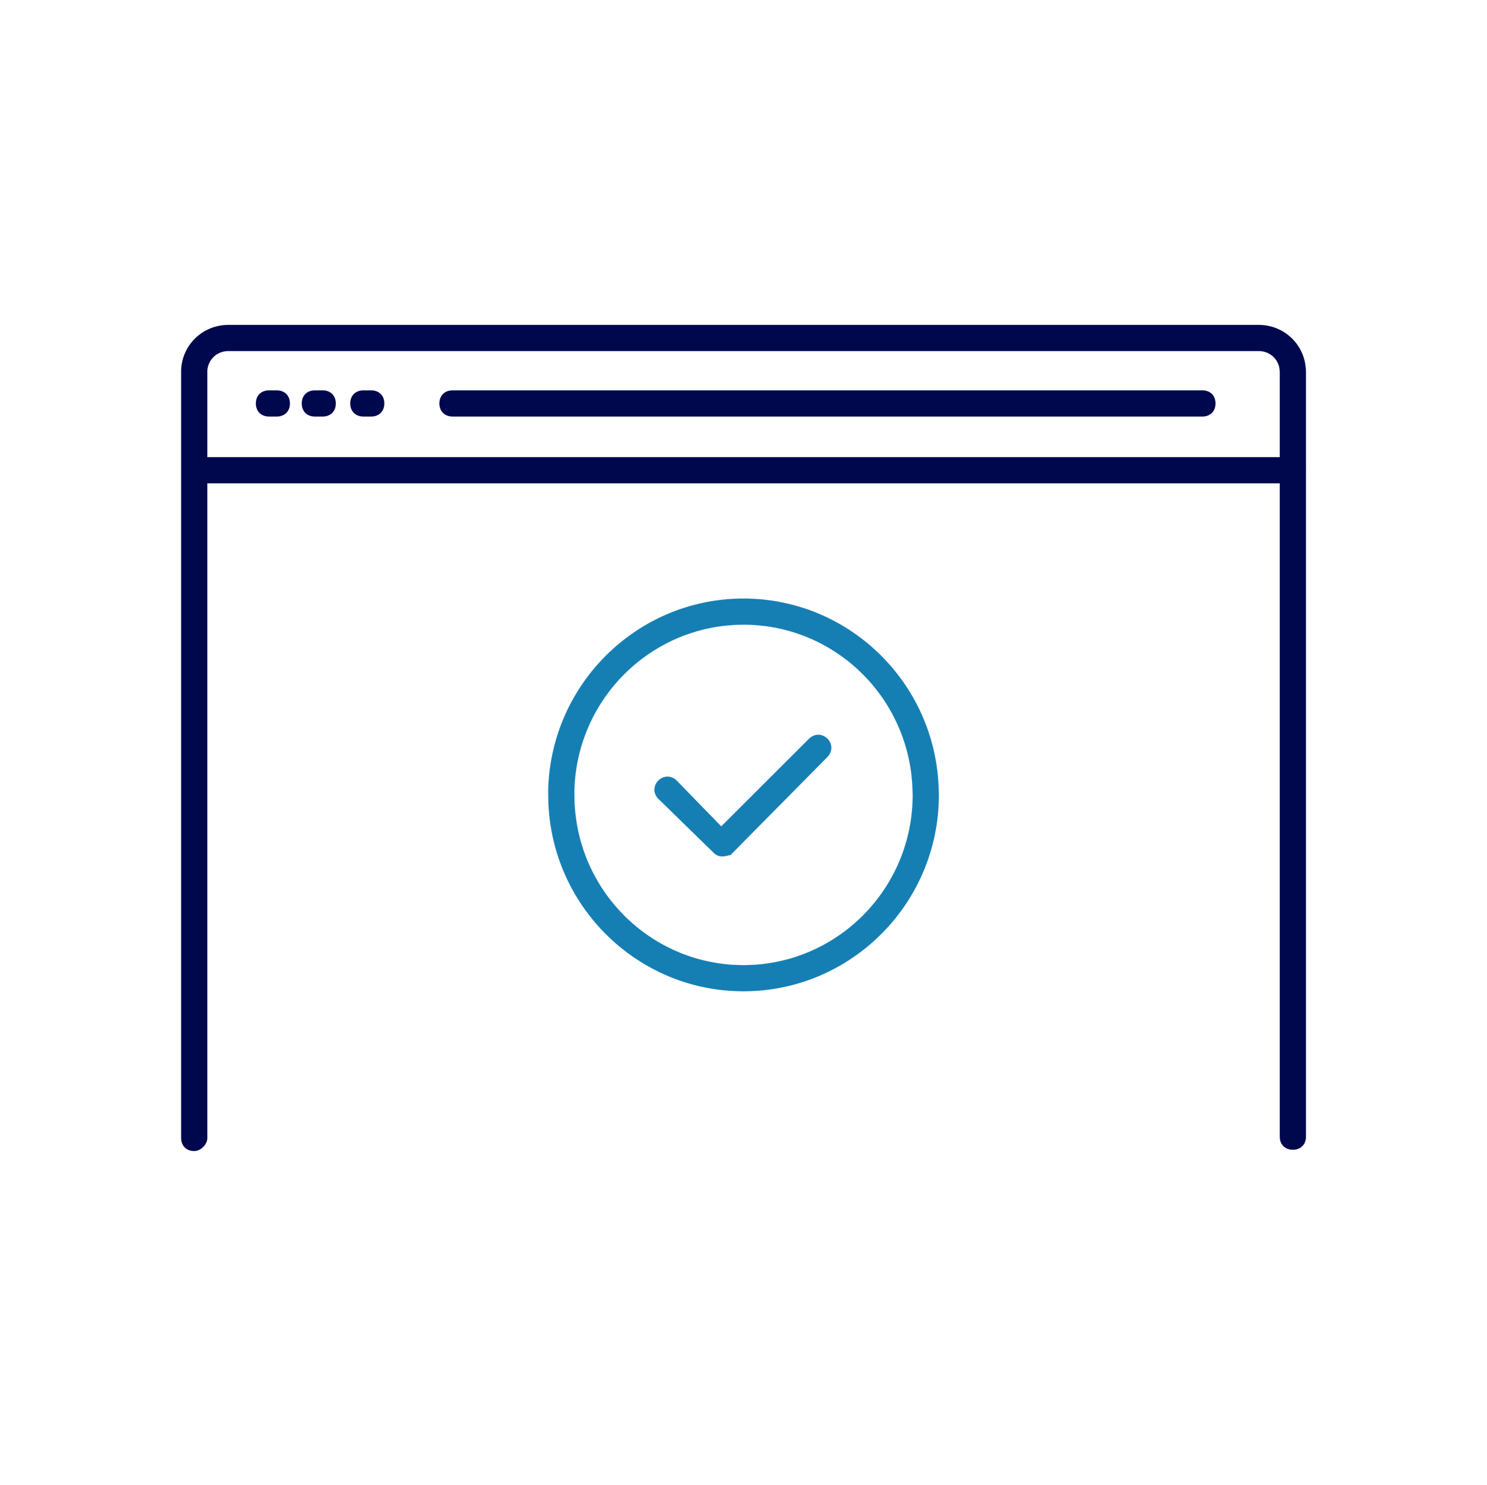
Web browsers
Popular web browsers
How to find and use a browser
Notes:
We mentioned earlier that a browser is what you use to view and access websites – basically, you can see it as a window to the internet.
Popular web browsers
The most popular browser is 'Google Chrome'. It can be used on any kind of device. It is the standard browser on Chromebooks.
The second most popular is 'Safari'. This is just for Apple devices like iPhones, iPads and Macbooks
'Microsoft Edge' comes in third place and is their browser. You might have heard of their older browser 'Internet Explorer’. Edge replaced Internet Explorer a few years ago
Has anyone heard of 'Firefox'? That’s another browser. Unlike the others, it doesn’t come as standard with a particular make of device. It’s by a not-for-profit company called Mozilla. Some web developers like to use this one
How to choose:
It’s good to try out different browsers to see what you like. Just because your device comes with one, it doesn’t mean you can only use that one. For example, you may have an Apple device but find Chrome easier to use.
How to use:
You can find your standard browser on your home screen, desktop or in your apps.
You can also download other browsers
Once you open a browser, you can go to a website. To do this, you need to enter something called a 'web address'. This is just like an address in the real world – it tells the browser exactly where that website is.
If you don’t know the web address, you can still find that website, by using a search engine. Let’s take a look at these next …

Slide 19
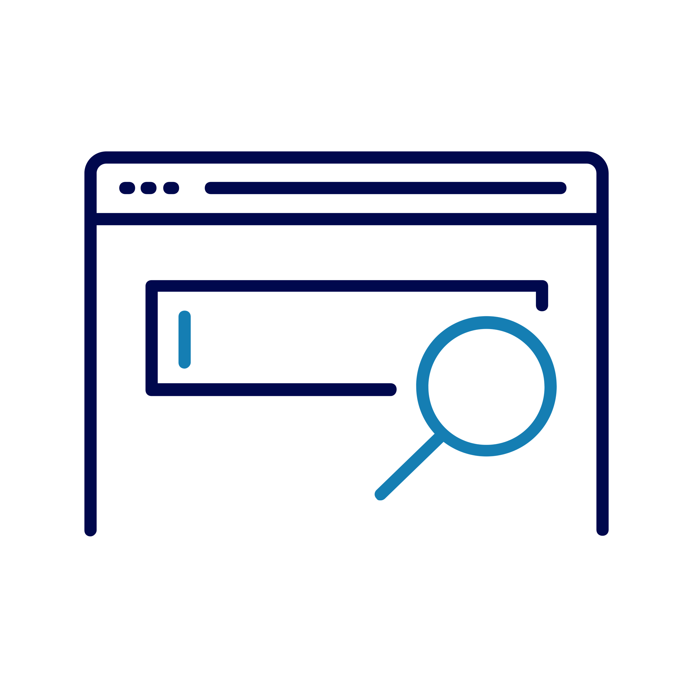
Search engines
A tool from your browser
Ask a question or find a website
Notes:
Search engines are tools you can use to find what you need. They do this based on the words or questions you type into them.
So you can use a 'search engine' to find a website without knowing the address. It does all the hard work for you by searching through all the information available online and showing you what it thinks you need.
The words you type in to search are often called 'search terms'. You can make these as general or specific as you want. In general, the more specific you can be, the quicker you’ll find exactly what you’re after. For example, maybe you’re looking to buy a new pair of shoes. If you went into a shoe shop and the assistant asked what you were looking for, you might give them an idea of the type of shoe, maybe the colour and definitely the size. It’s the same with search engines. Putting ‘pink hi-tops size 10’ will give you results that are more tailored to your needs than if you just typed ‘shoes’
There are plenty of search engines out there, to use. Some come with standard browsers on your device, and you can use others too.
Google is the most popular search engine and it’s what you see on Google devices like Chromebooks
Bing is Microsoft’s search engine, so you get this along with the Edge browser on any Windows devices
Yahoo is another example – that’s not tied to any particular device brand
There’s no need to download these search engines as they’re basically just websites. Once you’ve found one you like, you can make that your favourite, or ‘default’ browser by going into your device settings.

Slide 20
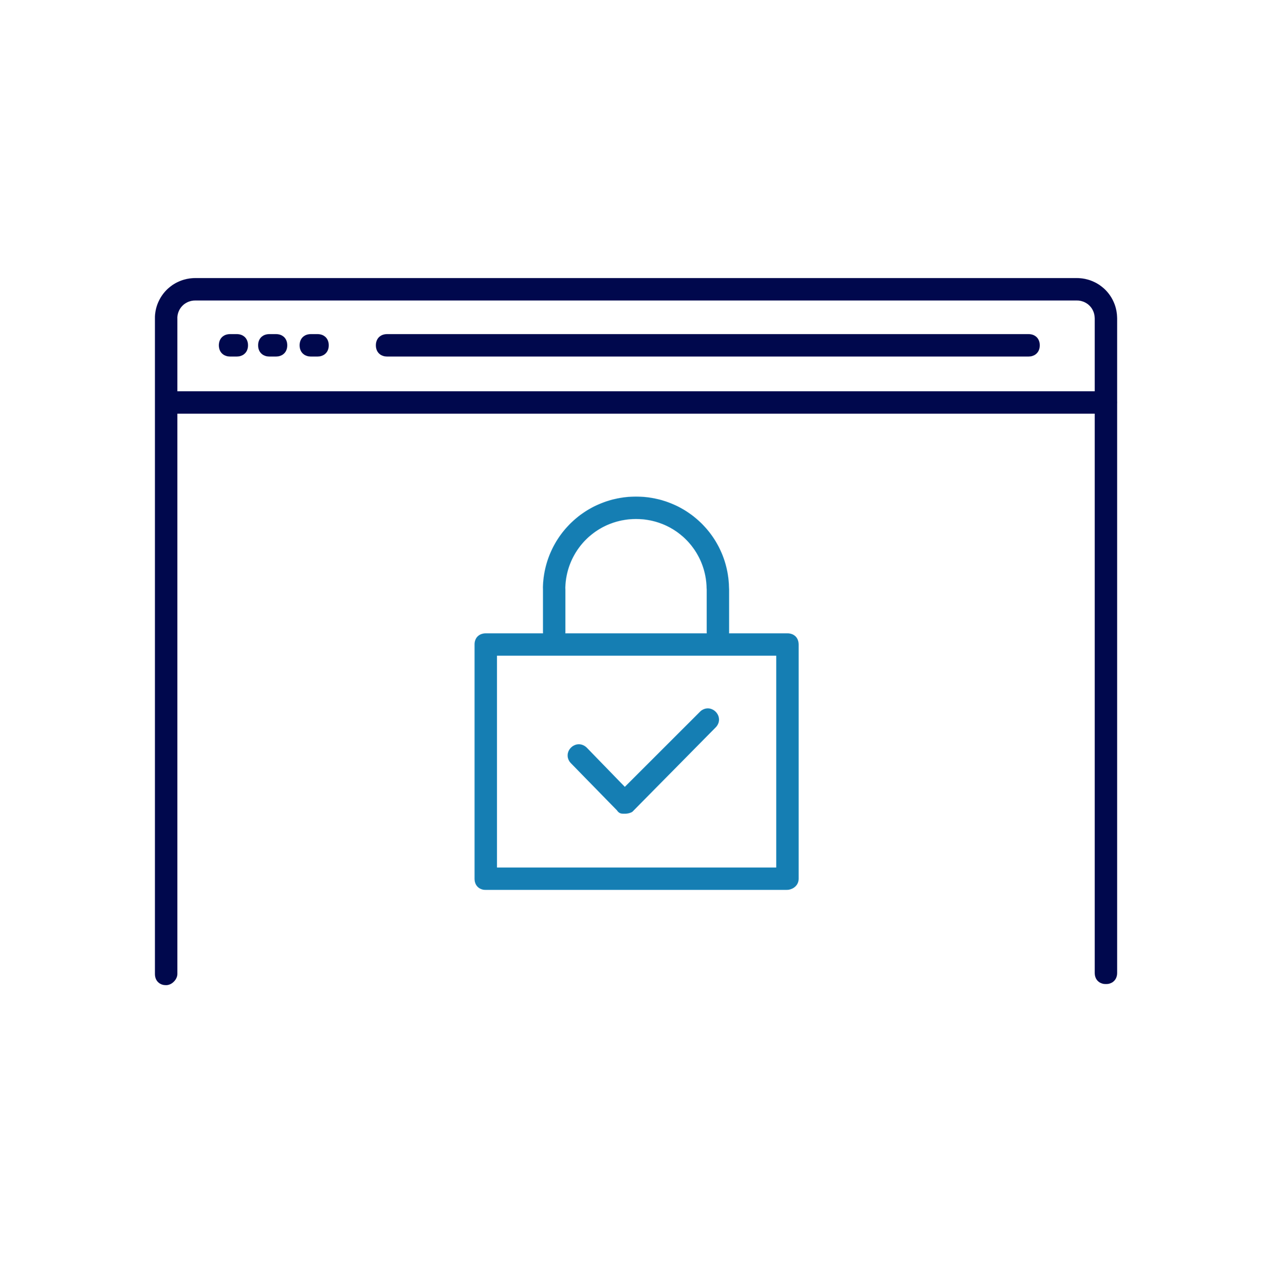
Safe browsing tips
Look for the padlock and ‘https’
Use your browser’s security tools
Create strong passwords
Think before you click
Notes:
Now, let's talk top tips for safe browsing. Here’s what we’ve got for you:
Check for the padlock icon in the address bar and "https://" at the beginning of the web address. These are clues that the site is secure
Use browser security tools: Browsers often have built-in security tools, like pop-up blockers and privacy settings. It’s a good idea to get familiar with these and use them to help keep you safe
Create strong passwords: Think ‘long and strong’ – just like when you were setting up your Wi-Fi password on your router. And don’t be tempted to use the same password for more than one site. There are tools you can use to generate and store your passwords for you. And it’s not the end of the world if you forget your password – most sites have a way to help you reset it
Think before you click: If you’re using a mouse, use it to hover over links to see the actual web address they lead to. This can help you spot fake links.
TRAINER NOTE: See also How to spot a fake website - Stop! Think Fraud (stopthinkfraud.campaign.gov.uk)

Slide 21

Favourites and bookmarks
What are favourites and bookmarks?
How to save your favourite site
Notes:
TRAINER NOTE – Just connecting to the internet and doing a simple search may be sufficient for your learners – if so, skip this slide and go straight to the explore activity
Now, let's look at a very handy thing you can do if you’ve got websites you want to visit a lot – saving them as favourites or bookmarks.
Some devices call these ‘favourites’ and some call them ‘bookmarks’ but basically they’re the same thing – shortcuts to help find your favourite websites
The idea is – you’re on a website you think you’ll visit again. With just one or two clicks or taps you can save it. Then when you want to see that site another day, you can just go to your ‘Favourites’ or ‘Bookmarks’ area and there it is.
Let’s see how to do this:
TRAINER NOTE – Demo saving a site as a Favourite / Bookmark. Close the browser then demo how to find that saved site. Encourage learners to follow along.
TRAINER NOTE– If time permits and learners have the skills and interest, mention how to organise, remove and sync bookmarks

Slide 22

Activity: Explore the Web
Open your browser
Find the search bar
Type what you need
See the results
Decide where to go
Notes:
Now it’s time to explore the Web together. Think of this as time for you to try out what we’ve covered today, ask any questions and just get comfortable with searching.
First, see if you can find a web browser on your device, and open it
Can you spot the search bar? It’s usually at the top of the browser screen
Now type something into that search bar. It could be a word, like ‘laptop’, a phrase like ‘laptops under £500’ or a question like ‘what’s the best value laptop in the UK?’
Don’t forget to press ‘Enter’ or tap the search icon to see the results. What do you see now? There’s likely to be lots of people trying to sell you a laptop here. Depending on what you typed, you might also get articles from tech magazines or consumer websites. Following these sites might give you more information so you can compare models
Be aware that often the top results are sponsored – that means the company has paid to have their site at this top spot. You can see if this is the case as they usually have the word ‘Ad’ or ‘Sponsored’ next to them
Now have a play – just type over the search field with something else – maybe something you’d like to find out more about. Why not see if you can find that signalchecker site by searching for it?
Look out for something called ‘People also ask’ – that’s something that you can use to filter your results even more

Slide 23
Today you've seen how to:
Explored what we mean by 'the internet’
Connected to Wi-Fi
Opened and used a browser
Searched for information
Kept safe when browsing and searching
Notes:
TRAINER NOTE – Ask questions as you go through this list (e.g. can anyone give me another word we use for ‘internet’?, how did you connect to the Wi-Fi here? What would you look for in a website to see if it was secure?)
Let's take a moment to reflect on what you've accomplished today:
You’ve explored what we mean by 'the internet’
You’ve connected to Wi-Fi
You’ve opened a browser and used it
You’ve used a search engine to find information
You’ve also started learning how to keep safe when browsing and searching
TRAINER NOTE – Prompt for any questions or feedback. Check level of confidence in doing these in future, ask what they found most useful, anything they’d like to know more about (or to go through again before the lesson ends) and where they think they’ll need more practice.

Slide 24

Any questions?
Notes:
Trainer NOTE – Ask if they have any questions, comments or feedback that you can help with. You could consider this as an opportunity to check level of confidence in doing these in future, ask what they found most useful, anything they’d like to know more about (or to go through again before the lesson ends) and where they think they’ll need more practice.

Slide 25
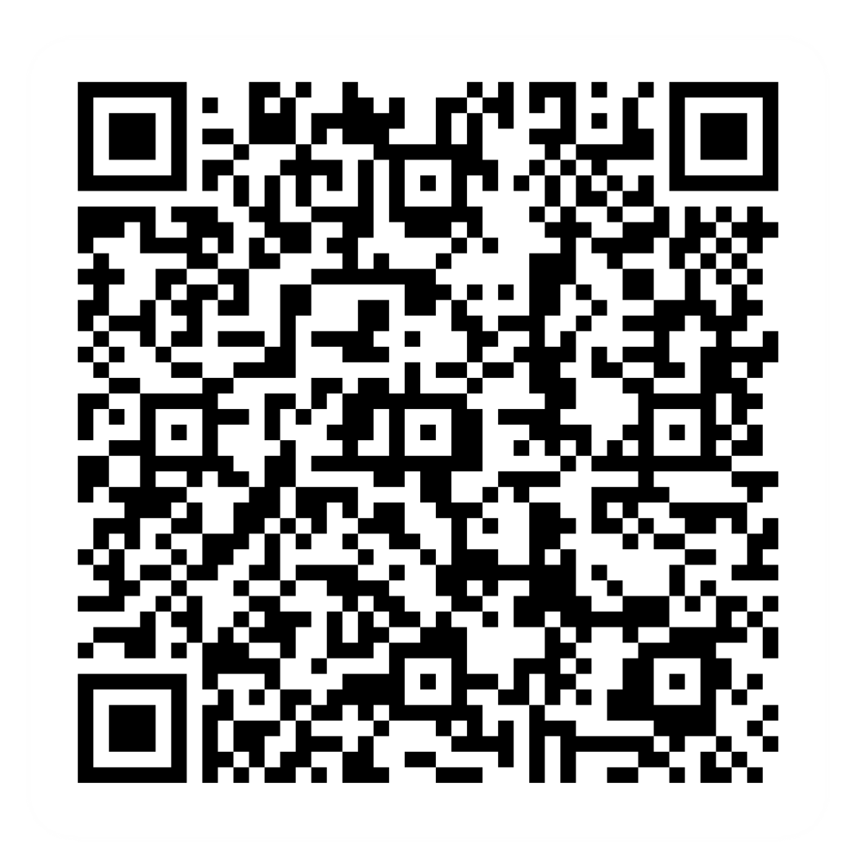
Post-session survey
Notes:
Encourage learners to scan the QR code here and complete our short post-session survey around levels of confidence now they have completed the training, plus any other comments or feedback about the session

Slide 26
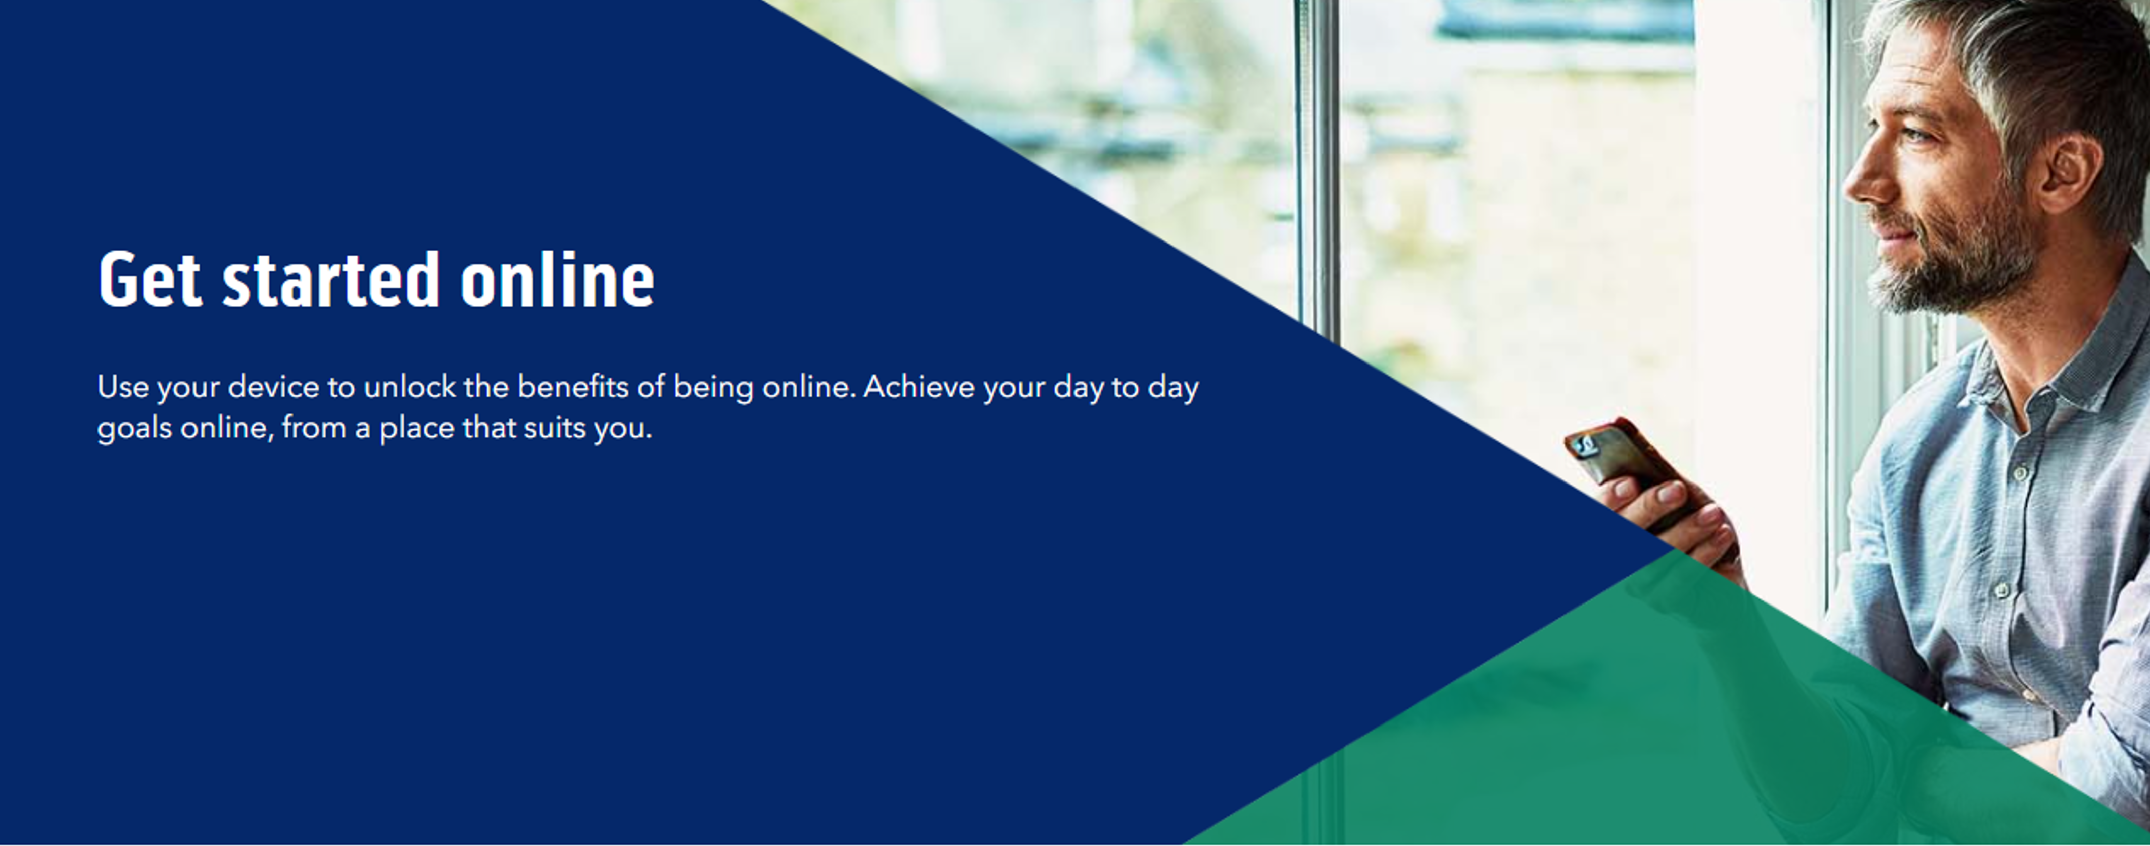
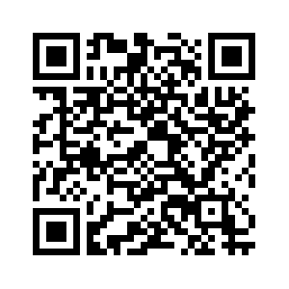
Notes:
Trainer notes
Signpost related content on the Academy website https://www.bankofscotlandacademy.co.uk/learn-for-life/get-started-online/
Alternatively, they could use their phone cameras to scan the QR code here.
If they don’t feel comfortable using this yet, then suggest they take our other lessons: “Connecting to the internet” and “ Stay safe online”, if you don’t know the next dates for these or how to help them sign up then speak to the Academy team before your session.
If part of a programme, share the date and topic of the next session

Slide 27
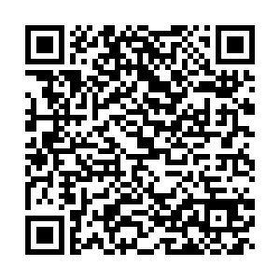
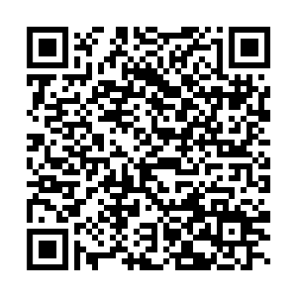
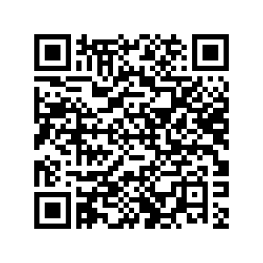
Want to find out more?
Our Digital Helpline: 0345 222 0333
Comparison sites : ‘Save money on services and utilities’
Using public Wi-Fi safely
Finding information online
Notes:
TRAINER NOTE – Optional additional slide with online module names and associated QR codes to take learners directly to this content
Thanks for attending today’s session.
Don’t forget, if you feel you need more one to one support, you can call our Digital Helpline
We’ve also put QR codes up here for some of our online lessons which talk a bit more about some of the topics we’ve looked at today, if you want to find out more about them
TRAINER NOTE – Support learners to access these lessons through QR code / searching and saving as favourites so they can view them later.

