Slide 1
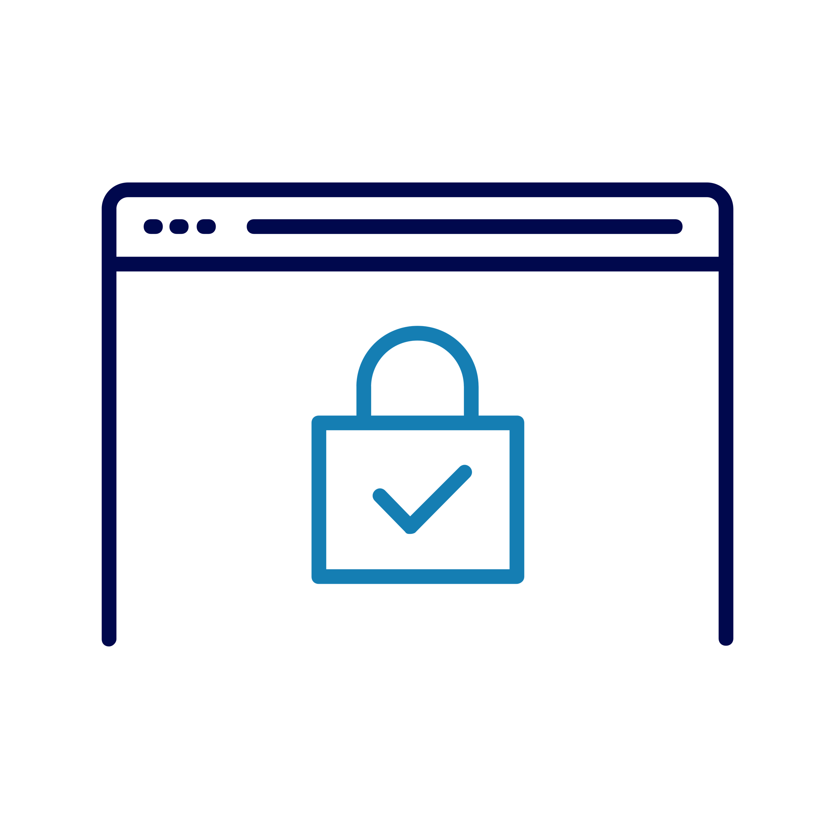
Stay safe online
Notes:
Before the session starts: have the following webpages up and available:
https://stopthinkfraud.campaign.gov.uk/
https://www.actionfraud.police.uk/
Check what Wi-Fi network is available, its name and any password required; write up / make available to the learners
Welcome people to the lesson
Go to the next slide when you're ready to start the lesson

Slide 2
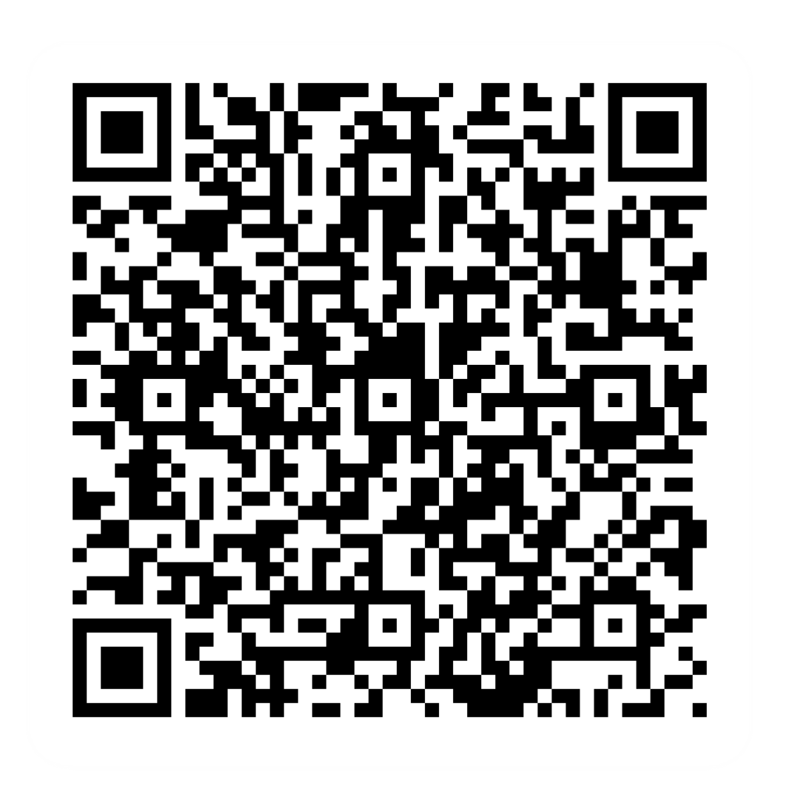
Pre-session survey
Notes:
Encourage learners to scan the QR code here and complete our short pre-session survey around levels of confidence in the session’s topics today, plus what they would like to get out of the session

Slide 3

Welcome
Notes:
TRAINER NOTES –
If this lesson marks the start of a programme, welcome people to the programme
If it is not, then welcome people to the lesson
Welcome to today's lesson on staying safe online
My name is [Your Name], and I'm here to help you today
We're excited to be here with you as you start to safely explore the Internet
We want to make this learning experience practical, relatable, and, most importantly, helpful to you
In the room (or virtually), we also have [Any Co-Presenter's Name] who is here to help you during this session
TRAINER NOTE – for small groups / virtual sessions, learners could introduce themselves at this point
Being online can help you keep in touch with people, develop new skills, keep up to date on the latest news, and shop online. It can even let you know if you might need an umbrella by checking the weather in just a few taps or clicks
At some point, everyone worries about the possible risks of being online. You are not alone. This is not a reason to avoid being online though. There are plenty of ways to make sure you can enjoy the benefits and stay safe
As we go through today's lesson, please do ask questions, and let us know if you need anything. If we can't help today, we'll make sure you get the help you need after the session
Let us know if we're going too fast or too slow, or if you need a break. We want you to get the most out of today, so I'll be guided by you

Slide 4

How to get the most from this session
Notes:
Before we begin, here’s a few tips on how to get the most from this session
If we mention any resources during the session, we’ll share these with you at the end
We want this lesson to be as interactive as possible, so we’ll be asking questions as we go along – and we want you to ask lots of questions, too!
Sometimes we’ll have a short discussion about what we’re looking at, or we might move on. It will depend on how we’re doing for time
Remember, it's all about learning together, so ask away and don’t worry about how your question sounds, or getting the right answer – Spoiler alert: sometimes there’s no single right answer. It's your thoughts that matter most. And we're here to make your experience as easy and enjoyable as possible
NOTE FOR VIRTUAL DELIVERY – Encourage people to comment and ask questions in the chat or experiment and try using the emojis. (Describe what an emoji is if needed)​ ​
To comment in the chat, find the chat box. It’s usually on the side or at the bottom of your screen. Click (or tap) in the chat box, enter your comment, and hit 'Enter' or 'Send.' Your message will then appear in the chat for everyone to see. It's a great way to ask us questions or share your thoughts during our session. So, feel free to chat away!​
We’d like to make today as interactive as possible to make your experience more interesting​
First, we’ll show the question on the screen. Read the question and possible answers. Pick the answer you think fits best and pop the letter for that answer (A, B, C, or D) in the chat (if and when you’re ready). Don't worry about getting it right or wrong. Just go with your gut feeling!​

Slide 5
How confident are you about staying safe online?
Very
A little bit
Not very
Not at all
Notes:
Before we start, how confident are you currently about staying safe online? Please share your comfort level in the chat by typing the letter corresponding to your answer:
Very
A little bit
Not very
Not at all
NOTE FOR VIRTUAL DELIVERY – Ask participants to comment with their answer in the chat box
TRAINER NOTE – Reassure learners:
Remember, the fact that you're here shows you're already taking steps to boost your online safety. Today’s lesson is designed to build your confidence, and we'll cover essential strategies to help you stay safe online
TRAINER NOTE – Follow-up discussion:
Very – Fantastic! You're off to a great start, and today’s lesson will reinforce your knowledge
A little bit – That's absolutely okay. This lesson is tailored to help you get the skills you need
Not very – No worries. We're here to guide you, and you'll find you will get better with a bit of practice
Not at all – Don't worry. We're here to support you every step of the way. As we progress, you'll see how these things are within your reach
Feel free to engage in the chat, and remember, this is a learning journey. Your questions and insights are valuable. Let's proceed and continue developing your online safety skills

Slide 6

Today we want to help you:
Understand online safety
Log in securely
Spot suspicious links
Keep your device safe
Notes:
Today, we want to make sure you leave feeling more confident in your ability to stay safe online.
We'll explain how to stay safe online and keep your personal information safe
You'll learn how to keep your information you use to get into your device and online accounts (like usernames and passwords) safe. Tip: Don't share them with anyone or write them down and leave them near your device
You'll learn how to spot suspicious links in emails, websites, social media messages, and pop-ups.
And, last but not least, we'll help you find and download tools to keep your devices safe and up-to-date
Every device is a bit different, so we'll provide general steps, tips, and what to look for. If you need more specific guidance for your device, just let us know, and we'll help you. We're here to make this as practical and useful for you as possible
And if you need further help with your particular type of device, we'll share some helpful resources at the end of the lesson

Slide 7

What being ‘safe’ means
How do you stay safe in the real world?
How might that differ online?
Notes:
Let's start with a simple question – in your everyday life, what are some things you do to stay safe in the real world? Take a moment to think about it and feel free to share your thoughts
TRAINER NOTE – Pause for a brief discussion
These habits you’ve just mentioned are important for your safety in the real world. Now let's link that to what it means to be safe online. Imagine the online world as an extension of our physical world. Just as you lock your front door when you leave home to protect your belongings, the online world has its own set of safety rules
So, think about what you do to stay safe in your everyday life. Locking your front door to protect your belongings for example. Well, in the online world, we have similar steps to take
Let's start thinking about how to stay safe in the digital world

Slide 8

Know the risks
Fraud
Scams
Scammers
Notes:
Let's start by discussing various online risks. Fraud, scams, and scammers are terms we use to talk about online risks
TRAINER NOTE – Ask learners if they can explain the terms before giving the definitions
Fraud is when someone tricks you to get your money or personal information. Imagine someone pretending to be something they're not, just to take your stuff. So, it's all about being careful and not falling for those tricks
Scams are just another name for the types of fraud. You'll often hear people use them both. If someone has been scammed, they’ve been tricked out of their money and/or personal details
Scammers are the people who do this. Sometimes they’re known as 'fraudsters.’ They're the ones attempting to trick people into giving them their money or personal details
Now, scammers are usually after one of two things: money or personal details. People often worry most about the loss of money, but you need to look after your personal details too

Slide 9
Which of these help you
stay safe online?
Having strong passwords
Not clicking on links I’m unsure about
Keeping my phone locked
Not sharing my personal details unless I know the sender
Notes:
What are some of the ways you can stay safe online?
Having strong passwords
Not clicking on links I’m unsure about
Keeping my phone locked
Not sharing my personal details unless I know the sender
TRAINER NOTE – All these are correct – spend time discussing why, especially if anyone has missed one or more of these

Slide 10
How can you spot a scam?
Notes:
Spotting scam messages can be tricky, and some of the more advanced scams can even fool the experts
TRAINER NOTE – Ask learners if they know any ways to spot a scam. Then reveal the answers on the next slide

Slide 11

How to spot a scam
Importance
Spelling and odd layout
Time pressure
Reward
Current events
Notes:
Here are some common themes that may indicate you've been targeted by a scam:
Importance – Some scammers pretend to be from well-known businesses to make you think the message is important. Don't fall for it
Spelling and odd layout – Mistakes in messages could be a sign of a scam – although these days, more scammers are using AI to create their messages
Time pressure – If a message asks you to do something quickly, be cautious
Reward – If something seems too good to be true, it's often a scam
Current events – Scammers may try to take advantage of current news to make you believe they're real
Always ask yourself, "Was I expecting this message?" If not, it could be a scam

Slide 12

Types of scams
Scam email messages
Romance scams
Buying-online scams
Ransomware
Notes:
Understanding these risks is important – just as it’s important to be aware of potential dangers in the physical world
Let’s look at a few examples
TRAINER NOTE – Examples start from the next slide

Slide 13

You get an email
You don’t know the sender.
They’re asking for personal information.
What do you do?
Reply with information
Ignore the email
Report it
Check using contact details you trust
Notes:
Let's test your instincts in a common online scenario. Imagine you receive an email from an unknown sender asking for your personal information. What would you do in this situation?
Reply with information
Ignore the email
Report it
Check with the sender using contact details you trust
Take a moment to choose your answer
TRAINER NOTE – The correct responses here are C. Report it and D. Check with the sender using contact details you trust
C. Report it: If you ever receive an email that seems suspicious or requests personal information, report it. If you have received an email which you’re not quite sure about, forward it to report@phishing.gov.uk
D - Check with the sender using contact details you trust: If you know the person that the message is supposed to have been sent by, it’s a good idea to check with them directly and make sure they sent it. If the message comes from a business or organisation, you can find their contact details by searching online – don’t trust the contact details in the email. You can then explain the email you have received and check they are aware of it.
Follow-up discussion:
Now, let's discuss why these are the right choices. These kinds of emails are attempts to trick people into sharing sensitive information. Reporting them helps prevent others from falling for these types of traps. Checking using another channel that you know, and trust can give you an extra line of safety before responding to or interacting with the email. Online safety is a shared responsibility, and being aware of these situations will help you to navigate the digital world securely. Feel free to share any experiences or thoughts you might have on this topic

Slide 14
You meet someone online
They ask for your personal information.
What do you do?
Share my information
Say no. Don’t share
Ask why they need it
Seek advice
Notes:
Let's explore another scenario related to online interactions. You've been chatting with someone online. They ask for your personal information, including your full name, address, and phone number. What would you do in this situation?
Share my personal information with them
Say no and not share any personal information
Ask them why they need this information
Seek advice from someone I trust
Take a moment to choose your answer.
TRAINER NOTES –
The correct responses here are:
B. Say no and not share any personal information – Take care and be cautious when sharing personal details online, especially with someone you've just met. Your privacy is important, and sharing information like this can pose risks
D. Seek advice from someone I trust –Seeking advice adds an extra layer of security. If you're unsure about the situation, talking it though with someone you trust provides valuable insights
Discuss the answers and share tips based on the responses
Emphasise the importance of protecting personal information online and the potential risks of sharing such details with strangers
Let's discuss why these are the recommended choices
You need to protect your personal information online
Saying no to sharing sensitive details helps protect your privacy and security
Seeking advice helps you make sure that you make informed decisions. It also highlights the importance of involving people you trust in your online interactions
Feel free to share any thoughts or experiences related to this scenario

Slide 15

You download a file
Now your device is locked with a message demanding money to unlock it. What do you do?
Pay to get access back
Ignore it and hope it goes away
Disconnect from the internet and get professional help
Ask a friend/ colleague for advice
Notes:
Let’s do one final scenario
You recently downloaded a file from an unfamiliar website, and now your computer is locked with a ransom message demanding money to unlock it. What steps would you take?
Immediately pay the ransom to unlock my computer
Ignore the message and hope it goes away
Disconnect my computer from the internet and seek professional help
Ask a friend or colleague for advice
TRAINER NOTES –
The recommended course of action here is:
C. Disconnect my computer from the internet and seek professional help – In case of a ransomware attack, you should isolate your computer from the internet to prevent further damage. Seeking professional assistance will help you safely resolve the ransomware incident
Discuss the answers and share best practices based on the responses
Stress the importance of not paying ransoms, disconnecting from the internet to prevent further damage, and seeking professional assistance to resolve ransomware incidents
Thank you for sharing your responses
Paying ransoms is not recommended
The best practice involves disconnecting your computer from the internet to contain the situation and seeking help from professionals who can address the issue safely
Scammers often use various tactics - like pretending to be someone else, sending messages with links or requests for your personal details, and sometimes even pretend to be romantic interests. They might also try to trick you when you're shopping online. Always be cautious and check the sender can be trusted before responding or clicking on links
Spotting and talking about these risks are the first step in staying safe online
TRAINER NOTE: pause to discuss any questions or thoughts they have on this topic

Slide 16

How to reduce the risks
Keep devices safe
Take care with public Wi-Fi
Check websites are secure
Follow the Take Five message –
Stop, Challenge, Protect
Notes:
TRAINER NOTE – Stress the importance of applying these principles while learners are using their devices remotely
Let's continue our journey to reduce online risks with practical steps
Securing your devices – Set up a screen lock, like a password or fingerprint, on all your devices. Locking your devices, when you’re not using them, helps keep your personal details safe, especially if you lose your device
Be careful with public Wi-Fi –Public Wi-Fi can be tempting but risky. Scammers might set up their own "free Wi-Fi" to access your device. If you use public Wi-Fi, avoid logging into sensitive accounts, like your bank
Take care visiting websites – Make sure you're on secure websites, especially those from those you trust. Look for a padlock icon and "https" in the web address. Check for spelling and grammar errors on the site.
Remember the Take Five Message:
Stop – Take a moment to think before taking any action regarding your finances or personal details.
Challenge – Question requests that seem too good to be true. Criminals often rush or panic you
Protect – Contact your bank if you suspect a scam and report it to Action Fraud
Staying safe online is about being careful and staying informed. Don't rush into sharing personal information, and always double-check if something seems unusual

Slide 17

How to reduce the risks
Keep things up to date
Create strong passwords
Use a password manager
Enable 2-factor authentication
Install security software
Notes:
DELIVERY NOTE – No need to demo these, just talk through and signpost, where appropriate, further sources of advice/info
Let's explore practical steps to reduce online risks and keep yourself safe:
Make sure you apply the latest updates on your devices. These updates help keep your data safe. You'll often get notifications to update; it's best to do this when you get them. You can also set your device to update automatically
Protect your accounts by using strong and unique passwords. Don't reuse them. Scammers can easily guess weak passwords. A strong password could be a combination of three random words, with some letters changed to make it harder to guess
Never share your passwords or use the same password for multiple things. If you have trouble remembering your passwords, consider using a password manager, which can create strong passwords and store them safely for you
Two-factor authentication (2FA) - also called multi-factor authentication (MFA) and 2-step verification (2SV) adds an extra layer of security to your accounts. It could be a code sent to your phone, a fingerprint or face scan. It's a great way to keep your accounts extra safe. If you want to know more about this, there's a gov.uk site to help you, which includes how to go about setting this up: Turn on 2-step verification (2SV) - Stop! Think Fraud (stopthinkfraud.campaign.gov.uk)
Install antivirus and security software to help keep your devices safe. There’s built-in antivirus software for Apple and Windows devices. You can also get separate software – some are free, others you pay for, though they may offer a free trial. It’s a good idea to ask around and do your research when you’re thinking of getting this, to make sure anything you get doesn’t conflict with your device’s built-in software. Phones and tablets don’t need antivirus software, just make sure you only install or download apps from your official app store – and don’t forget to update these apps when a new version is available, to keep their own security features up-to-date
Tip: You can practice using search engines to search to advice stay up to date about how to stay safe online. This is a good way to stay up to date with the latest know-how

Slide 18
How often should you
change your passwords?
Every 1 - 3 months
Every 6 - 12 months
When prompted by the system or device
When I know my device has been hacked
Notes:
How often should you change your passwords?
Every 1 - 3 months
Every 6-12 months
When prompted by the system or device
When I know my device has been hacked
NOTE FOR VIRTUAL DELIVERY – Ask participants to comment with their answer (A, B, C or D) in the chat box
TRAINER NOTES –
There isn't a one-size-fits-all answer when it comes to how often you should change your password, and it often depends on the specific app, site, or system you're using. The frequency of password changes can vary based on different factors
Discuss the answers and share best practices based on the responses
Let's discuss the options:
Every 1 - 3 months – Some platforms may recommend regular changes, but this can be overdoing it
Every 6-12 months – This can be a more manageable option while still giving quite a high level of protection
When prompted by the system or device – Many systems prompt password changes at recommended times
When I know my device has been hacked – Always change your password straight away if you know or suspect that something has happened to your device
The frequency often depends on how sensitive the information involved is, how important it is to you to keep safe, and if there are any other security measures in place, like 2FA. Always follow the recommendations of the specific service you're using.

Slide 19
How confident are you in reporting online scams?
I know exactly how to do this
I know a bit about this
I’m not sure I could do this
I don’t know how to do this
Notes:
How confident are you in knowing how to report online threats or scams?
A.I know exactly how to do this
B.I know a bit about this
C.I’m not sure I could do this
D.I don’t know how to do this
DELIVERY NOTES –
Discuss the answers and share tips based on the responses
Based on the answers, address any concerns, move to next slide, and offer additional guidance as needed

Slide 20

What to do if something happens
Contact Action Fraud:
0300 123 2040 actionfraud.police.uk
Tell your bank
Change your passwords
Scan your device
Notes:
If you encounter a problem online, quick action is key. Here's what to do:
Contact authorities: If you suspect a scam, report it to Action Fraud at 0300 123 2040 or online at Action Fraud. In Scotland, you can contact Police Scotland at 101
MODERATOR NOTES –
Share the following in chat: If you think you’ve been scammed, the first thing to do is report it to Action Fraud on 0300 123 2040 or online at http://www.actionfraud.police.uk. If you're in Scotland, you can contact Police Scotland on 101
Provide specific instructions for contacting authorities virtually and encourage participants to utilise chat for questions and sharing
Gather evidence – Keep any screenshots or any relevant data related to the incident together. This evidence can be really helpful for reporting and potential investigations
Tell your bank – If your bank account is affected, contact your bank immediately. They can secure your accounts and investigate
Change your passwords – If you think someone might have your password, change it right away. Make sure your new passwords are strong and unique for each account
Scan for your device – Run an antivirus and malware scan on your devices to make sure your data is safe
Taking these steps quickly can make a big difference
Stay alert, seek help, and take action if you encounter a problem

Slide 21

Today you've seen how to:
Understand online safety
Log in securely
Spot suspicious links
Keep your device safe
Notes:
You've covered a lot in this lesson, and I want to highlight what you've achieved and what comes next:
You now know how to protect your personal information and keep the details you use to access your devices and online accounts secure
You can spot suspicious links and understand various online risks
You've learned how to use security software effectively and how important it is to keep your software up to date.
You're well-equipped to navigate the online world more safely

Slide 22
Any questions?
Notes:
Trainer NOTE – Ask if they have any questions, comments or feedback that you can help with. You could consider this as an opportunity to check level of confidence in doing these in future, ask what they found most useful, anything they’d like to know more about (or to go through again before the lesson ends) and where they think they’ll need more practice.

Slide 23
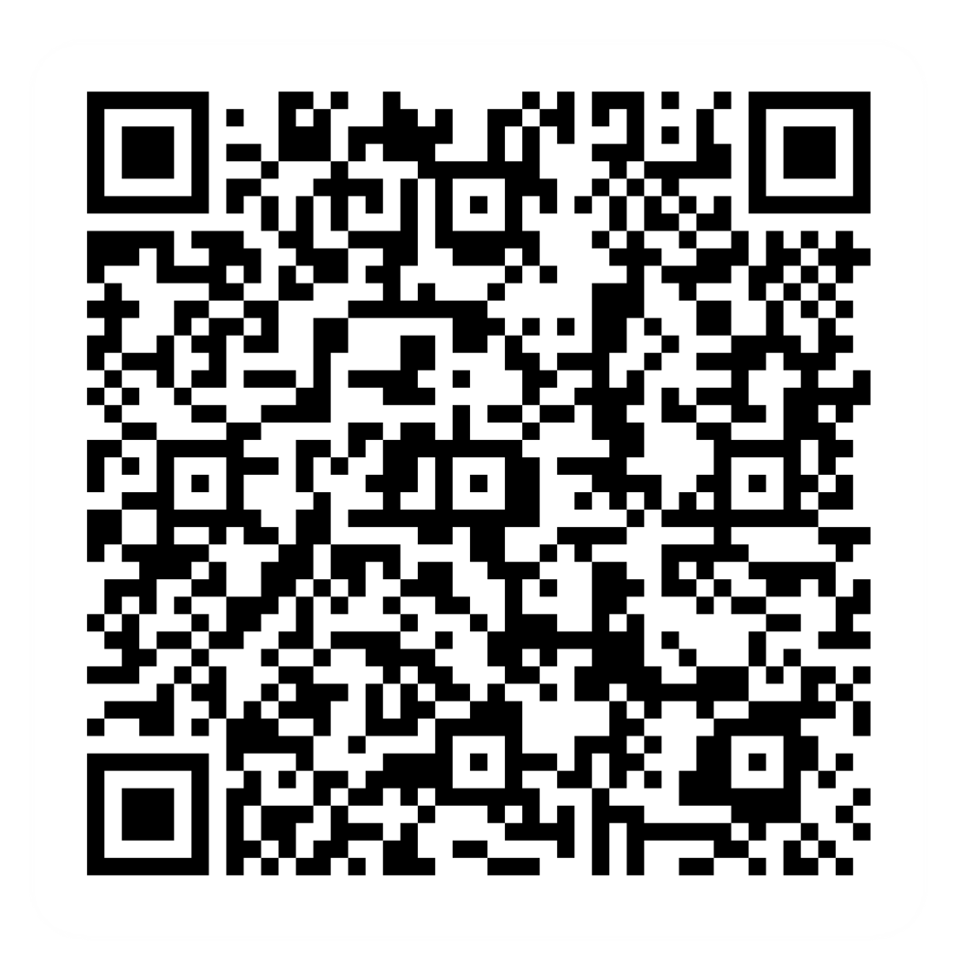
Post-session survey
Notes:
Encourage learners to scan the QR code here and complete our short post-session survey around levels of confidence now they have completed the training, plus any other comments or feedback about the session

Slide 24
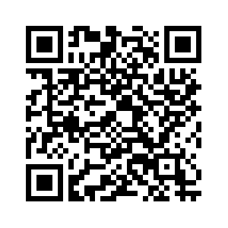
Notes:
Signpost related content on the Academy website https://www.bankofscotlandacademy.co.uk/learn-for-life/get-started-online/
Encourage them to search for this site. Alternatively, they could use their phone cameras to scan the QR code here
If part of a programme, share the date and topic of the next session

Slide 25
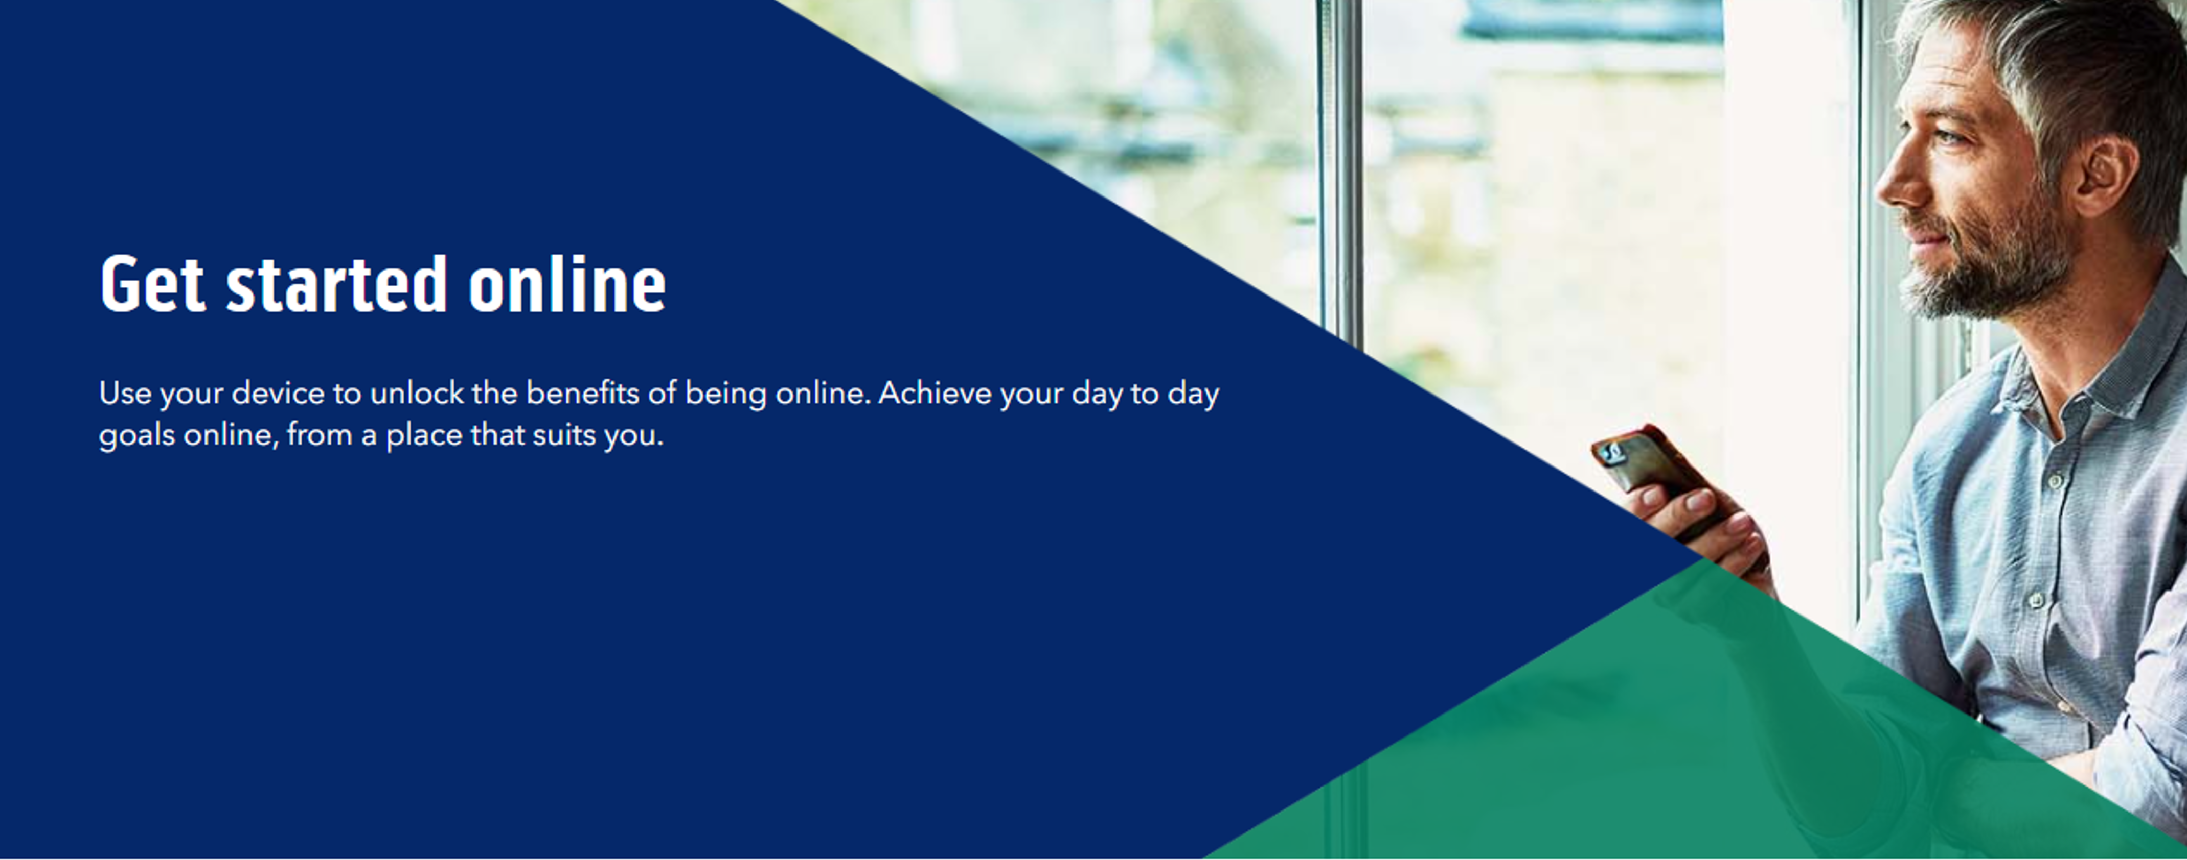
Notes:
Trainer notes
Signpost related content on the Academy website https://www.bankofscotlandacademy.co.uk/learn-for-life/get-started-online/
Alternatively, they could use their phone cameras to scan the QR code here.
If they don’t feel comfortable using this yet, then suggest they take our other lessons: “Connecting to the internet” and “ Stay safe online”, if you don’t know the next dates for these or how to help them sign up then speak to the Academy team before your session.
If part of a programme, share the date and topic of the next session

