Slide 1

Managing your money online
Notes:
Have LBA and MoneyHelper sites up and running before the session:
(moneyhelper.org.uk/en/everyday-money/budgeting/budget-planner)
Check what Wi-Fi network is available, its name and any password required; write up / make available to the learners
Welcome people into the room
Introduce yourself
Make sure everyone is comfortable
Go to the next slide when you’re ready to start the lesson

Slide 2
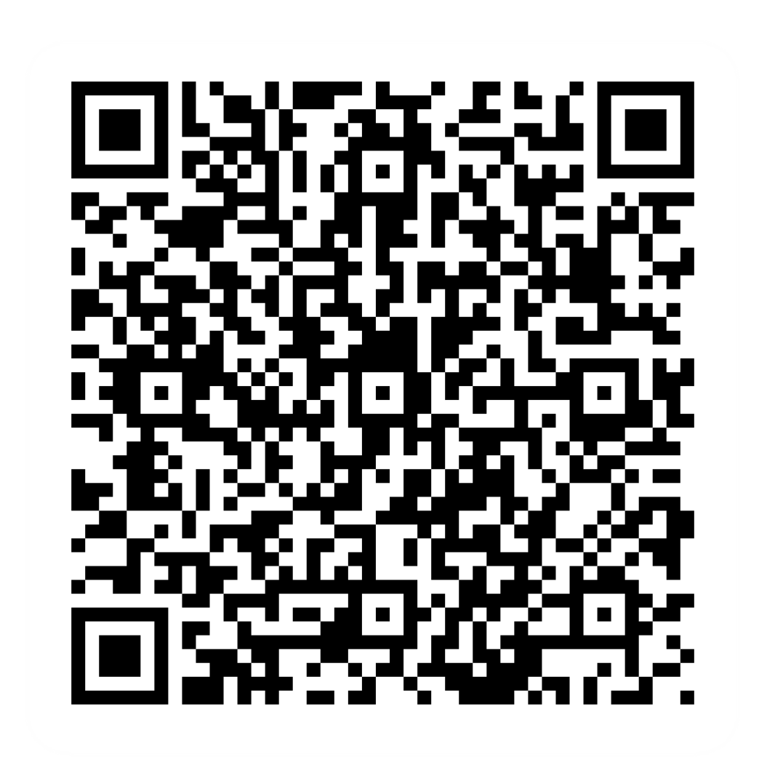
Pre-session survey
Notes:
Encourage learners to scan the QR code here and complete our short pre-session survey around levels of confidence in the session’s topics today, plus what they would like to get out of the session

Slide 3

Welcome
Notes:
TRAINER NOTES –
If this lesson marks the start of a programme, welcome people to the programme
If it is not, then welcome people to the lesson
Welcome to today’s lesson on managing your money online
My name is _ and I’m here to help you today
We're excited to be here with you as you start to look after your money online – whether that’s through a bank or through the use of websites or apps
We want to make this learning experience practical, relatable, and, most importantly, helpful to you
In the room (or virtually) we also have [Any Co-Presenter's Name] who is here to help you during this session
TRAINER NOTE – for small groups / virtual sessions, learners could introduce themselves at this point
So, in today’s session, we'll help you understand more about the benefits of managing your money online. We'll help you with the first steps of online banking and help you get set up. We'll also help you stay safe while spending and managing money online. Finally, we’ll give you some tips and tools on how to budget
If you have your device with you, we’ll help you through the steps as you go
If you don’t have a device with you today, you can still learn what you can do when you use it next
As we go through today’s lesson, please do ask questions, and let us know if you need anything. If we can’t help today, we’ll make sure you get the help you need after the session
Let us know if we’re going too quickly, too slowly, or if you need a break. We want you to get the most out of today, so I’ll be guided by you

Slide 4

How to get the most from this session
Notes:
Before we begin, here’s a few tips on how to get the most from this session
If we mention any resources during the session, we’ll share these with you at the end
We want this lesson to be as interactive as possible, so we’ll be asking questions as we go along – and we want you to ask lots of questions, too!
Sometimes we’ll have a short discussion about what we’re looking at, or we might move on. It will depend on how we’re doing for time
Remember, it's all about learning together, so ask away and don’t worry about how your question sounds, or getting the right answer – Spoiler alert: sometimes there’s no single right answer. It's your thoughts that matter most. And we're here to make your experience as easy and enjoyable as possible
NOTE FOR VIRTUAL DELIVERY – Encourage people to comment and ask questions in the chat or experiment and try using the emojis. (Describe what an emoji is if needed)​ ​
To comment in the chat, find the chat box. It’s usually on the side or at the bottom of your screen. Click (or tap) in the chat box, enter your comment, and hit 'Enter' or 'Send.' Your message will then appear in the chat for everyone to see. It's a great way to ask us questions or share your thoughts during our session. So, feel free to chat away!​
We’d like to make today as interactive as possible to make your experience more interesting​
First, we’ll show the question on the screen. Read the question and possible answers. Pick the answer you think fits best and comment the letter for that answer (A, B, C, or D) in the chat (if and when you’re ready). Don't worry about getting it right or wrong. Just go with your gut feeling!​

Slide 5
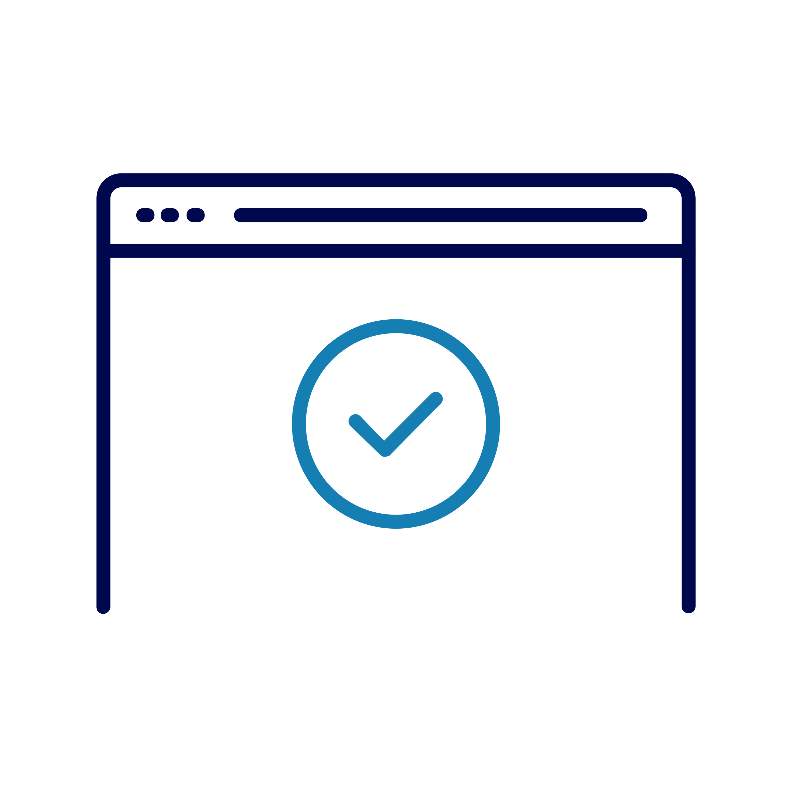
Today we want to help you:
Set up online banking
Start to bank online safely
Decide the way to pay online that's right for you
Use online tools to help you budget
Disclaimer: Everything that is discussed today is for guidance and is not financial advice. Any websites, tools etc. are examples of what's available.
Notes:
So, here’s what we’d like you to get out of today. We want to help you:
Understand how to set up online banking and the importance of starting to bank online safely
Explore various methods of deciding the way to pay online that's right for you
Discover other digital tools and methods that can help you with budgeting and managing your finances online
Every device is slightly different. Today we’ll share general steps, tips and what to look for
If you want more help doing any of the steps on your device as we go through, just let us know and we’ll give you a hand
If you need more help with your type of device, we’ll share some useful resources at the end of the session
Now, let's talk about why managing your money online is so important:
When you have access to your finances online, it's like having your bank at your fingertips at any time of the day
This means you can check your balance, make payments, and manage your spending whenever it suits you. No more waiting in long bank queues or worrying about your local branch being open or closed

Slide 6
What can you do with your money online?
Notes:
TRAINER NOTES –
This slide is an opportunity for a discussion and flipchart activity
Engage the learners in a discussion about what they can see and do with online banking, payment, and related tools
Encourage the participants to share their thoughts and questions
Use a flipchart or whiteboard to note down key points from the discussion
Go to the next slide to reveal

Slide 7

You can:
Check your balance
Move money between accounts
See statements
Send/receive money
Check payments
Shop online
Pay bills
Budget
Notes:
So, it turns out you can do a whole lot. You can check your balance at any time, move money between your accounts, see your bank statements, make payments, and even make sure your payments have gone through whenever suits you. When you have access to your finances online, it's like having your bank at your fingertips at any time of the day. No more waiting in long bank queues or worrying about your local branch being open or closed
And here's a handy tip: with some banking apps, you can freeze your credit or debit cards in just a few clicks if it's ever lost or stolen, helping you keep your money that extra bit safe
How about when you're spending money online, or paying others? You can pay for things when shopping online or send money from your bank account to another person's account. There are different ways to pay people, bills or utilities
Plus, when you shop online, you can use different way to pay, from credit and debit cards to payment services. There are also options, some that might charge extra, to spread or delay your payments. We'll talk about all of these and point out what to think about when you're deciding how to pay, so you'll know the pros and cons of each way
And there are tools out there that can help you plan and budget your money. We'll look at some of these today, to show you what they do and how they could help you keep on top of things

Slide 8

Setting up online banking
Visit your bank's website or app
Register using your personal details
Create your log-in details
Read the T&Cs
Complete security checks
Notes:
TRAINER NOTE: ANIMATED SLIDE (ONCE YOU HAVE TALKED THROUGH THE SCENE-SETTING, CLICK THROUGH EACH OF THE 5 STEPS AS YOU TALK THROUGH THESE IN TURN)
Let's explore setting up online banking. I'll walk you through the initial steps involved in setting up your online banking step by step
It's important to note that the process can vary depending on the bank you're with and the type of device you're using.
Different banks may have slightly different ways of doing things
Whether you're using a mobile phone, tablet, or a desktop computer can make a difference too
Once set up, you can access online banking through a browser, or you can download an app onto your mobile phone, to use ‘mobile banking’. Sometimes people use both the app and the website
Mobile apps give you the flexibility to manage your account on the go
Sometimes you can do more on the website – it’s good to check
Let’s break it down: (CLICK THROUGH EACH STEP IN TURN HERE)
First, visit your bank's website or app
Then, register using your personal details. This will include things like your name, date of birth, postcode, and account information. This is to make sure that you can access your account securely
Create your log-in details. This normally includes a customer number and a way to get into your account, like a username and password. Others will ask you to set up other types of protection like a PIN , or even fingerprint, depending on your bank. (Not: this ‘PIN’ is different to the PIN you use with your bank card to take out cash or when shopping out and about)
Read the terms and conditions to make sure you understand and are happy with what you’re signing up for
Complete any security checks that make sure you are who you say you are (this keeps you safe and stops other people accessing your money)
TRAINER NOTE – Reassure learners that they can get advice from their bank if they need it

Slide 9
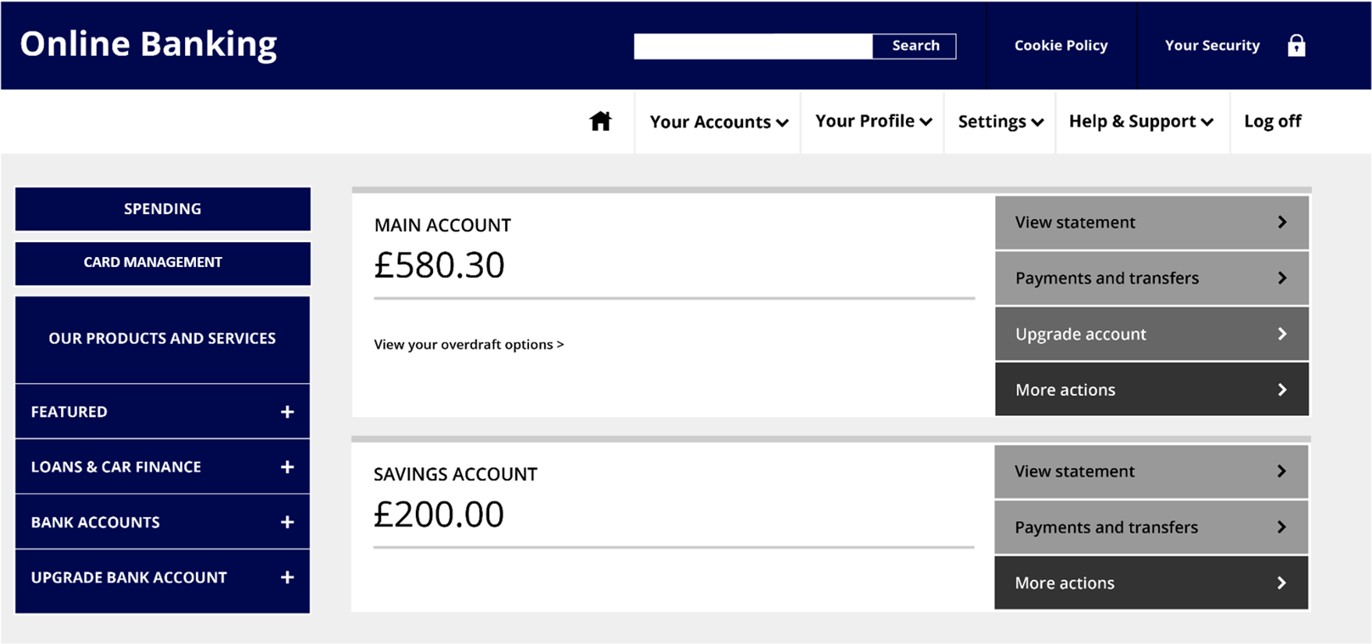
Using online banking
Search
Your accounts
Settings
Support
Spending
Card Management
Products and services
Pay and transfer
Notes:
Once you've set up your online banking, it’s time to start using it. Here’s what a typical screen looks like when you first go into the website or app. Let’s take a look at what you can see here – and what you can do when you start to use online banking:
TRAINER NOTE – Make it clear that this is just an example – that the screen they see will depend on the bank, the device and whether they are viewing the website or the app
Point out each area / feature in turn:
Search – you may see a search area to find account info or items quickly
Your accounts – You’ll see the names or types of account you have, together with the account balance – the amount you currently have in the account. In this example, the person has two accounts – a main account and a savings account.
Settings – You might see these in the form of a cog or gear icon. You can do things here like setting text alerts for when your account balance drops below a certain amount, or to set how or if you want to get marketing information from your bank
Help & Support – there will usually be some help or support button or section. It might be in the form of a question mark icon. Use this to get help with your account or how to bank online
On the left, you can see options to get info on:
Spending – This might be a breakdown or chart to show you what you’ve been spending money on. Some banks offer this option, which can be helpful if you’re trying to see where you might save or cut down your spending
Card management – There’s likely to be an area where you can do things like viewing your card details, cancelling and ordering new cards, reporting a card lost or freezing/unfreezing a card
Products and services – This is where the bank shows what other accounts and services are available to you.
On the right, you can see:
An option to view the account statement – to give an up-to-date view of recent payments into and out of the account
Pay and transfer – This gives you a few options. It’s where you start when you want to make a payment or transfer money between accounts. You can also see and cancel any payments – so for instance, you can see when your last direct debit to your gas company was, or cancel a standing order
Let’s look at how you would go about making your first payment or transfer online now … (LEADS INTO NEXT SLIDE)

Slide 10
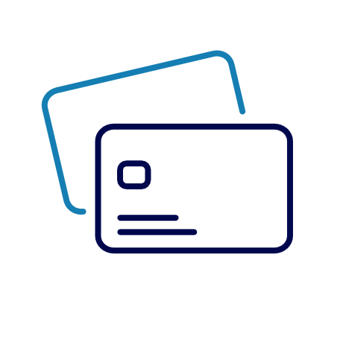
Making your first transaction
Look for the ‘Pay or Transfer’ option
Pick the account you want to pay from
Pick or set up your payee
Type in the amount and date
Is this a regular payment?
Check and confirm
Notes:
TRAINER NOTE: ANIMATED SLIDE (CLICK THROUGH EACH OF THE 6 STEPS AS YOU TALK THROUGH THESE IN TURN)
So here’s a guide to what to do and what to expect when you make your first transaction. A ‘transaction’ is anything that involves money going in or out of your account. So it could be a deposit, a cash withdrawal, moving money between your accounts or paying someone either using your bank card or online. Let’s look at those online payments and see how you would do that:
First, look for that ‘pay or transfer’ option – that’s your starting point. You may see another option after you’ve selected that – you’ll be looking for one that talks about making a payment or transfer money
If you’ve got more than one account, you’ll need to say which one you want to use to make the payment
Then pick your payee. Does anyone know what a ‘payee’ is? It’s simply the person or company you're paying money to. If it’s someone you haven’t paid before, you’ll need to give the details of them and their account. The next time you pay them, you won’t need to give all this information again
Type in the amount you want to pay, and the date you want the payment to be made. If you don’t put a date, the bank is likely to assume you want to make the payment that day, so do check if you want to change this to another date
You’ll be asked whether this is a regular payment – like a Direct Debit or a Standing Order
Now it’s time to read through the details on the screen to double-check they’re all correct, before you confirm it. Take time to do this, every time. You don’t want your money going to the wrong account, or on the wrong date

Slide 11
Keeping safe – what you and your bank do
Passwords
Two-factor security
Payment approvals
Notes:
When you bank online, you need to know that your money is safe. So let's look now at how you and your bank can work together to keep it safe:
It all begins with a strong password. When you set up your online banking, choose a unique combination of letters, numbers, and symbols. And remember to change it from time to time to keep your account extra safe
Here’s a tip for strong passwords: Think of three short words, string them together and pop in some numbers.
TRAINER NOTE –write up an example (flipchart / whiteboard if possible - you can ask the learners for ideas for the words as appropriate):
For example, 'seat', 'bird' and 'snap'. If you start each word with an upper case letter and swap each 'a' for the number '4', you end up with Se4tBirdSn4p.
Two-factor security – For added protection, your bank might use two-factor or multi-factor security. This could involve things like fingerprints, scanning your face or answering security questions (such as memorable place, first pet's name, first school, etc). Sometimes, your bank will text or email you a code that you can use to confirm it’s really you. These are all there to provide extra locks on your account to help keep your money safe
Payment approvals – You might come across situations where your bank asks for your approval before certain payments go through. When this happens, it's a good point to just pause and check that you do want to make the payment of that amount to that person or company. It's always good to pause like this before completing any purchase online. This is an important security step to make you're in control of your money
Strong passwords, extra layers of security, and payment approvals are great things to keep your money safe online

Slide 12
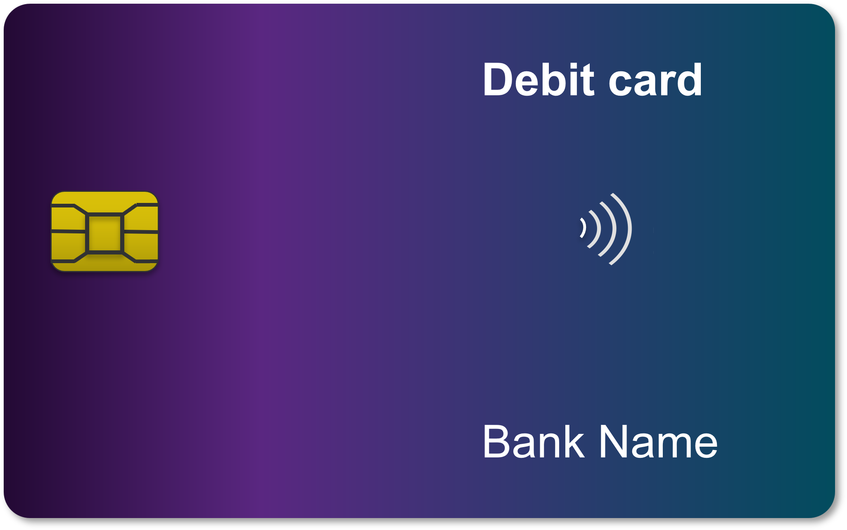
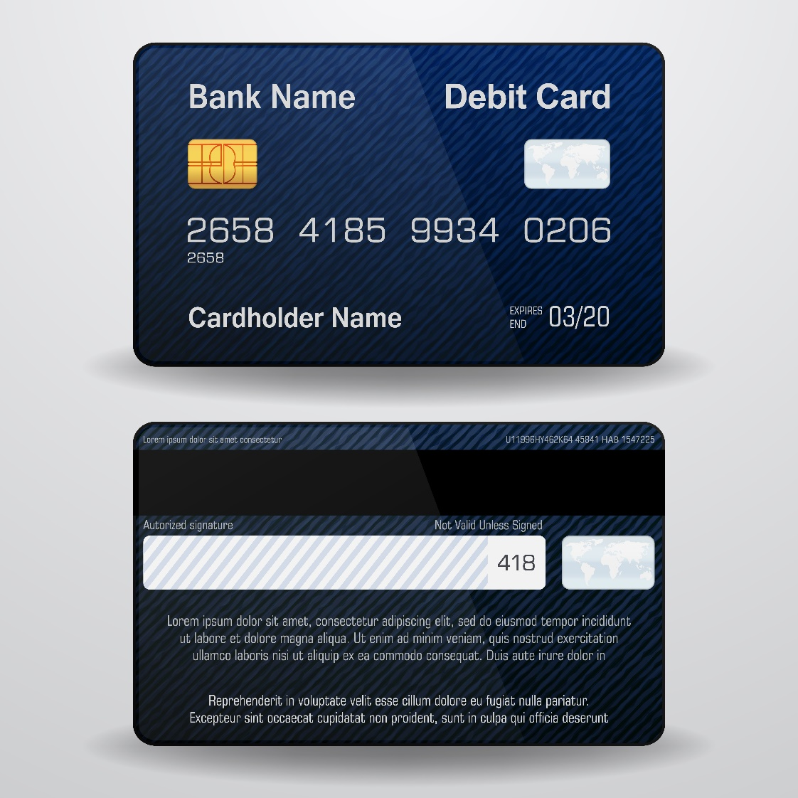
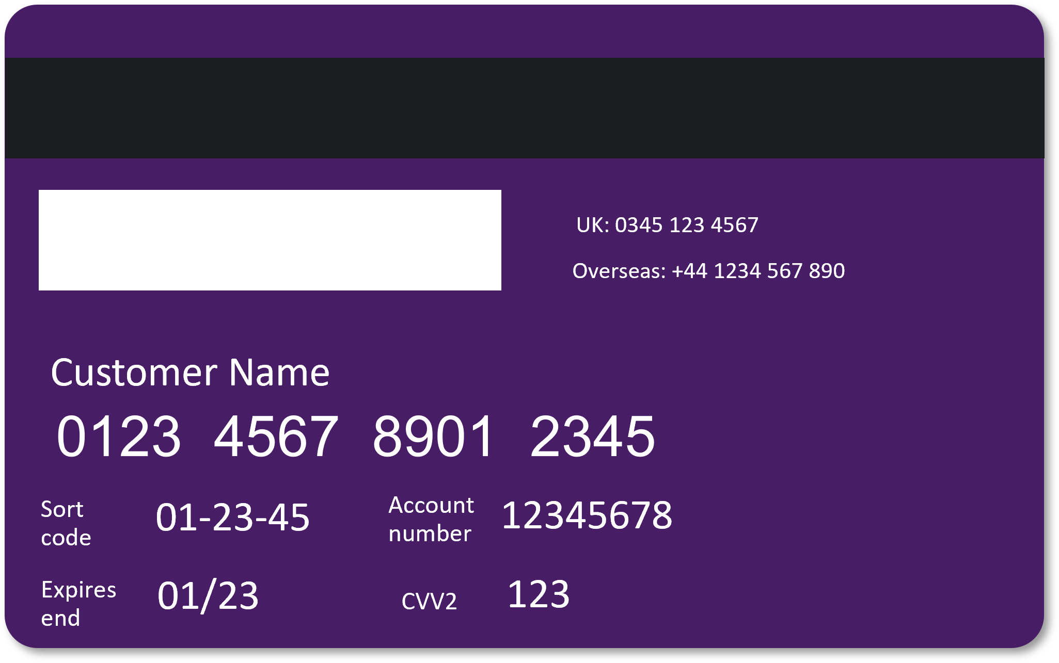
How to pay online: credit and debit cards
Notes:
TRAINER NOTE: ANIMATED SLIDE
There are different ways to pay online – let’s start by looking at cards. You can use bank cards (debit or credit) for instant transactions. For many years, this is what the cards have looked like – you may have one like this, with the long number on the front
(CLICK TO REVEAL ‘NEW-STYLE’ CARDS)
And this is what most new cards look like now – the banks have started putting all the information on the back of the cards as an added safety measure. So you may have one that looks like this
Either way, all the information that an online store needs is on your card
Let’s look at what this is … (LEADS INTO NEXT SLIDE)

Slide 13
How to pay online: credit and debit cards
1
2
3
1
2
3
Notes:
TRAINER NOTE: ANIMATED SLIDE - CLICK TO REVEAL EACH NUMBERED ITEM IN TURN
To process the payment, the website will need to know the type of card you’re using, together with:
The 16-digit long card number from the card (this is on the front of the older style cards and on the back of newer ones)
The expiry date
The 3-digit code/ CVV (Card Verification Value) code. This is on the back of the card

Slide 14

Other ways to pay online
Payment services
‘Buy now pay later’ schemes
£
Remember: check before
you pay!
Notes:
There are other ways to pay online
Payment services like PayPal, Google Pay, and Apple Pay may offer added security and convenience
Buy now, pay later options are sometimes available to spread costs. However, be careful with these as some can come with high interest rates and may end up costing you more. (We’ll talk about this in the next slide)
Before you give your payment details, always stop and check. Do you trust this site?
Let’s think about the pros and cons of the different ways to pay now … (LEADS INTO NEXT SLIDE)

Slide 15

Pros and cons
Debit cards
Credit cards
Payment services
Buy now pay later
Notes:
TRAINER NOTE: ANIMATED SLIDE (CLICK THROUGH EACH OF THE 4 OPTIONS AS YOU TALK THROUGH THESE IN TURN)
Debit cards transfer money directly from your bank account. This can make it easier to see exactly how much money you still have and whether you can afford it right now
Credit cards let you borrow and pay back later but may charge you interest, so you end up paying more. It's good to check the details if you're paying this way
Payment services can be a secure way to pay. Once set up, they're quick and easy to use as you don't need to keep typing in your card number
Buy now, pay later options can be quite appealing. But check the terms carefully. Some of these schemes charge a lot of interest, which can make that item very expensive in the long run. Plus, if you miss a payment, there are extra charges so you'll need to spend time and effort keeping on top of your payments

Slide 16
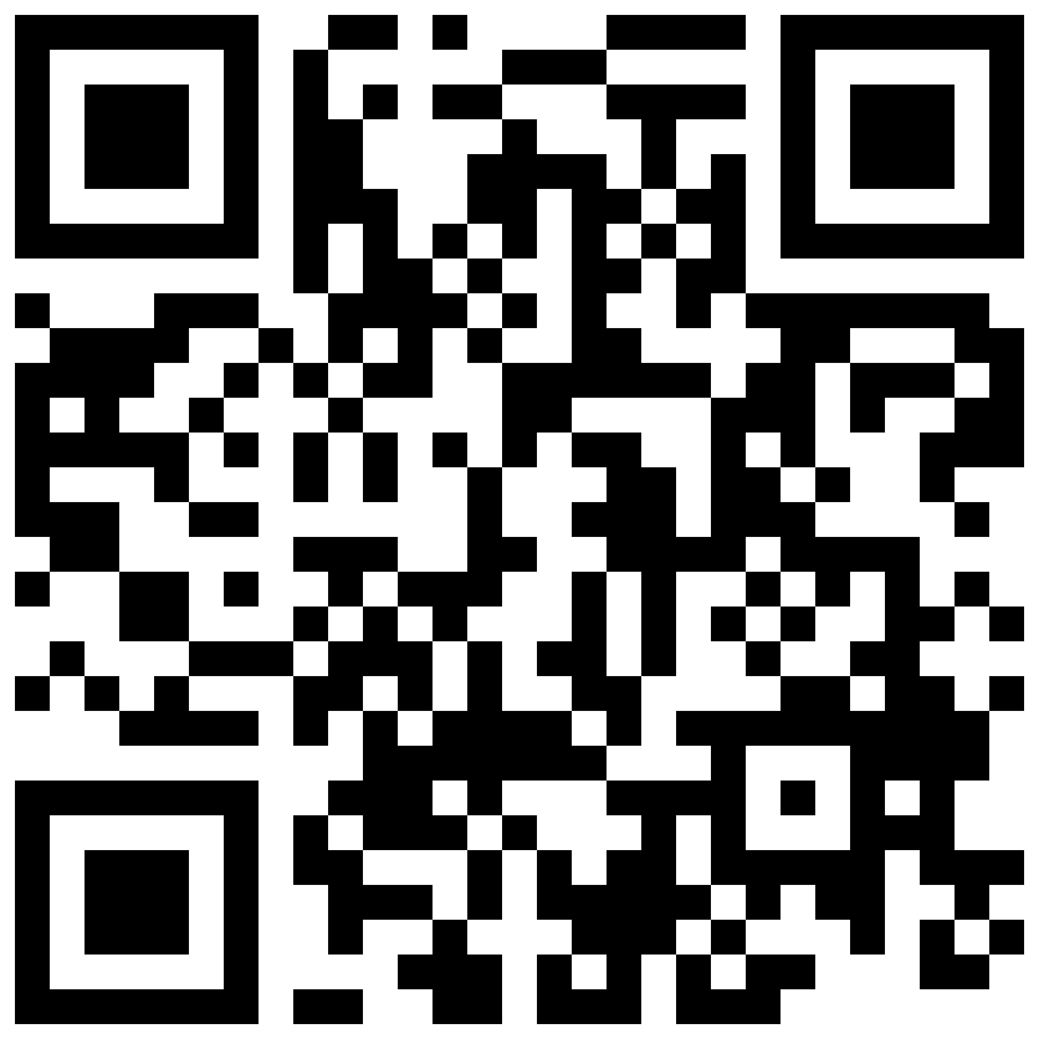
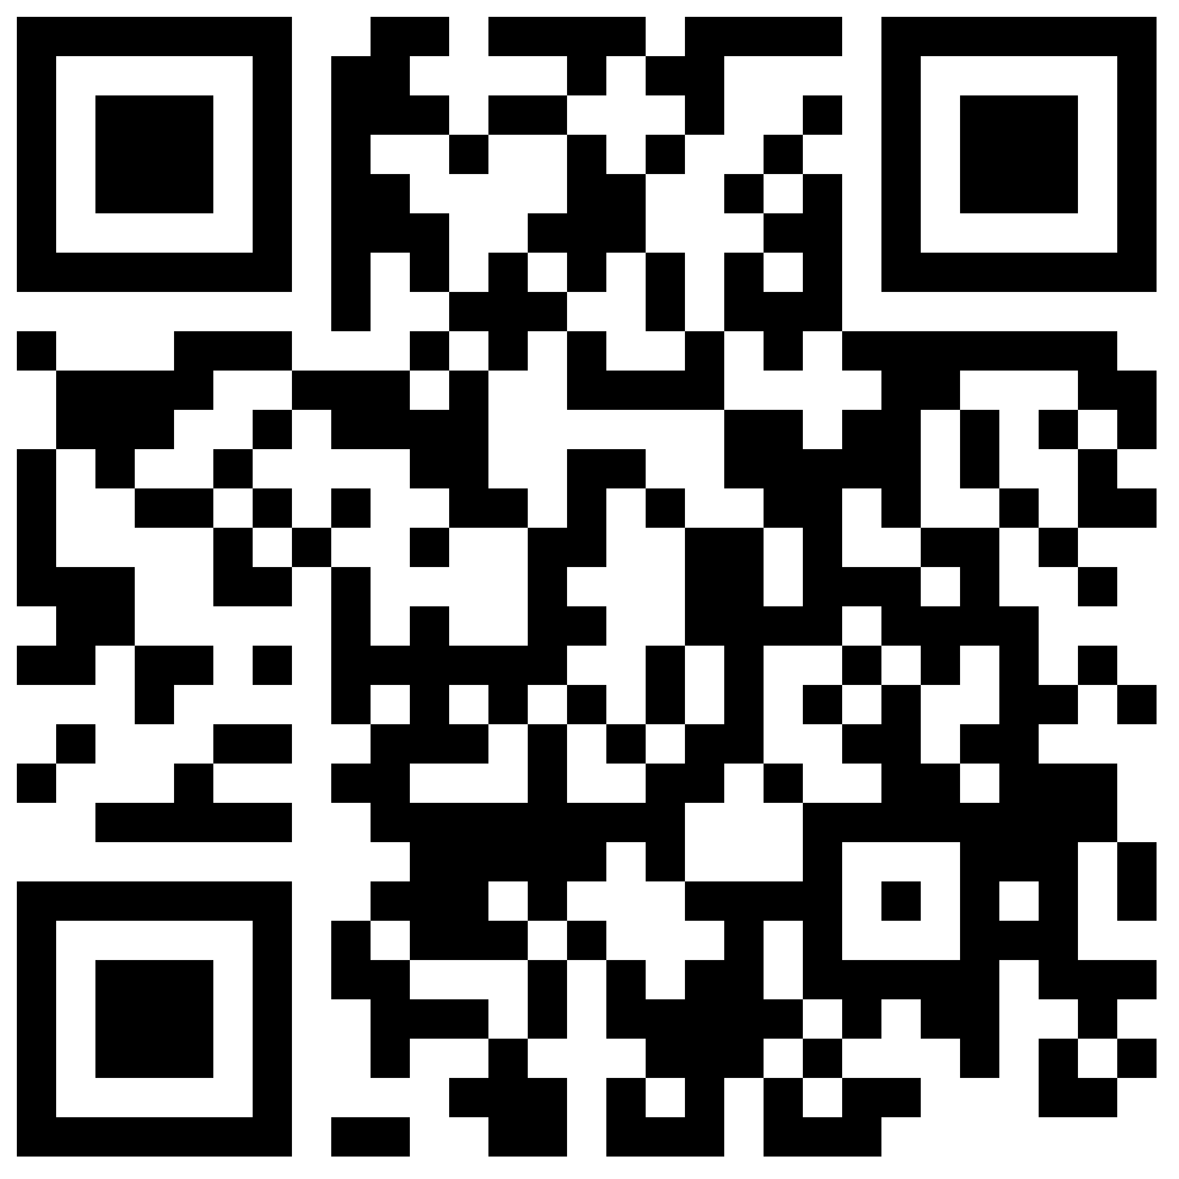
Online tools to help you budget
Citizens Advice
MoneyHelper
Notes:
Now we're going to explore online budgeting tools. These are online tools that can help you manage your finances better
The two sites we mention here are Citizens Advice and MoneyHelper. (We’ll show you one of these in a little more detail in a moment)
TRAINER NOTE – Demonstrate how to access QR codes if needed
Most banks also offer their own online budgeting tools
There are also other apps and software available that can help you do this
These tools make budgeting easier, helping you understand your income, expenses, and how much you could save with a plan for managing your ingoing and outgoings
Budgeting tools make it easy to manage your finances and reach your financial goals

Slide 17


Using these tools
Open the tool
List your income
List expenses
Tool works out balance
Find ways to reduce spending
Save with the remaining balance
Notes:
Now, let's look at the Money Helper tool, and how to use it
TRAINER NOTE – Demo with MoneyHelper (moneyhelper.org.uk/en/everyday-money/budgeting/budget-planner) if possible – if not, just talk through the steps here
I’ll demonstrate using the MoneyHelper budget planner. Here are the steps:
Step 1 – Open the MoneyHelper budget planner on their website
Step 2 – Start by adding up your income. That’s the money you have coming in. Include things like wages from work, pensions, or benefits (such as child benefit). If you get some money more irregularly, work out an average monthly amount noting down what you get each month for say 6 months then dividing it by 6 – or if you know what you’ve earned for the past 12 months, add it all up and divide it by 12. Some tools will do the working out for you here
Step 3 – Next, list your regular outgoings. These include things like rent/mortgage, bills, and insurance. Estimate changing expenses, such as groceries and petrol, by looking at past spending. Take a bit of time to think about all your regular expenses. This might include a gym subscription, streaming service or your mobile phone package
Step 4 – The planner will automatically calculate your balance, showing how much money is left after covering regular expenses
Step 5 – Examine your spending habits. Identify areas where you can cut back. Again, some tools will be able to help with this – like showing you where you’re spending most and offering hints and tips
Step 6 – Use the balance to build an emergency fund or save for future goals. It's good to think about what you might want to save up for - or to just know you've got a bit of money that's there if you need it for unexpected bills or repairs
TRAINER NOTE – Ask the learners what they might want to save for / what they think might happen that they'd suddenly need to pay for

Slide 18
Today you’ve seen how to:
Set up online banking
Start to bank online safely
Decide the way to pay online that's right for you
Use online tools to help you budget
Notes:
Let's take a moment to reflect on what you've accomplished today. You should now be able to
Set up online banking
Start to bank online safely
Decide the way to pay online that's right for you
Use online tools to help you budget
TRAINER NOTE – Prompt for any questions or feedback. Check their level of confidence in doing these in future, ask what they found most useful, anything they’d like to know more about (or to go through again before the lesson ends) and where they think they’ll need more practice

Slide 19
Any questions?
Notes:
TRAINER NOTE – Ask if they have any questions, comments or feedback that you can help with. You could consider this as an opportunity to check level of confidence in doing these in future, ask what they found most useful, anything they’d like to know more about (or to go through again before the lesson ends) and where they think they’ll need more practice.

Slide 20
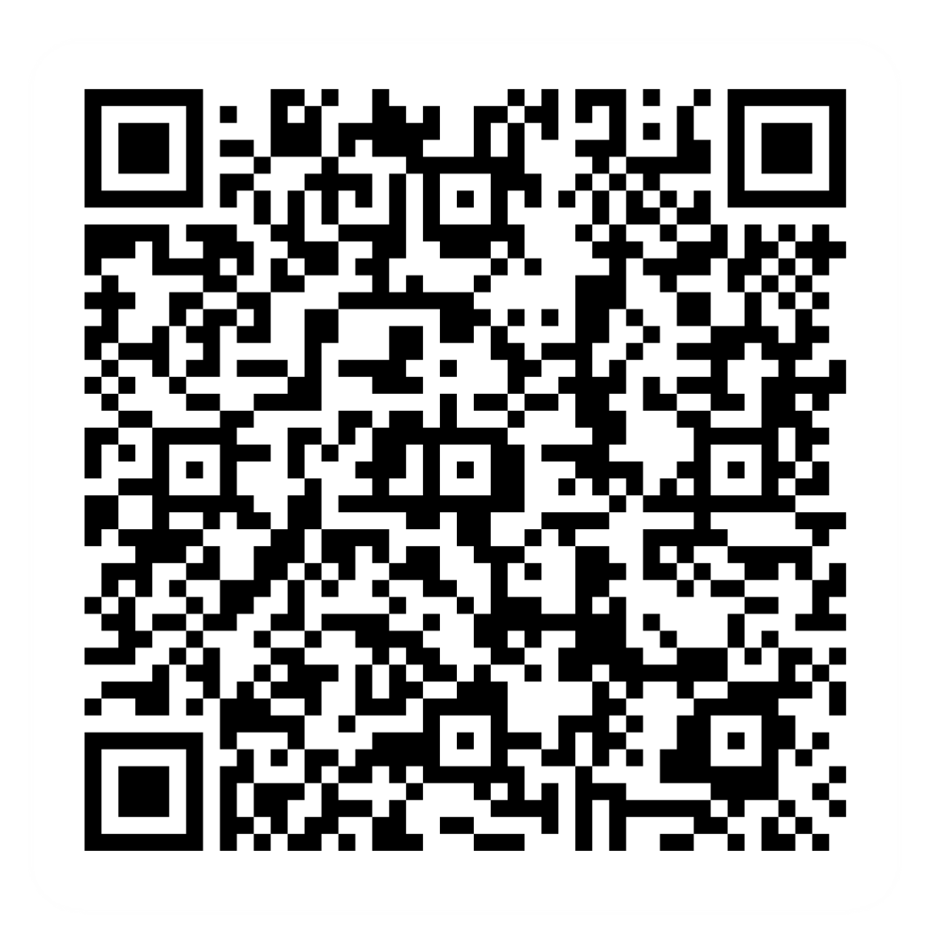
Post-session survey
Notes:
Encourage learners to scan the QR code here and complete our short post-session survey around levels of confidence now they have completed the training, plus any other comments or feedback about the session

Slide 21
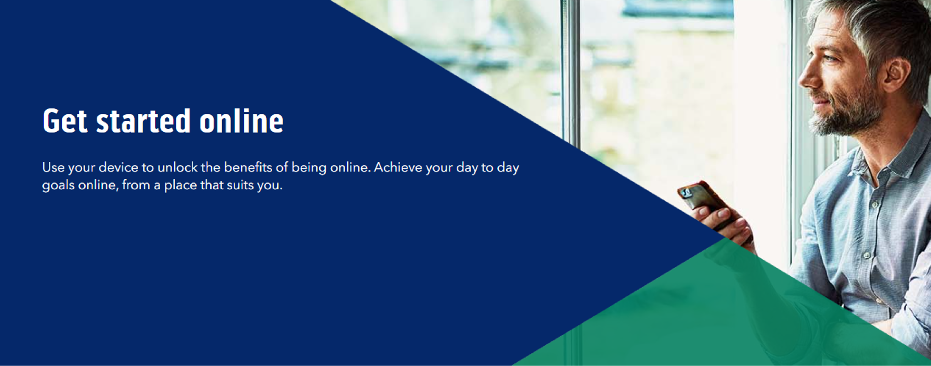
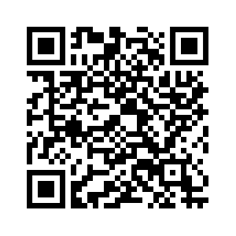
Notes:
Trainer notes
Signpost related content on the Academy website https://www.bankofscotlandacademy.co.uk/learn-for-life/get-started-online/
Alternatively, they could use their phone cameras to scan the QR code here.
If they don’t feel comfortable using this yet, then suggest they take our other lessons: “Connecting to the internet” and “ Stay safe online”, if you don’t know the next dates for these or how to help them sign up then speak to the Academy team before your session.
If part of a programme, share the date and topic of the next session
Resources:
Work out your budget (Citizens advice) https://www.citizensadvice.org.uk/debt-and-money/budgeting1/work-out-your-budget/
Budget Planner (Money Helper) https://www.moneyhelper.org.uk/en/everyday-money/budgeting/budget-planner

