Slide 1

Accessing local services online
Notes:
Open websites prior to the session:
(local council website); other local services sites – think about your learners, the type of services they might access offline currently and the services that are local to them and have a website / app
Check what Wi-Fi network is available, its name and any password required; write up / make available to the learners
Welcome people into the room
Introduce yourself
Make sure everyone is comfortable
Go to the next slide when you’re ready to start the lesson

Slide 2
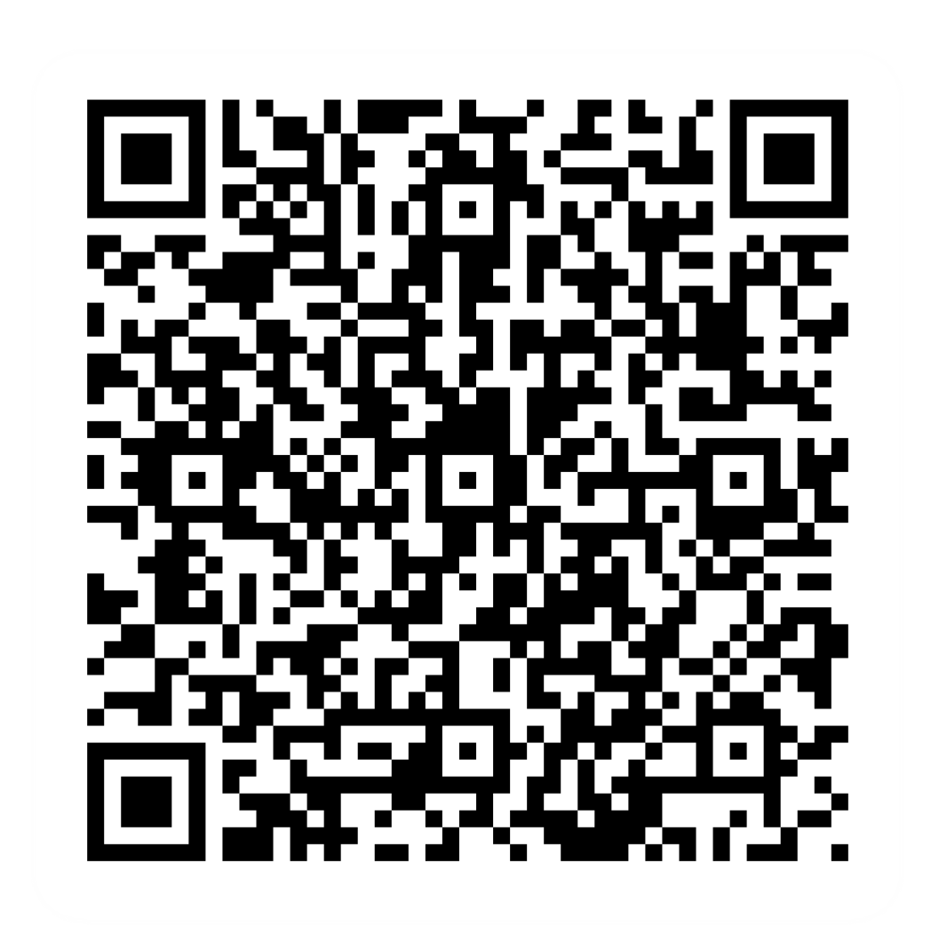
Pre-session survey
Notes:
Encourage learners to scan the QR code here and complete our short pre-session survey around levels of confidence in the session’s topics today, plus what they would like to get out of the session

Slide 3

Welcome
Notes:
TRAINER NOTES –
If this lesson marks the start of a programme, welcome people to the programme
If it is not, then welcome people to the lesson
Welcome to today’s lesson on accessing local services online
My name is _ and I’m here to help you today
We're excited to be here with you as you start to access and book services online
We want to make this learning experience practical, relatable, and, most importantly, helpful to you
In the room (or virtually) we also have [Any Co-Presenter's Name] who is here to help you during this session
TRAINER NOTE – for small groups / virtual sessions, learners could introduce themselves at this point
So, in today’s session, we'll help you discover the different types of services that you can access online and to be able to complete the required information to access or book these services
If you have your device with you, we’ll help you through the steps as you go
If you don’t have a device with you today, you can still learn what you can do when you use it next
As we go through today’s lesson, please do ask questions, and let us know if you need anything. If we can’t help today, we’ll make sure you get the help you need after the session
Let us know if we’re going too quickly, too slowly, or if you need a break. We want you to get the most out of today, so I’ll be guided by you

Slide 4

How to get the most from this session
Notes:
Before we begin, here’s a a few tips on how to get the most from this session
If we mention any resources during the session, we’ll share these with you at the end
We want this lesson to be as interactive as possible, so we’ll be asking questions as we go along – and we want you to ask lots of questions, too!
For this session, I'll be mostly asking for your own ideas, thoughts and suggestions. So think about your own experiences, and where you think online access might be an option
Sometimes we’ll have a short discussion about what we’re looking at, or we might move on. It will depend on how we’re doing for time
NOTE FOR VIRTUAL DELIVERY – Encourage people to comment and ask questions in the chat or experiment and try using the emojis. (Describe what an emoji is if needed)​ ​
To comment in the chat, find the chat box. It’s usually on the side or at the bottom of your screen. Click (or tap) in the chat box, enter your comment, and hit 'Enter' or 'Send.' Your message will then appear in the chat for everyone to see. It's a great way to ask us questions or share your thoughts during our session. So, feel free to chat away!​
We’d like to make today as interactive as possible to make your experience more interesting​, so we'll make sure you have time to pop your answer in the chat when I'm asking for your thoughts or ideas on a particular topic. NOTE: if the virtual group is small enough, also show / encourage the 'hands up and speak' option

Slide 5

Today we want to help you:
List services you can book online
Find and book local services
Access health services online
Notes:
So, here’s what we’d like you to get out of today. We want to help you:
List services you can book online
Understand how to find and book local services through different platforms
Discover how to access health services online
We'll help you gain the knowledge and skills to complete the required information to access or book these services
Bear in mind that every device is slightly different. Today we’ll share general steps, tips and what to look for
If you want more help doing any of the steps on your device as we go through, just let us know and we’ll give you a hand

Slide 6

Why access services online?
Notes:
Before we dive into the world of online services, let's set the scene. Think about your daily, weekly, and monthly tasks. From grocery shopping to booking appointments or paying bills, many of these can now be done online
Using these online services can save you time and make life more convenient. You can access information and complete tasks without leaving your home. It can also save you time if the alternative is phoning up and waiting in a queue for your call to be answered - for health and local council services for example. So, let's explore how to make the most of these services

Slide 7
What services can you access online?
Notes:
Let's discuss: What services do you think you can access online?
Share your ideas and experiences
TRAINER NOTE – Run a short discussion/chat-based activity

Slide 8

Some examples
Make an appointment
Book a trip or activity
Eat in – or out
Sign up to keep fit
Contact your council
Notes:
Let's see a few examples that we've come up with:
Make an appointment – You can schedule appointments with local businesses - like your GP, hairdresser, garage or optician
Book a trip or activity – Buy cinema, event, or travel tickets online
Eat in or out – Whether you're booking a table at the local restaurant or ordering a takeaway
Sign up to keep fit – Sign up for the gym or fitness classes online
Contact your council – Apply for housing benefit, find a local school, pay your council tax, or request pest control services
TRAINER NOTE – Ask learners what kind of thing they contact their council about, and use their answers to show how much of this can be done online

Slide 9

How to access local services online
Search by company name or type of service
Using apps / websites
Local council websites
Notes:
TRAINER NOTE: use this slide to list/introduce the different ways to find local services online – the subsequent slides will go in more detail for each one, with the option for learners to explore and practise
There are a few ways you can access services online
Searching by company name or type of service – You can search for local services like hairdressers, cinemas, gyms, or restaurants by typing their names in the search bar. If you don't have a named business in mind, but you know the kind of service you need, try typing, for example, 'gyms near me' in your search. You'll get a list of results and a map view, so you can see the nearest ones
Using apps/websites – Many businesses have apps or websites that allow you to book appointments, buy tickets, or order food online
Local council websites – Your local council's website provides various online services
Let’s explore each of these now ...

Slide 10

Search for a service
Search by name
or
Type ‘… near me’
Hairdressers
near me
Restaurants
Cinemas
Gyms
Notes:
TRAINER NOTE – Demo how to search by company name or type of service (e.g., for hairdressers, cinemas, gyms, or restaurants) and encourage learners to try this for themselves. Optional follow-up: if they find a particular site that they think they’ll use again, encourage them to ‘star’ or ‘bookmark’ that site
Enter the name of the business you're looking for in the search bar
Sometimes, you might not know the name of the business you are looking for. Other times, you might want to find things like a local hairdresser, restaurant, or gym close to where you are. To do this, you can type what you're looking for and add 'near me' at the end. For example, 'find a hairdresser near me' or 'restaurants near me.' This tells your device to look for these places in your current location
When you do this search, you'll see a list of businesses or places that match what you have typed. You can also see where they are on a map. This can be handy if you're not familiar with the area or just want to see what's near you
To learn more about a specific business, all you need to do is tap or click on it. You'll see more details like their address, contact information, and even reviews from other people. This can help you decide if it's the right place for you
'Near me' searches make it easy to find what you need, right where you are, without having to travel far. It's like having a local guide at your fingertips

Slide 11

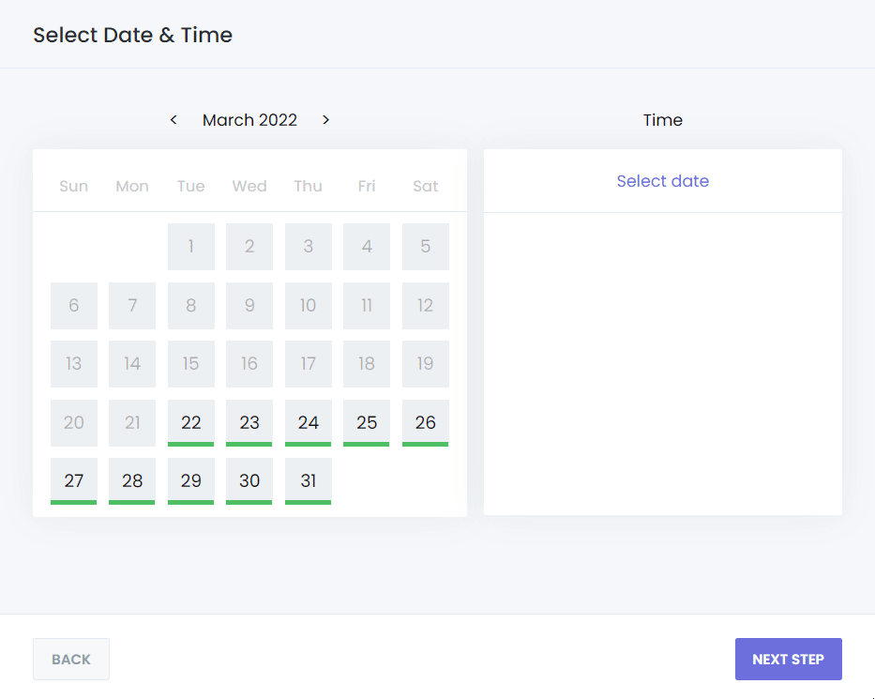

Using apps/ websites
Download app or visit website
See what options are available
Book or order what you need
Notes:
Let's see how to use apps and websites to find what you need
First, you'll want to download the app (if it's available) or visit the website on your device. To do this, go to the app store and search for the app, or open your web browser and type in the website's address
Once you're on the app or website, you'll see options for what they offer. To find what you're looking for, you can usually use a menu, tabs, or a search bar
Next, when you've found what you want, it's time to book or order. You should see a button that says something like 'Book Now' or 'Order.' Click or tap on that
You might need to provide some details. It could be as simple as picking the date and time you want or choosing from a list of services they offer. If there's a payment involved, you'll be asked to do that as well
After you've done that, you can expect a message telling you your order has been received. This might be a text message, an email, or a message within the app
So, it's about just a few things: finding, selecting, giving some info, and then waiting for that confirmation
TRAINER NOTE – Once you’ve gone through the generic steps, ask for suggestions of things the learners book locally that they may currently do by phone or in person (e.g. takeaway / restaurant booking, hair or eye test appointment, gym session or cinema tickets etc). Encourage them to explore the online (web / app) alternative and / or pick one of their suggestions and demo the process of booking online

Slide 12
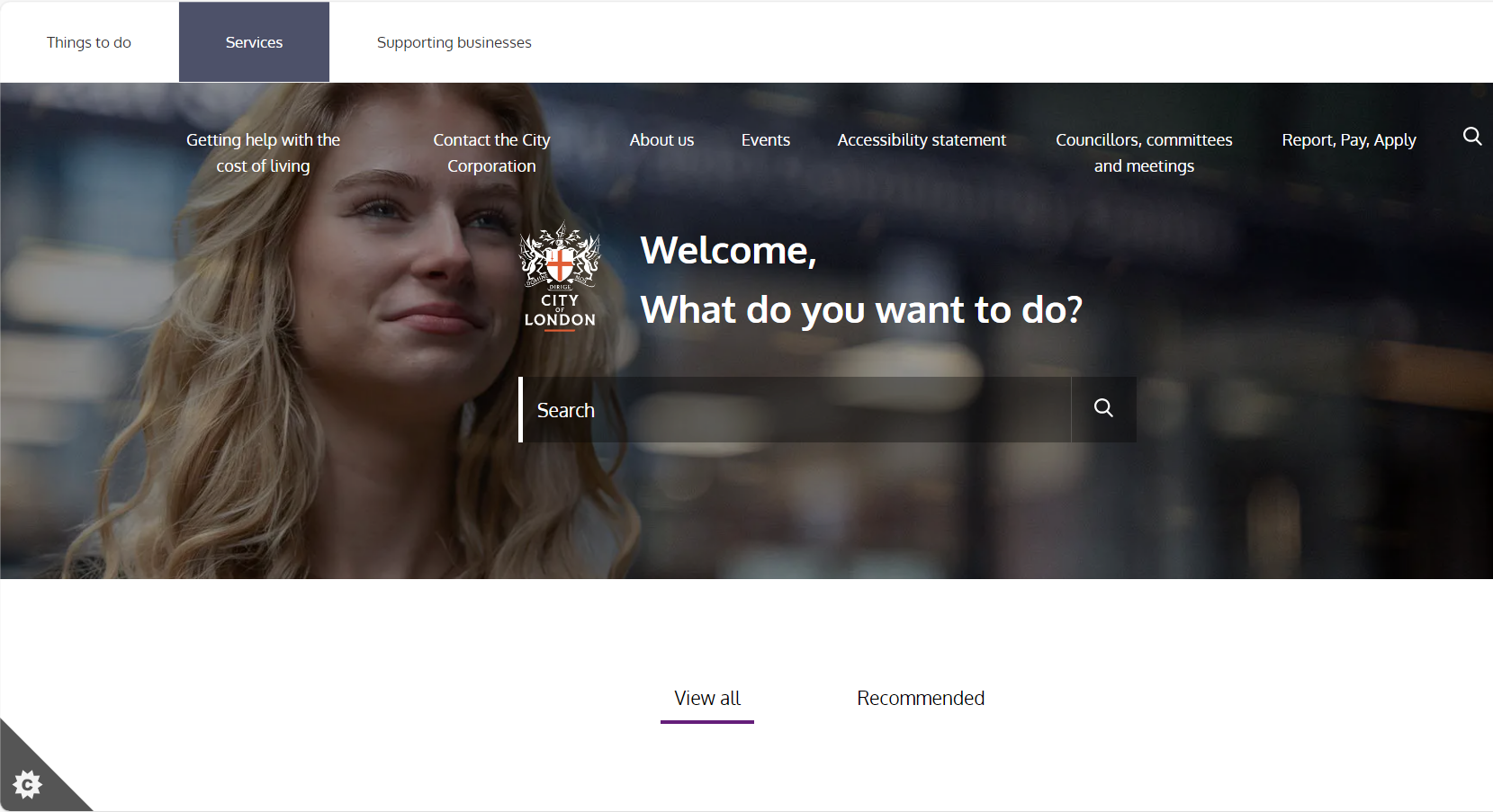
Local council websites
Visit your council's website
Find the service you need
Make your request
Notes:
TRAINER NOTE – Show examples of local council websites and the services they offer online (can be done as a demo; encourage learners to follow / explore)
Let's talk about using your local council's website. This can be a helpful place for various services, and I'll guide you through it:
First, visit your local council's website. You can do this by typing in your council's name or 'website' into your web browser
Once you're there, you'll want to find the service you need. Most council websites have a menu or tabs that help you navigate. You'll see things like 'Pay Bills' or 'Report Issues.' Just click on the one that matches what you're looking for
When you've found the service you need, you'll usually see an option to 'Make Your Request' (or something similar). This part is like filling out a form. You'll need to give them your details, like your name and address, and describe what you need. It's quite straightforward, and if you ever get stuck, they often have help sections that you can check
In short, it’s about visiting the website, finding the right service, and making your request by filling in a form

Slide 13

How to access health services online
Local health services
NHS websites and apps
Notes:
Let's now explore how to access health services online. It's a handy way to manage your health needs
You can access services from local health providers, like your GP, optician, or dentist, online. This means you can find these services, book appointments, and even order your prescriptions from the comfort of your own home (or wherever you are)
And when you're looking for reliable information about specific health conditions or symptoms, the NHS websites and apps are a great place to go. They're trusted sources that provide information, health advice, and details about local hospitals and other services

Slide 14

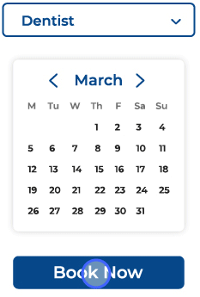
Local health services
Visit the website or download the app
See the services available
Book or order what you need
GP
Notes:
TRAINER NOTE – Demonstrate how to access local health services, e.g., GPs, opticians, dentists – to find a local service, appointment-booking, prescription ordering etc. Again, it may help to first ask what local services they currently book by phone / in person and use these examples to demo / encourage exploration
Accessing local health services online is about making your health needs more convenient
To start, you can either visit the website or download the app for your local health services
Once you're there, you'll want to see what services they offer. This includes checking their opening hours and contact information, which can be really useful
When you need to book an appointment or order a prescription, can be as simple as clicking the right options on the website or app. Choose what you need, confirm it, and you're all set. They'll usually send you a confirmation, like a text or email, so you know where you stand
Don't forget, you can (use ‘near me’ searches to) explore different healthcare providers in your area to find the one that suits you best

Slide 15
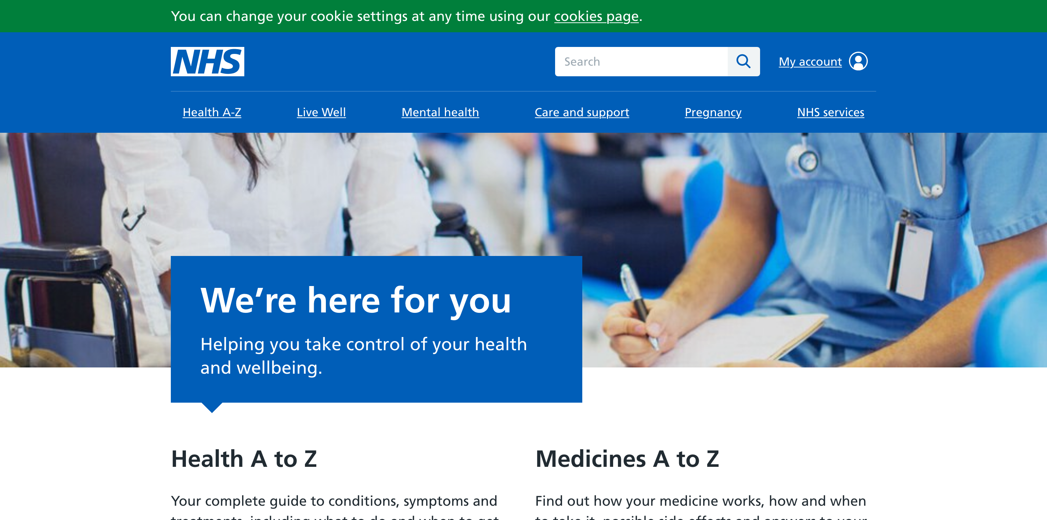
NHS websites and apps
Find info on health conditions
Get health advice
Look up local or UK healthcare services
Your NHS account
Notes:
TRAINER NOTE – Demonstrate NHS websites and apps (UK-wide / country-specific) – to find information about medical conditions, health advice, local hospitals and other healthcare services. A good example to use is: search ‘nhs’ from browser; go to the nhs website; use their search bar to type in ‘arm’; view result; select ‘elbow and arm pain’
Finally, let's explore the NHS websites and apps. They're a reliable source for all things health-related
First off, you can find information on health conditions. The NHS is generally the best place to look up symptoms or conditions you might be worried about. You can be sure the information here comes from trusted healthcare experts
You can also get general health advice, including what to do when you're not sure how to handle a health issue. The 111.nhs.uk site is helpful for this. It provides help when you it but aren't sure what to do
Now, if you're looking for local or UK healthcare services, you're in the right place. You can find a GP, see where you can get a flu jab, or manage appointments for treatments or procedures through their e-Referral service
Don't forget to create your NHS account. It's your key to accessing certain services. To set it up, you'll need your NHS number (if you know it), along with your name, address, and date of birth. This account can link to other services like prescription providers, your GP, and your health records. It's all about making your healthcare management easier
TRAINER NOTE – (If you haven’t already) do a ‘follow-me’ demo on how to access local/NHS health services online and save them as a favourite

Slide 16
Today you've seen how to:
List services you can book online
Find and book local services
Access health services online
Notes:
Let's take a moment to reflect on what you've accomplished today
We've explored various online services, from booking local appointments to accessing health information
You should now be able to
List services you can book online
Understand how to find and book local services through different platforms
Discover how to access health services online
The best way to learn is by doing. Try out what you've learned in this lesson
TRAINER NOTE – Prompt for any questions or feedback. Check their level of confidence in doing these in future, ask what they found most useful, anything they’d like to know more about (or to go through again before the lesson ends) and where they think they’ll need more practice
If you need further assistance or want to explore more, visit our Academy site. Specifically, check out the 'Introduction to Online Services' and 'Managing Your Healthcare Online' lessons

Slide 17
Any questions?
Notes:
Trainer NOTE – Ask if they have any questions, comments or feedback that you can help with. You could consider this as an opportunity to check level of confidence in doing these in future, ask what they found most useful, anything they’d like to know more about (or to go through again before the lesson ends) and where they think they’ll need more practice.

Slide 18
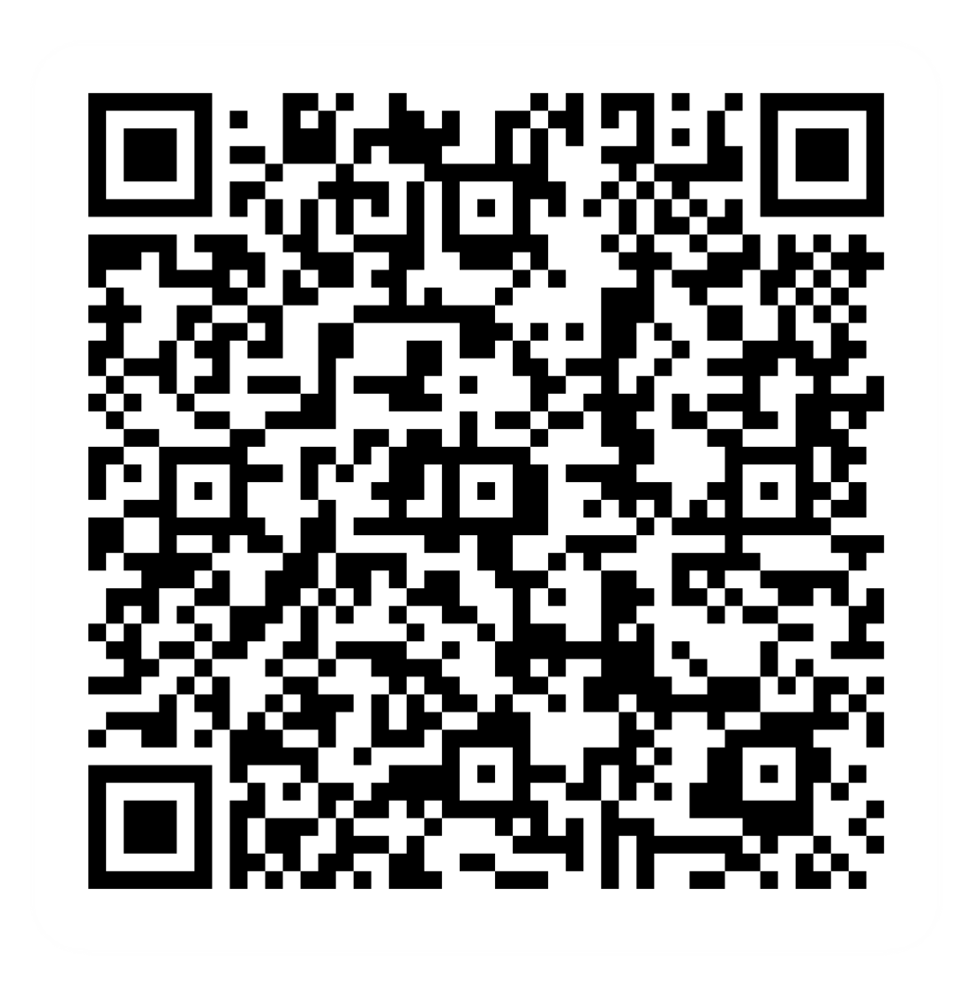
Post-session survey
Notes:
Encourage learners to scan the QR code here and complete our short post-session survey around levels of confidence now they have completed the training, plus any other comments or feedback about the session

Slide 19
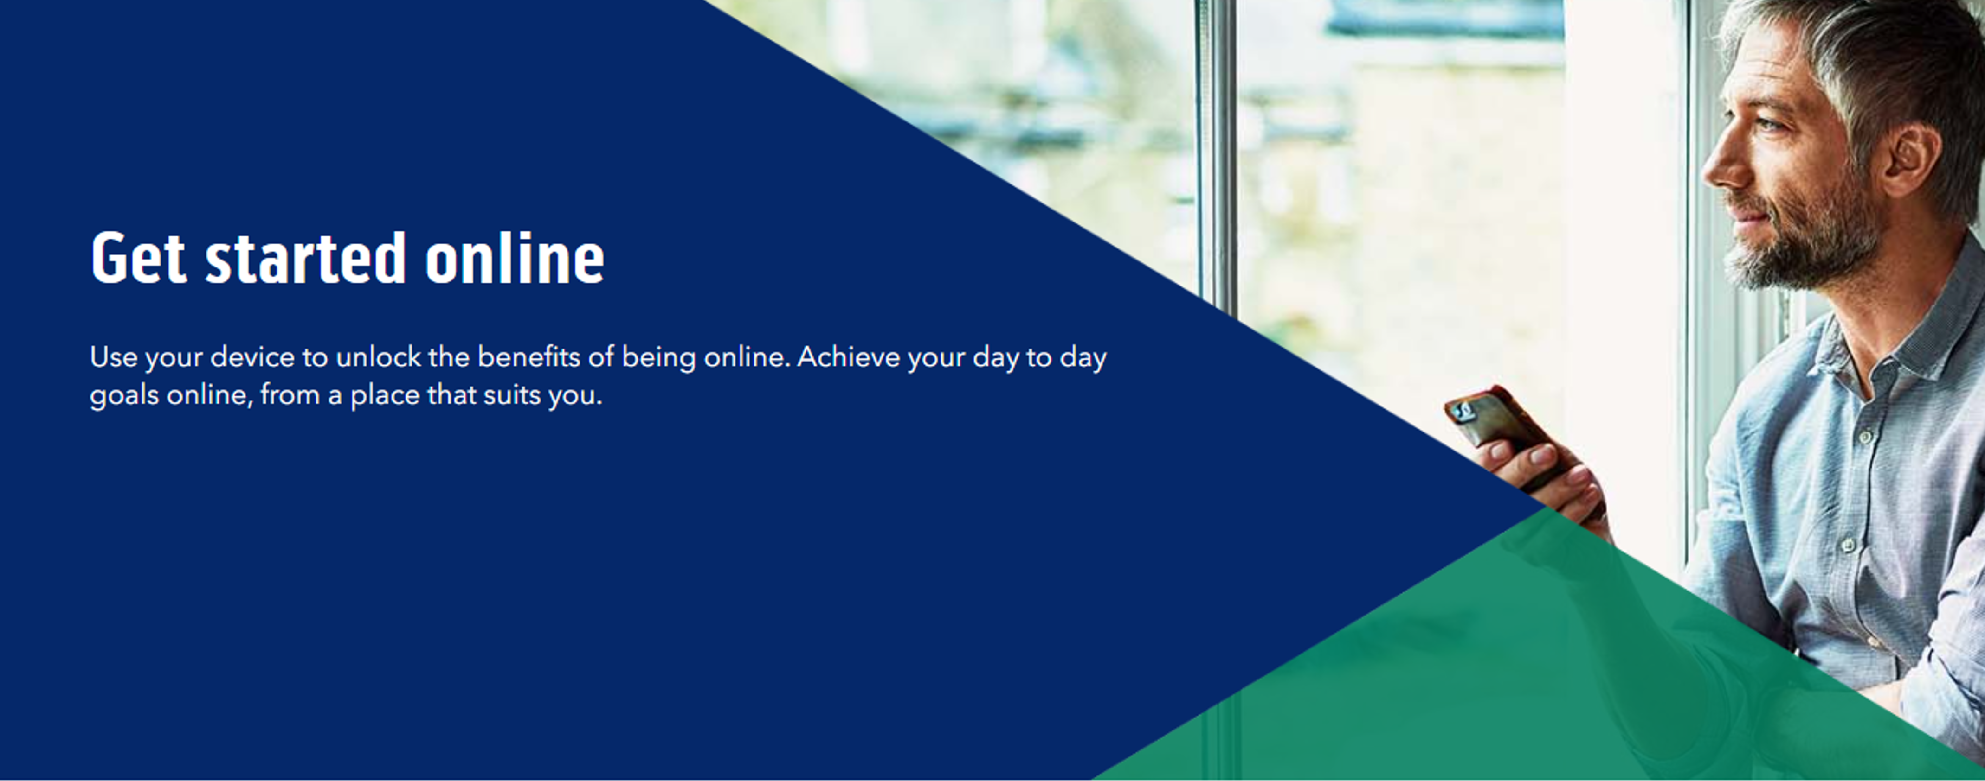
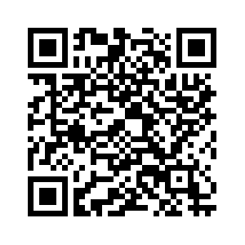
Notes:
Trainer notes
Signpost related content on the Academy website https://www.bankofscotlandacademy.co.uk/learn-for-life/get-started-online/
Alternatively, they could use their phone cameras to scan the QR code here.
If they don’t feel comfortable using this yet, then suggest they take our other lessons: “Connecting to the internet” and “ Stay safe online”, if you don’t know the next dates for these or how to help them sign up then speak to the Academy team before your session.
If part of a programme, share the date and topic of the next session

