Slide 1

Shopping online
Notes:
Check what Wi-Fi network is available, its name and any password required; write up / make available to the learners
Welcome people into the room
Introduce yourself
Make sure everyone is comfortable
Go to the next slide when you’re ready to start the lesson

Slide 2
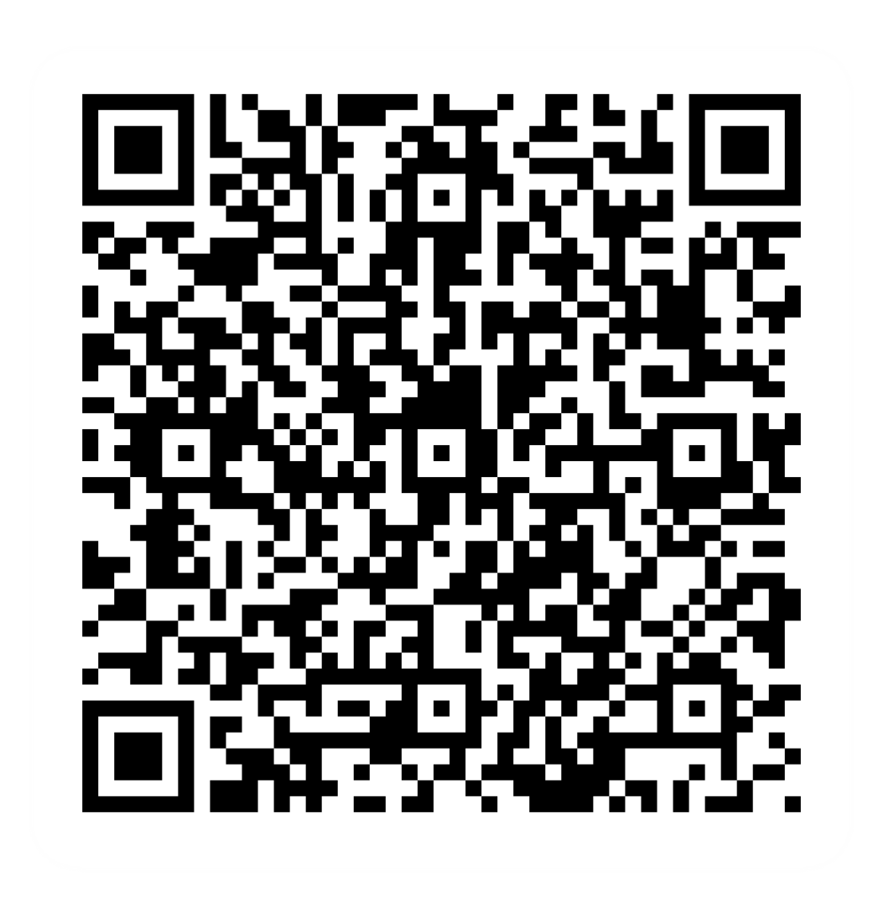
Pre-session survey
Notes:
Encourage learners to scan the QR code here and complete our short pre-session survey around levels of confidence in the session’s topics today, plus what they would like to get out of the session

Slide 3

Welcome
Notes:
TRAINER NOTES –
If this lesson marks the start of a programme, welcome people to the programme
If it is not, then welcome people to the lesson
Welcome to today’s lesson on shopping online
My name is _ and I’m here to help you today
We're excited to be here with you as you start to shop online
Before we get started, it’s worth noting that you don't have to replace your in-person shop with online shopping. Online shopping can be a helpful addition to the way you shop, or you can choose to do almost every type of shop you do online
We want to make today’s learning experience practical, relatable, and, most importantly, helpful to you
In the room (or virtually) we also have [Any Co-Presenter's Name] who is here to help you during this session
TRAINER NOTE – For small groups / virtual sessions, learners could introduce themselves at this point
So, in today’s session, we will walk you through the general steps to help you shop online. We'll also cover delivery options and how to stay safe and save money while you shop
If you have your device with you, we’ll help you through the steps as you go
If you don’t have a device with you today, you can still learn what you can do when you use it next
As we go through today’s lesson, please do ask questions, and let us know if you need anything. If we can’t help today, we’ll make sure you get the help you need after the session
Let us know if we’re going too quickly, too slowly, or if you need a break. We want you to get the most out of today, so I’ll be guided by you

Slide 4

How to get the most from this session
Notes:
Before we begin, here are a few tips on how to get the most from this session
If we mention any resources during the session, we’ll share these with you at the end
We want this lesson to be as interactive as possible, so we’ll be asking questions as we go along – and we want you to ask lots of questions, too!
For this session, I'll be mostly asking for your own ideas, thoughts and suggestions. So think about your own experiences, and where you think online access might be an option
Sometimes we’ll have a short discussion about what we’re looking at, or we might move on. It will depend on how we’re doing for time
NOTE FOR VIRTUAL DELIVERY – Encourage people to comment and ask questions in the chat or experiment and try using the emojis. (Describe what an emoji is if needed)​ ​
To comment in the chat, find the chat box. It’s usually on the side or at the bottom of your screen. Click (or tap) in the chat box, enter your comment, and hit 'Enter' or 'Send.' Your message will then appear in the chat for everyone to see. It's a great way to ask us questions or share your thoughts during our session. So, feel free to chat away!​
We’d like to make today as interactive as possible to make your experience more interesting​, so we'll make sure you have time to pop your answer in the chat when I'm asking for your thoughts or ideas on a particular topic. NOTE: if the virtual group is small enough, also show / encourage the 'hands up and speak' option

Slide 5

Today we want to help you:
Find and buy things online
Compare prices to choose where you shop
Shop online safely
Notes:
Here’s what we’d like you to get out of today. By the time we finish, you should feel able to shop online safely and confidently. We want to help you:
Find and buy things online – from searching for products and services through to paying for and getting them
Compare prices - just like shopping around, but from the comfort of your sofa. You can then decide the app or site you'll use to shop for a particular item
Know how to shop more safely online
Now, every device is slightly different, so today we’ll share general steps, tips and what to look for
If you want more help doing any of the steps on your device as we go through, just let us know and we’ll give you a hand
If you need more help with your type of device, we’ll share some useful resources at the end of the session

Slide 6
What can you buy online?
Notes:
Let's discuss: What can you buy online?
Share your ideas and experiences
TRAINER NOTE – Run a short discussion/chat-based activity

Slide 7
Some examples
Clothes
Electronics
Books
Groceries
Holidays
Entertainment
Notes:
Let's explore some examples of things you can buy online. Keep in mind you can find a wide range of goods and services online. Most of what you need is just a click (or tap) away. Here are just a few examples:
Clothes – Explore endless options in size, colour, and style. Whether it's comfy casual wear, clothes for work, or fun costumes, you'll find it online. Many high street clothing shops (like Matalan, Next, and New Look) also have websites and apps, and you may find there’s a wider range online compared with their high street stores. So if your local store doesn't have those shoes in your size, try their website! There are also online only options such as Asos and boohoo.com
Electronics – Upgrade the technology in your home with online purchases. From televisions to game consoles and ‘smart’ devices, both high street retailers with online platforms and online-only stores offer a range of options. Sites like Currys, Amazon, and AO all sell electronics
Books –Immerse yourself in the world of literature. Whether you prefer physical copies or digital versions, there's something for every book lover. There are online-only options like Bookshop.org alongside well-known high street choices such as WHSmiths or Waterstones
Groceries – Simplify your life by ordering groceries online. Choose between in-store pickup or convenient home delivery. These include big supermarkets like Tesco, Sainsbury's, and the online-only Ocado
Holidays and mini breaks – Plan your getaway from the comfort of your home. Book flights, accommodations, or appointments online. Examples include booking.com, lastminute.com, and the AirBnB app
Entertainment, You can spend your leisure time with online options. Enjoy streaming subscriptions like Netflix, Disney+ or Amazon Prime . Additionally, explore music streaming services like Spotify and Apple Music. Don't forget, you can also buy cinema, theatre, or event tickets online, either directly from the venue or through official ticket sellers like Ticketmaster or SeeTickets
Now, let's hear from you. What's on your (online) shopping list? Feel free to share. We'll look at how to buy online shortly
TRAINER NOTES –
Ask learners what kind of thing they want to buy online, and use their answers to show how much of this can be done online
Encourage people to ask if they have specific items or questions about certain products Give examples here - maybe a mix of high street retailers with websites/apps plus some online-only examples

Slide 8

How you buy online
Websites
Apps
Online marketplaces
Notes:
Let's explore some of the various ways you can dive into the world of online shopping. Knowing your options can boost your confidence and make your online shopping experience even more enjoyable
Here are some of the ways you can buy goods and services online:
Websites on any device – Accessing online stores through the websites of your favourite retailers is an option that gives you a lot of options. Whether you're using a computer, laptop, or any device with internet access, this method offers direct links through search engines, plus you don’t need to download anything
Mobile apps on your smartphone or tablet – For a more tailored and mobile-friendly experience, many online stores have an app to help you shop. These are designed specifically for smartphones or tablets, providing a user-friendly interface. Not all retailers have apps, but for those that do, it can make the shopping process a lot easier
Online marketplaces – Imagine an online market with various stalls, each run by different sellers. That's essentially how online marketplaces like Amazon, eBay, Etsy and Vinted work. They are one-stop-shops where many different sellers offer their products.
Each of these methods has its own advantages, and the best choice might depend on what it is you are buying
Knowing where and how to shop online will make it easier and more useful for you
If you have a specific device or platform you're interested in, please feel free to ask. Your online shopping journey is about to get even more exciting!

Slide 9

The buying process
Find
Notes:
TRAINER NOTE – Demo the buying process on a commonly used site such as Amazon. Encourage learners to follow along (if they can)
Now, let's look at the buying process when shopping online
The first thing you'll need to do is find the things you want to buy. You can do this by searching on a website or app
TRAINER NOTE – Question/prompt the learners to think about how they’d search for what they need
Look out for the search icon – it's often an easily recognisable magnifying glass

Slide 10

The buying process
Find
Add
Notes:
TRAINER NOTE – Demo the buying process on a commonly used site such as Amazon. Encourage learners to follow along (if they can)
Once you've found the things you’re looking for, add them to your basket
You can repeat these two steps – searching for what you want then adding to your basket – until you’ve found everything you want to buy

Slide 11

The buying process
Find
Add
Check
Notes:
TRAINER NOTE – Demo the buying process on a commonly used site such as Amazon. Encourage learners to follow along (if they can)
Once you’ve finished adding items, check your basket to make sure you've put the right items and quantities in there
At this stage, if something's not quite right, you can change it. So if you can see quantity is two but you only want one of this item, you can change it. Or if you decide you don't want to buy something, you can clear it out of your basket completely

Slide 12

The buying process
Find
Add
Check
Checkout
Notes:
TRAINER NOTE – Demo the buying process on a commonly used site such as Amazon. Encourage learners to follow along (if they can)
When you're happy with the things in your basket, head to the checkout, just like you would in a physical store
If you’ve changed your mind on something you have already added to your basket, no problem, you can make changes at this stage. Whether it's adjusting quantities or removing an item, you have flexibility

Slide 13

The buying process
Find
Add
Check
Checkout
Details
Notes:
TRAINER NOTE – Demo the buying process on a commonly used site such as Amazon. Encourage learners to follow along (if they can)
At the check-out stage, you'll need to provide your details for the purchase. This will include things like your delivery address and payment information
During the checkout, you'll often be able to choose a delivery option. This could include standard, next-day, or named day delivery, as well as options for collection from a store or an alternative pickup point. Bear in mind that the delivery costs may vary depending on which option you pick

Slide 14
The buying process
Find
Add
Check
Checkout
Details
Pay
Notes:
TRAINER NOTE – Demo the buying process on a commonly used site such as Amazon. Encourage learners to follow along (if they can)
Choose your preferred payment method. Depending on the site, you may see different payment options available. These include credit or debit cards, payment services like PayPal, GooglePay, ApplePay, and 'buy now, pay later' or pay-in-instalments options. Keep in mind that some options may come with additional costs, so it's good to be aware of them

Slide 15
The buying process
Find
Add
Check
Checkout
Details
Pay
Confirm
Notes:
TRAINER NOTE – Demo the buying process on a commonly used site such as Amazon. Encourage learners to follow along (if they can)
Finally, once you’ve made your choices, confirm the purchase. After this step, you'll can usually expect to receive a confirmation email

Slide 16

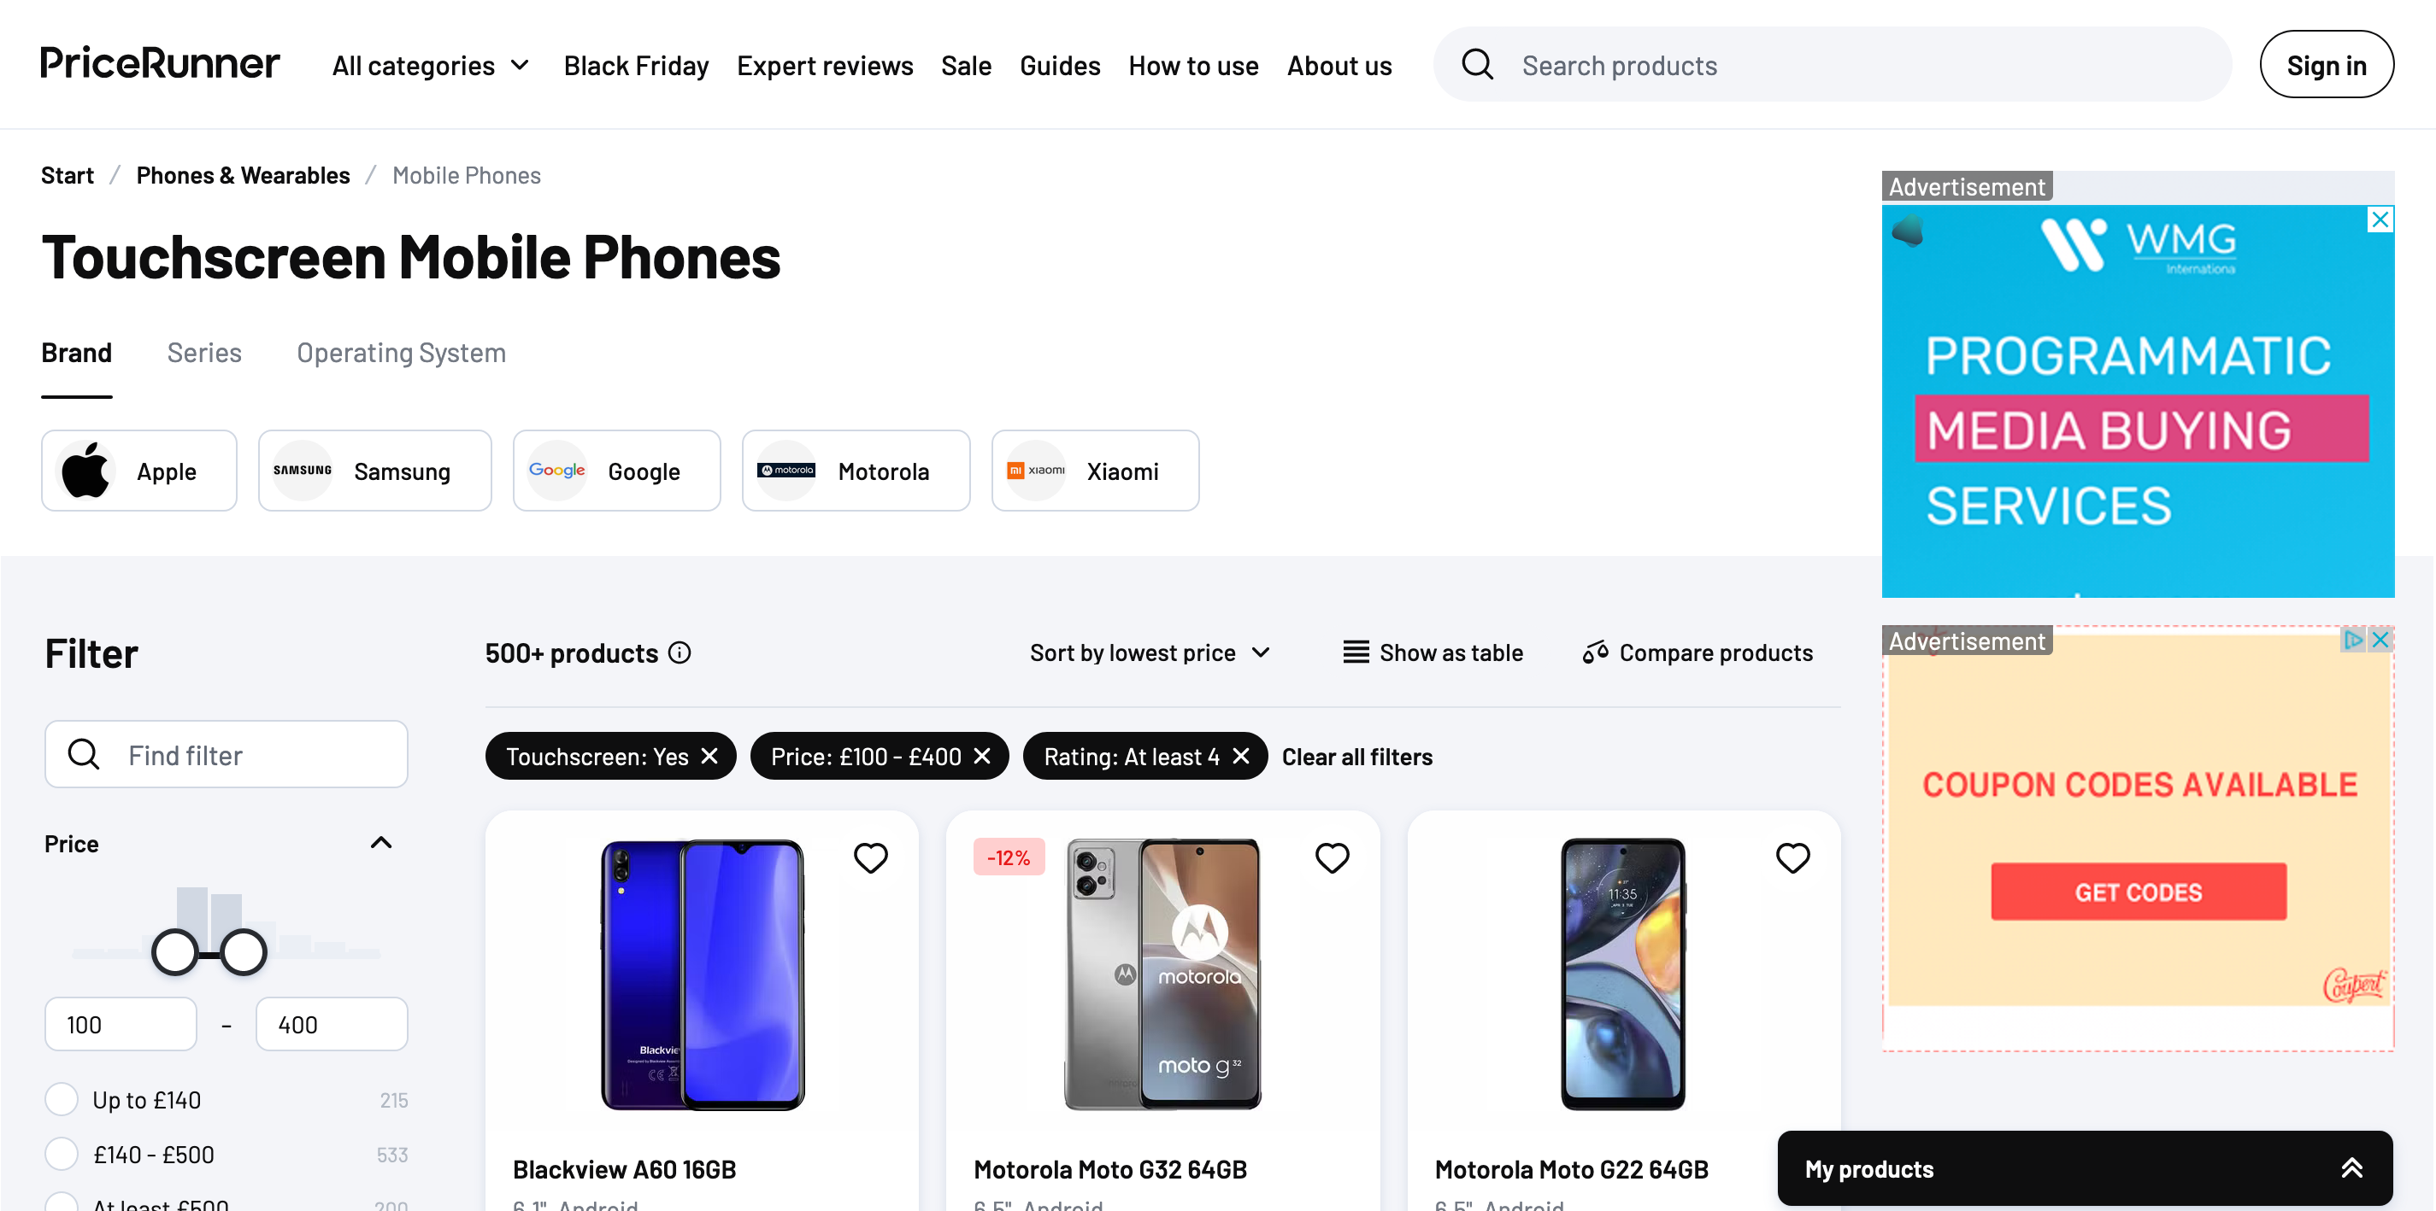
Using comparison sites
Visit comparison site
Enter product or service
Browse options and filter by preferences
Compare prices, features, and customer reviews
Select the best option for you
Follow the link to the seller
Notes:
TRAINER NOTE – Demo how to use comparison site. Encourage learners to follow along
Now, let's talk about using comparison sites to make our money go further when shopping online. Comparison sites are a great tool to help you find the best deals
Visit a comparison site of your choice – Choose a comparison site that suits your needs. Some general examples include Google Shopping, PriceRunner, and Kelkoo. Plus, there are sites that focus on certain things like insurance, travel, and holidays
Enter the product or service you want to compare. - Type in what you're looking for; for example, 'air fryer' or 'mobile phone'. The more specific you are, the more relevant your results will be . For instance, you might say 'iPhone 14' instead of 'mobile phone.' If you have a certain make or model in mind, naming it can give you more relevant results quicker
Browse through the options and filter by your preferences. Explore the options presented to you and use filters to narrow your search. Most comparison sites allow you to set preferences like price range, helping you stick to your budget, or sorting by customer reviews to check what you’re buying is of the quality you’d expect. Some comparison sites let you sort results by 'base price' (excludes postage) or 'total price' (includes postage) - this can help you decide whether you want to buy online or in-store
TRAINER NOTE – Demo how filtering works, such as setting a minimum and maximum price, or searching by brand
Compare prices, features, and customer reviews. Take your time to compare the options you are shown. Look for details about the product, prices, and what other customers have to say
Select the best option for your needs. Once you've compared, choose the option that suits you best
Follow the link to the seller. Comparison sites usually provide direct links to the seller's website, making it easy to go and buy what you were looking for
TRAINER NOTE – Demo clicking through on to the seller’s website, but stop there

Slide 17

Keeping safe when you shop online
Use safe websites
Keep your account details safe
Avoid public Wi-Fi when paying online
Pick a secure payment option
Notes:
Now, let's look at how to keep yourself safe when shopping online. It's important to protect your information for a secure shopping experience
Use safe websites. Make sure you're using a known site with a good reputation. Look for the padlock symbol in the browser's address bar. This indicates a secure connection. Plus, check for 'https' in the URL, and verify the site's address and reviews on platforms like TrustPilot or Google
TRAINER NOTE – Point out the padlock symbol in the browsers address bar – mention that a padlock you see elsewhere on the retailers screen may not mean anything at all
Keep your account details a secret and avoid using the same usernames and passwords across different sites.
TRAINER NOTE – Check whether or not learners know/remember what makes a strong password. If the answers are vague, quickly run through the following
Choose a unique combination of letters, numbers, and symbols and remember to change it from time to time to keep your account extra safe
Here’s a tip for strong passwords: 'Think of three short words, string them together and pop in some numbers
Avoid sharing payment information when you’re on public Wi-Fi. When shopping online, use secure, private connections or your phone’s data
Understand different payment options and what they do to make and keep your payments and details safe. Different payment methods offer various levels of security. Be aware of options like 'Verified by Visa' or 'Secure Code' for extra checks. If given a choice, some methods may be more secure than others. Platforms like PayPal provide additional security compared to direct money transfers

Slide 18
Today you've seen how to:
Find and buy things online
Compare prices to choose where you shop
Shop safely online
Notes:
Let's take a moment to reflect on what you've accomplished today
We've explored various online services, from booking local appointments to accessing health information
You should now be able to
Start shopping online – from finding products and services, to adding them to your basket, and how to check out and pay
Compare prices to choose where you shop
Stay safe when shopping online
The best way to learn is by doing. Try out what you've learned in this lesson
TRAINER NOTE – Prompt for any questions or feedback. Check their level of confidence in doing these in future, ask what they found most useful, anything they’d like to know more about (or to go through again before the lesson ends) and where they think they’ll need more practice
If you need further assistance or want to explore more, visit our Academy site. Specifically, check out ‘Shopping online' lesson
MODERATOR NOTE – Share in chat: www.bankofscotlandacademy.co.uk/learn-for-life/get-started-online

Slide 19
Any questions?
Notes:
Trainer NOTE – Ask if they have any questions, comments or feedback that you can help with. You could consider this as an opportunity to check level of confidence in doing these in future, ask what they found most useful, anything they’d like to know more about (or to go through again before the lesson ends) and where they think they’ll need more practice.

Slide 20
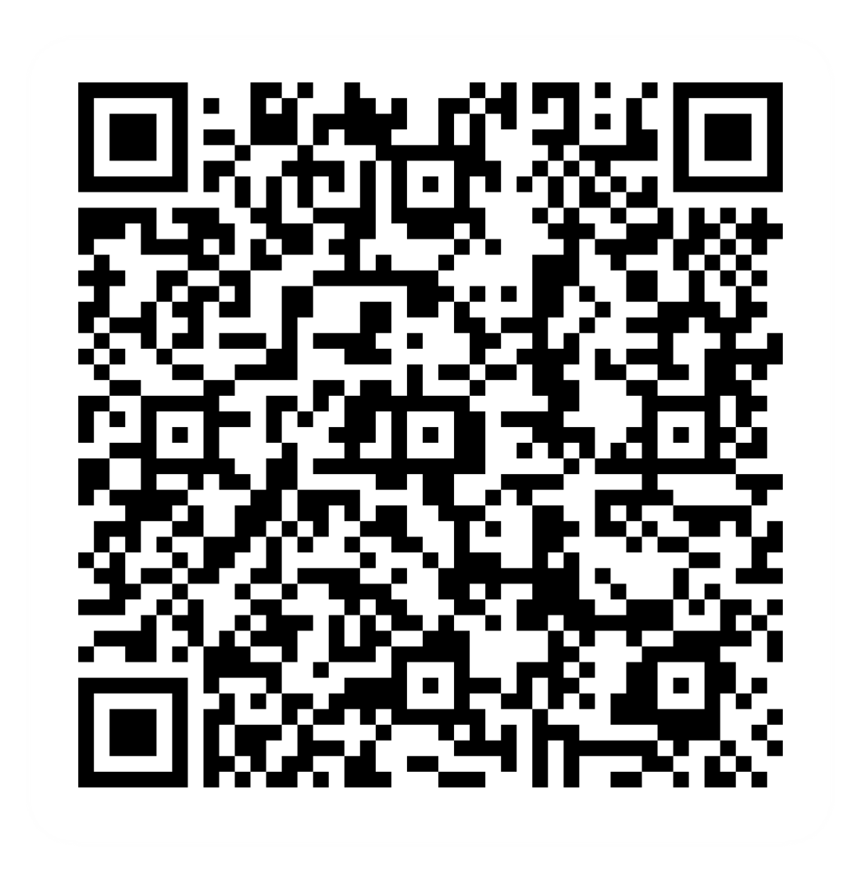
Post-session survey
Notes:
Encourage learners to scan the QR code here and complete our short post-session survey around levels of confidence now they have completed the training, plus any other comments or feedback about the session

Slide 21

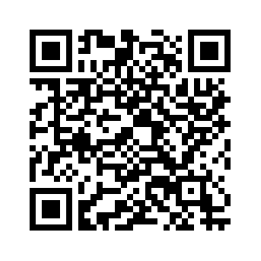
Notes:
Trainer notes
Signpost related content on the Academy website https://www.bankofscotlandacademy.co.uk/learn-for-life/get-started-online/
Alternatively, they could use their phone cameras to scan the QR code here.
If they don’t feel comfortable using this yet, then suggest they take our other lessons: “Connecting to the internet” and “ Stay safe online”, if you don’t know the next dates for these or how to help them sign up then speak to the Academy team before your session.
If part of a programme, share the date and topic of the next session

