Slide 1

Managing bills and utilities online
Notes:
Check what Wi-Fi network is available, its name and any password required; write up / make available to the learners
Welcome people into the room
Introduce yourself
Make sure everyone is comfortable
Go to the next slide when you’re ready to start the lesson

Slide 2
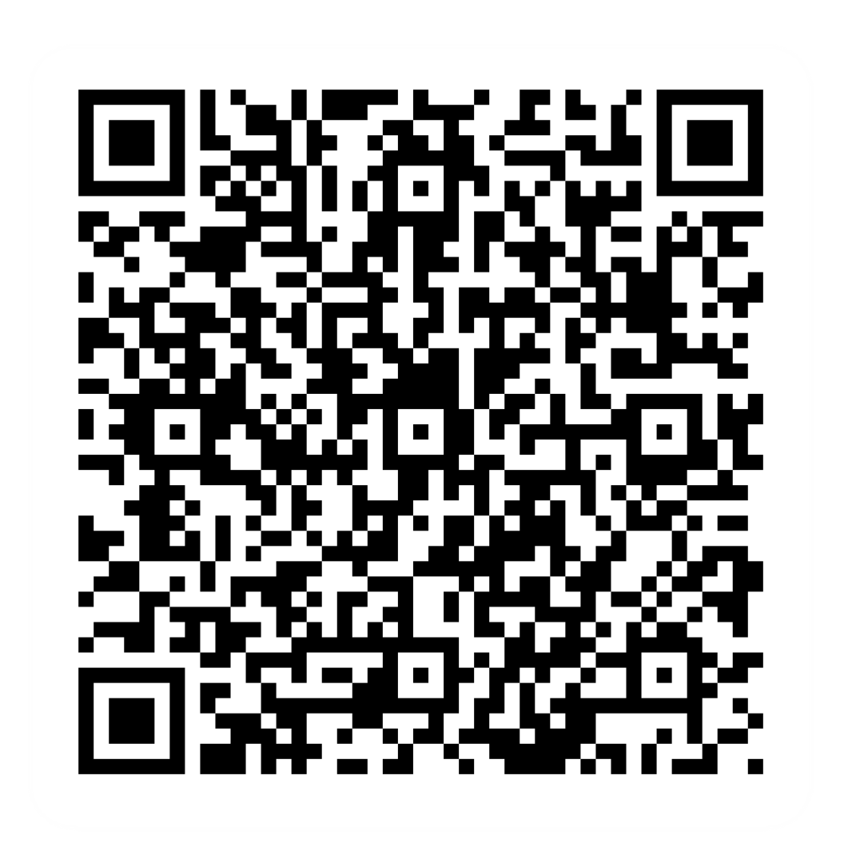
Pre-session survey
Notes:
Encourage learners to scan the QR code here and complete our short pre-session survey around levels of confidence in the session’s topics today, plus what they would like to get out of the session

Slide 3

Welcome
Notes:
TRAINER NOTES –
If this lesson marks the start of a programme, welcome people to the programme
If it is not, then welcome people to the lesson
Welcome to today’s lesson on managing your bills at utilities online
My name is _ and I’m here to help you today
We're excited to be here with you to explore the benefits of managing your bills online and help you access and manage various utility accounts from the comfort of your home
We want to make today’s learning experience practical, relatable, and, most importantly, helpful to you
In the room (or virtually) we also have [Any Co-Presenter's Name] who is here to help you during this session
TRAINER NOTE – For small groups / virtual sessions, learners could introduce themselves at this point
This session will help you with the skills to access and manage a wide range of utilities and services from the convenience of your own devices – from council tax to phone bills, from insurance to entertainment bills, we've got you covered
Whether you have your device with you today or not, we're here to help. If you do have it, we'll walk you through the steps. If not, don't worry; you can still learn the ropes for when you use it next
As we go through today’s lesson, please do ask questions, and let us know if you need anything. If we can’t help today, we’ll make sure you get the help you need after the session
Let us know if we’re going too quickly, too slowly, or if you need a break. We want you to get the most out of today, so I’ll be guided by you

Slide 4

How to get the most from this session
Notes:
Before we begin, here’s a a few tips on how to get the most from this session
If we mention any resources during the session, we’ll share these with you at the end
We want this lesson to be as interactive as possible, so we’ll be asking questions as we go along – and we want you to ask lots of questions, too!
Sometimes we’ll have a short discussion about what we’re looking at, or we might move on. It will depend on how we’re doing for time
Remember, it's all about learning together, so ask away and don’t worry about how your question sounds, or getting the right answer – Spoiler alert: sometimes there’s no single right answer. It's your thoughts that matter most. And we're here to make your experience as easy and enjoyable as possible
NOTE FOR VIRTUAL DELIVERY – Encourage people to comment and ask questions in the chat or experiment and try using the emojis. (Describe what an emoji is if needed)​ ​
To comment in the chat, find the chat box. It’s usually on the side or at the bottom of your screen. Click (or tap) in the chat box, enter your comment, and hit 'Enter' or 'Send.' Your message will then appear in the chat for everyone to see. It's a great way to ask us questions or share your thoughts during our session. So, feel free to chat away!​
We’d like to make today as interactive as possible to make your experience more interesting​
When we pose a question, feel free to type in the chat box or use the reaction emojis. Much of what we’ll be asking today will be ideas or opinions, so don’t worry about getting it right or wrong – just go with your gut feeling!
​

Slide 5

Today we want to help you:
View and manage bills online
Access and manage utility accounts online
Use comparison sites to save money
Disclaimer: Everything that is discussed today is for guidance and is not financial advice. Any websites, tools etc. are examples of what's available.
Notes:
Today we want to help you:
View and manage your bills online, and understand how this can save money and provide convenient options
Access and manage utility accounts like council tax, phone bills, internet/broadband, gas and electricity, water, insurance, entertainment bills, rent, and credit agreements online
Use comparison sites to save money and find the right provider for you
Now, every device is slightly different, so today we’ll share general steps, tips and what to look for
If you want more help doing any of the steps on your device as we go through, just let us know and we’ll give you a hand
If you need more help with your type of device, we’ll share some useful resources at the end of the session
TRAINER NOTE – Read out the disclaimer on the slide at this point

Slide 6
What utilities can you access online?
Notes:
Let's have a chat. Can anyone name a utility (or service) that can be managed online?
Share your ideas and experiences
TRAINER NOTE – Run a short discussion/chat-based activity. Allow participants to share their thoughts. Encourage participation and acknowledge responses positively.

Slide 7

Some examples
Gas, electricity, water
Insurance
Internet/broadband
Phone bills
Entertainment bills
Notes:
Let's explore some examples of utilities and services you can access online. Keep in mind you can manage a wide range of utilities and services online. Here are some examples:
Access your phone bill statements, check usage, and pay your bills online through your mobile provider's website or app
Keep an eye on your internet usage, pay bills, and even upgrade your plan through your internet service provider's online platform
See how much energy you’re using, submit meter readings, and pay your gas and electricity bills through your energy supplier's website or app
Check your water usage, set up paperless billing, and pay your water bills online through your water company's website
Review your insurance policies, make claims, and renew your coverage through your insurance provider's online portal
Manage your streaming subscriptions, make changes to your services, and view your entertainment bills online through streaming service platforms
Pay your rent online through your landlord's preferred method or a rent payment platform
TRAINER NOTES –
Ask learners which of these utilities and services they’d like to access online, and use their answers to show how much of this can be done online
Highlight that we’ll explain how to do this later in the lesson
Encourage people to ask if they have specific items or questions about certain utilities or services

Slide 8
How do you access these utilities online?
Notes:
There are lots of benefits to managing your utilities and services online. It's convenient, quick, and can save you time and effort
Let's look at how you create an online account. This is how you’ll set up your profile with the service provider
We'll explore this step by step, so you know how to manage your accounts securely
Please feel free to ask questions along the way, and don’t hesitate to ask for help if you get stuck

Slide 9


How do you access these utilities online?
Find
Notes:
TRAINER NOTES – Walk through the process, explaining it as you go. (Alternatively, you could do this as a follow-me demo)
First, find your provider’s website or app. This could be your energy supplier, phone company, or any other utility service. You may have found this information from talking to your provider, or through one of their emails. If you’re going for the app option, you’ll need to find their app on your device’s app store

Slide 10
How do you access these utilities online?
Find
Sign up
Notes:
Look for the "Sign Up" or "Create an Account" option. Click (or tap) on it to begin the registration process

Slide 11

How do you access these utilities online?
Find
Sign up
Set up
Notes:
Set up your account
You'll be asked to provide personal information, including your name, contact details, and sometimes your account or customer number
Create a strong password for your account. It's important to choose a password that's unique and difficult for others to guess
Some providers may send a verification code to your email or mobile number. Enter this code to confirm who you are
Input your billing details, such as your bank account or credit card information
Set your communication preferences. You can choose to get your bills and notifications through email or text message
Double-check all the information you've provided, and once you're satisfied, confirm your registration. At this stage, your online account is now created, and you can log in with your email and password

Slide 12
How do you access these utilities online?
Find
Sign up
Set up
Explore
Notes:
Once logged in, you can explore the various services offered by the provider, including paying your bills, monitoring your usage, and managing your account
TRAINER NOTES –
Emphasise that creating an online account is a one-time process that opens the door to easier and more flexible management of your utilities and services
Encourage learners to ask questions or seek clarification if needed
Note that they can use the app or website interchangeably

Slide 13
What can you do online?
Notes:
Once you’re in these apps and websites, what do you think you'll be able to do there?
Share your ideas and experiences
TRAINER NOTES –
Run a short discussion/chat-based activity
Encourage group discussion (ask open-ended questions)
Guide the discussion, if required, by getting the learners to think about what they may currently do offline (e.g. check paper account statements, phone to change their details or change tariff, etc.) and use these as examples of things that can be done digitally
So let’s look at some of the most popular things you can use these apps and sites for …
(leads into next slide)

Slide 14

You can
View account
Pay a bill
Make changes
Compare options
Get help
Notes:
TRAINER NOTE – List the actions you can perform online, demonstrating/pointing out on the page where you can take actions, talking through them as you go
For most online services, you can perform the following actions
View account – This is where you can see details about your account, like your billing history and usage
Pay a bill – Use this option to pay your bills online without the need for paper checks or postal services
Make changes – If you want to modify your plan, update your personal information, or change your preferences, this is where you can do it
Compare options – Use this feature to explore different plans, services, or products to find what best suits your needs
Get help – It's important to know where you can find help options online. Knowing where to find help will make your online experience smoother and more relaxed. Let’s look at how to find this kind of info now…
(leads into next slide)

Slide 15

Help options
FAQs
Chatbots
Help pages
Contact Us
Notes:
TRAINER NOTE – Demonstrate (point out) where to find the options for online help for:
FAQs – Frequently Asked Questions can provide quick answers to questions commonly asked by other customers. They're often found under the 'Help' or 'Support' section
Chatbots – Some services offer chat support that allows you to interact with a virtual assistant for immediate assistance
Help section – This is like having a user guide for the service. It may have more detailed information than in the FAQ section. Look for the help icon – this is sometimes shown as a question mark
Contact Us – If you have a query that’s not in the FAQs, or just want support that is more tailored to your needs, you might want to reach out by phone or email. Look for the ‘Contact Us’ option. Be aware that different providers give different contact details – for example, they may not all give out phone numbers, and some have online forms to complete rather than giving an email address

Slide 16

Find the best deal online
Compare products and providers
See what others are saying
Switch over easily
Notes:
When looking for new providers, comparison and review sites are your best friends. They help you find the best deals on various services like phones, insurance, broadband, and more. Here's how these sites can save you money:
TRAINER NOTES –
Encourage learners to consider how they can save money with these tips
Emphasise the choice and level of control learners have in managing their expenses online
Compare products and providers to find the best product for you, at the lowest cost. Think of comparison sites like online shopping malls. They gather options from different companies, showing you what's cheaper or better. There are some well-known ones like Confused.com, MoneySuperMarket, Compare the Market, GoCompare and uSwitch. They show you options that might be cheaper or better than what you currently have
See what others are saying – Look into review sites to know what people are saying about products and providers. Check out places like Which? and Trustpilot. These websites share thoughts from real users, helping you choose wisely.
When using these sites, look at things like people’s experiences, customer service, and how happy they are overall
Watch out for fake reviews: Not all reviews are from real people. Some might be fake or a bit too one-sided. When using review sites, look for patterns in reviews and get a feel for what people are generally saying. If something sounds too good to be true, it could be a good idea to dig a bit deeper. Genuine reviews usually tell you the good and not-so-good bits. If all reviews are all positives without any downsides, it's a bit odd. If this happens, double-check info from different places. If a service or product gets the thumbs up on different review sites, that's a good sign. But if reviews are all over the place, think twice about the info
Switch over easily:
You can usually complete your switch on the comparison site – No need to jump from one provider's website to another. Some sites will take you to the provider's page, but they should have all your information already. Just make sure everything's correct before you hit that 'buy' button
Check with your old provider – In most cases, your switch will handle cancelling your old policy or account. But sometimes, you might need to reach out to your old provider to cancel yourself. It's always a good idea to double-check
These sites allow you not only to find the best deals but also to make choices based on real user experiences. Take advantage of the tools available to make informed decisions for your needs

Slide 17

Know what you’re spending
Smart meters and energy apps
Online accounts
Banking sites and apps
Notes:
Know exactly what you're spending
Smart meters and energy apps, like Ivie (https://ivie.co.uk) , Hugo Energy (hugoenergyapp.co.uk) and Utrack (www.uswitch.com/mobile-app) help you see what you're spending on energy, and offer personalised tips to save money based on your usage. All these apps are free and work with whatever smart meter you have – they’re not tied to any specific energy provider. You can set alerts for usage limits and even compare tariffs from different providers.
Online accounts are useful for your other services and bills, too. Keep an eye on them to understand your habits, make changes, and save money on future bills. With online access, you can keep an eye on payments too.
And check your banking site or app for any payments or subscriptions for things you don’t need any more. Don't pay for stuff you're not using

Slide 18

More money-saving tips
Make the most of special offers
Check before you renew
Notes:
TRAINER NOTE – Emphasise the choice and level of control learners have in managing their accounts and bills online
Grab introductory offers – Companies often offer deals in the first year. You could take advantage of offers like free streaming or months of free service
Change to keep bills down – Don't let accounts auto-renew. Use comparison sites to find better deals. Ask your current provider to match or beat them

Slide 19

Staying safe online
Check the site
Keep your details safe
Don’t pay or share over public Wi-Fi
Notes:
Now, let's look at how to keep yourself safe when managing your bills at utilities online. Here’s what you need to remember:
TRAINER NOTE – Ask if they've encountered suspicious sites before
Always make sure you're on the official website. Look for a padlock symbol in the browser's address. This, together with 'https' in the front of the URL, means it's a secure connection. It doesn't guarantee that the site is legit, just that the connection is secure
If the site doesn't have both padlock and https, leave the site straight away. For the site name itself, do check the spelling and the format. If something seems off, trust your instincts
TRAINER NOTE – Point out the padlock symbol in the browser address bar
Keep your account details private. Try not to use the same usernames and passwords across different sites
TRAINER NOTE – Encourage questions about password strength and security habits. Check whether learners know/remember what makes a strong password. If the answers are vague, quickly run through the following and write up an example if required
For strong passwords, think of three short words. Join them all together, mixing in some numbers and symbols.
Avoid sharing payment information when you’re on public Wi-Fi. Public Wi-Fi is generally less safe than private networks. So always use secure, private connections or your phone’s data when dealing with bills and utilities online

Slide 20
Today you’ve seen how to:
View and manage bills online
Access and manage utility accounts online
Use comparison sites to save money
Notes:
Let's take a moment to reflect on what we’ve done today
You should now be able to
View and manage bills online (including utility accounts, council tax, insurance, entertainment bills, rent, and credit agreements, etc.) – and can now save time and money in doing so
Access and manage various utility accounts online (including gas and electricity, water, phone bills, and internet/broadband, etc.)
Use comparison sites to save money and find the right provider for you
You've gained valuable skills! Now, it's your turn to put them into action. Try out what you've learned, and remember, we're here for any questions or feedback
If you need further assistance or want to explore more, visit our Academy site. We recommend you check out our ‘Managing your bills and utilities' lesson
TRAINER NOTE – Prompt for any questions or feedback. Check their level of confidence in doing these in future, ask what they found most useful, anything they’d like to know more about (or to go through again before the lesson ends) and where they think they’ll need more practice
MODERATOR NOTE – Share in chat: Managing your bills: https://www.bankofscotlandacademy.co.uk/learn-for-life/budgeting-basics/managing-bills/

Slide 21
Any questions?
Notes:
Trainer NOTE – Ask if they have any questions, comments or feedback that you can help with. You could consider this as an opportunity to check level of confidence in doing these in future, ask what they found most useful, anything they’d like to know more about (or to go through again before the lesson ends) and where they think they’ll need more practice.

Slide 22
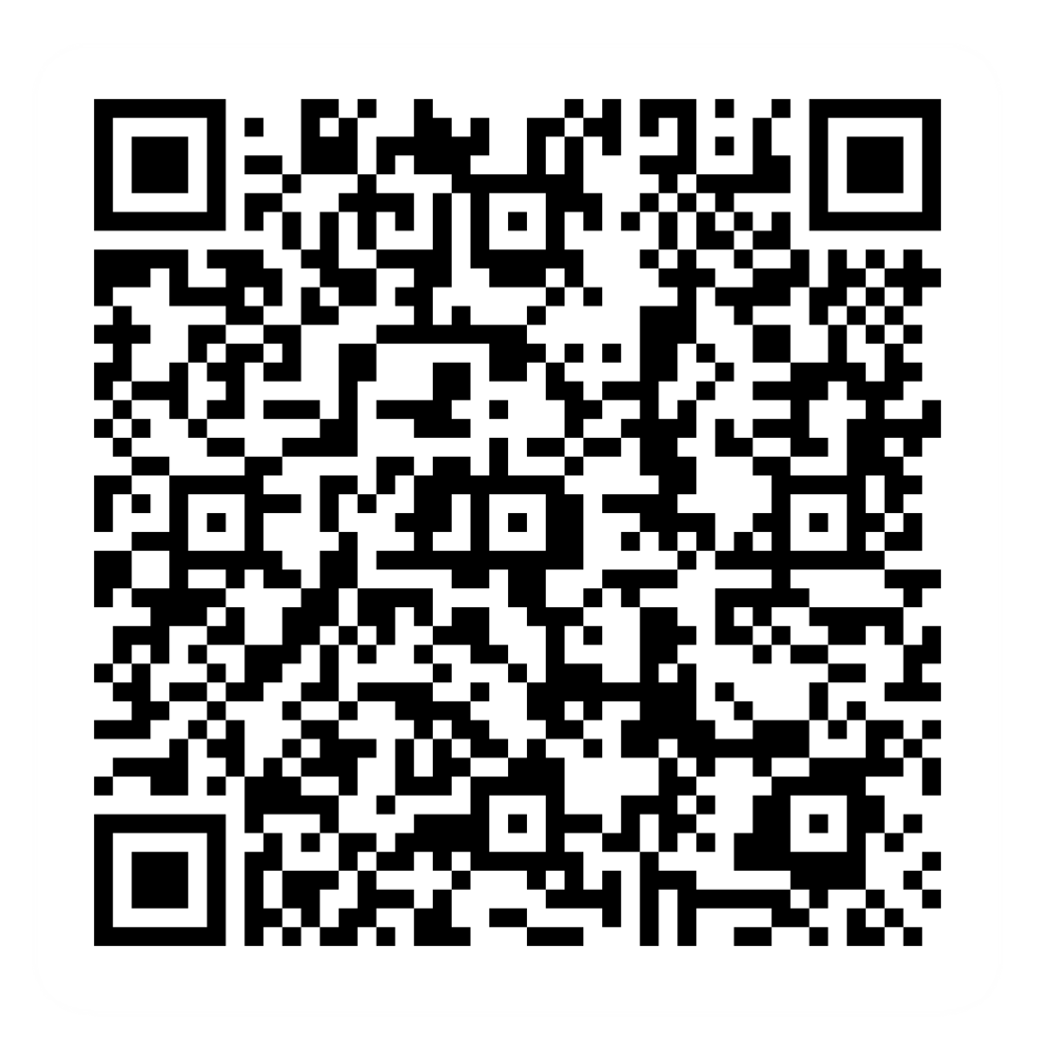
Post-session survey
Notes:
Encourage learners to scan the QR code here and complete our short post-session survey around levels of confidence now they have completed the training, plus any other comments or feedback about the session

Slide 23
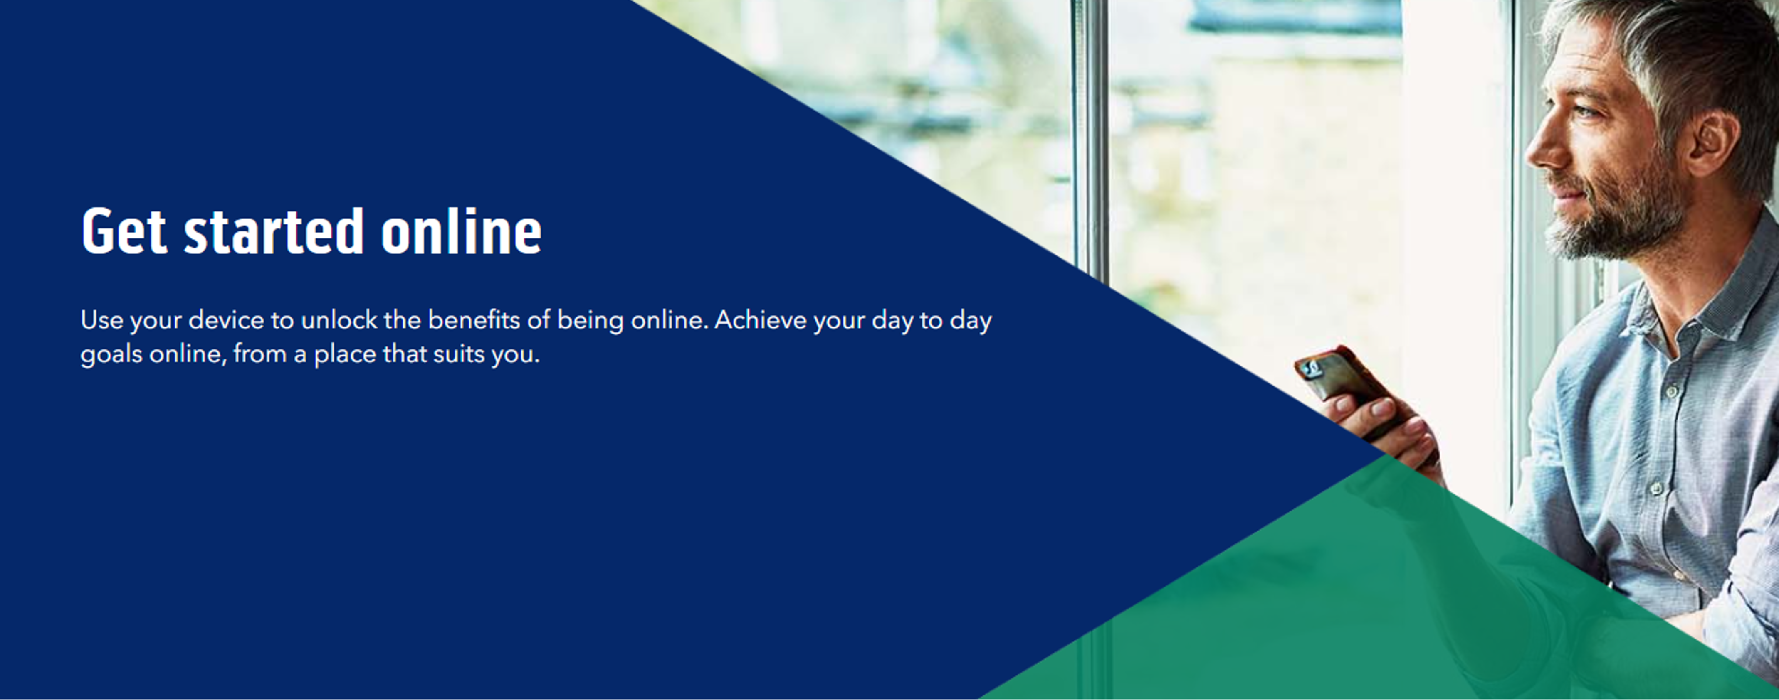
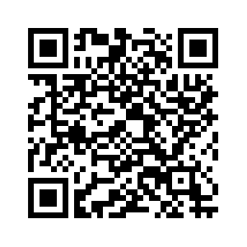
Notes:
Trainer notes
Signpost related content on the Academy website https://www.bankofscotlandacademy.co.uk/learn-for-life/get-started-online/
Alternatively, they could use their phone cameras to scan the QR code here.
If they don’t feel comfortable using this yet, then suggest they take our other lessons: “Connecting to the internet” and “ Stay safe online”, if you don’t know the next dates for these or how to help them sign up then speak to the Academy team before your session.
If part of a programme, share the date and topic of the next session

