Slide 1

Plan your travel online
Notes:
Check what Wi-Fi network is available, its name and any password required; write up / make available to the learners
Welcome people into the room
Introduce yourself
Make sure everyone is comfortable
Go to the next slide when you’re ready to start the lesson

Slide 2
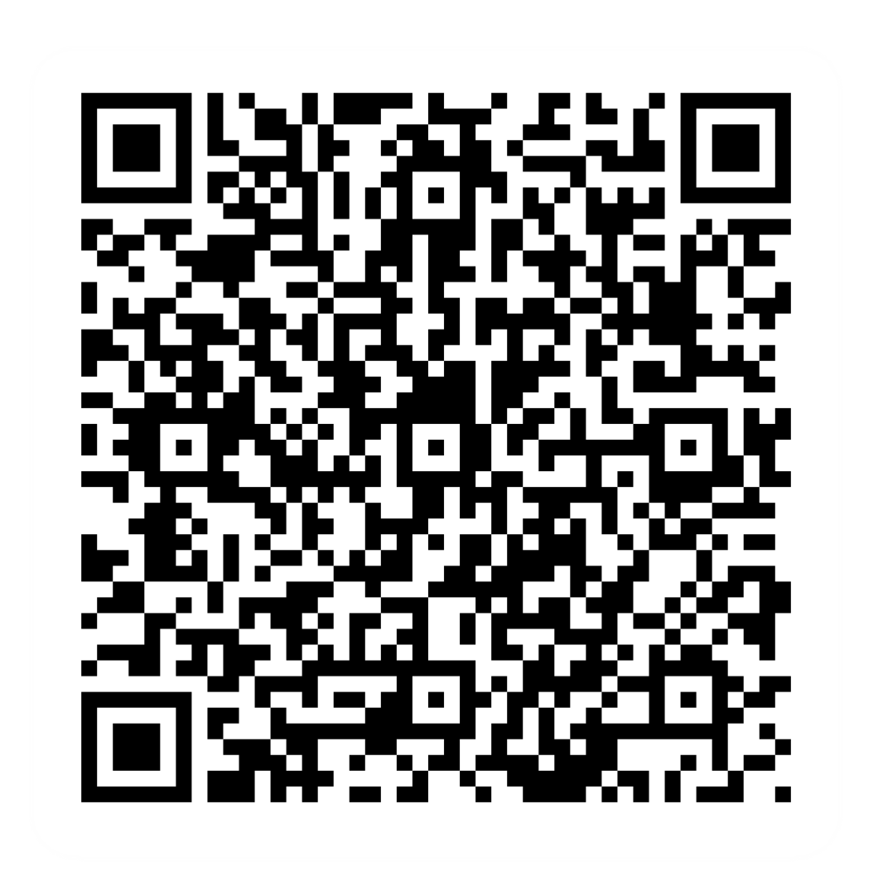
Pre-session survey
Notes:
Encourage learners to scan the QR code here and complete our short pre-session survey around levels of confidence in the session’s topics today, plus what they would like to get out of the session

Slide 3

Welcome
Notes:
TRAINER NOTES –
If this lesson marks the start of a programme, welcome people to the programme
If it is not, then welcome people to the lesson
Welcome to today's lesson on planning your travel online
I'm [Your Name], and I'm here to guide you through planning your travel online
We're thrilled to explore how you can use online tools to make your travel experiences smoother and more efficient
Today, we want to make the learning practical, relatable, and, most importantly, helpful to you
In the virtual room, we also have [Any Co-Presenter's Name] here to assist you during this session
TRAINER NOTE – For small groups / virtual sessions, learners could introduce themselves at this point
Throughout this session, we'll explore various aspects of online travel planning, from finding information to using helpful apps
If you have your device with you, fantastic! We'll guide you through the steps. If not, no worries; you can still learn valuable tips for your next trip
Feel free to ask questions and let us know if you need anything, we’ll go at your pace as much as possible
If there's anything we can't cover today, rest assured we'll help you find the information you need
Let us know if we're going too fast, too slow, or if you need a break. Your learning experience is our priority

Slide 4

Today we want to help you:
Use online tools to plan your journey
Book travel tickets online
Use mobile apps and tools to help when you're out and about
Notes:
Today, our goal is to help you:
Use online tools to plan your journey
Book (travel) tickets online
Use mobile apps and tools to help when you're out and about
Keep in mind that every device is slightly different, so we'll share general steps, tips, and what to look for
If you need more guidance on specific steps for your device, just let us know during the session

Slide 5

What online tools can help your travels?
Notes:
Let's have a chat – what tools can help our travels?
Feel free to share your ideas and experiences
TRAINER NOTE – Run a short discussion/chat-based activity. Allow participants to share their thoughts. Encourage participation and acknowledge responses positively. Examples:
Online maps (e.g., Google Maps, Waze, AA)
Ticket booking (e.g., National Rail Enquiries, Trainline, etc.)
Bus apps

Slide 6





Some examples
Flights
Bus / train / tram
Passes / tickets
Insurance
Location
Parking
Notes:
Let's explore some examples of travel-related services you can access online. Remember, the world of online travel planning offers a variety of tools and services. Here are some examples:
Book and manage your flights, check itineraries, and receive e-tickets through airline websites or travel platforms
You could use bus, train, and tram apps, on the go, to check the time of the next train/bus, find out where the nearest stop is (for the bus you want to take), check for any cancellations or disruptions to service, or look up alternative options.
You can buy passes or tickets for public transport through their website and apps
Explore and buy travel insurance online to ensure a worry-free journey
Use online maps and navigation apps to plan your routes, look up attractions and find your way around unfamiliar places
Having parking apps on your phone means you never need to look for the right change or a working pay and display machine again. You can even pre-book your parking space with some of these
TRAINER NOTES –
Ask learners which of these travel-related services they'd like to access online, using their answers to illustrate the range of possibilities
Note that later in the lesson, we'll explain how to access these services online
Encourage participants to ask questions if they have specific things or certain travel-related services

Slide 7

Using online tools to plan your travel
Find or decide where you’re going
Check your travel options
Book tickets
Get travel alerts and tips
Notes:
Now, let's look at how to go about using these tools to plan your travel
Find or decide where (and when) you’re going – Websites and apps can show you information based on where you want to go. Use sites like TripAdvisor, Trivago or Google for researching accommodation, restaurants, and attractions. All these give reviews and ratings from others, so you can start to get an idea of where to go. They also sometimes give you useful tips. Google Maps has a useful ‘street view’ option which can show you the area and helps you spot useful landmarks that might come in handy when trying to find your destination.
Check your travel options – Use the platform to explore various travel options, including routes and modes of transport. Sites like National Highways and route planning apps like CityMapper help you decide your best travel options. National Highways (they have Highways England, Highways Scotland and Highways Wales pages) can show planned roadworks on key roads as well as expected congestion areas and real-time Matrix signs. CityMapper can show you at-a-glance the costs and timings for alternative transport options so you can compare a shorter taxi or train journey with a longer but cheaper bus route – and see if it’s quicker to walk! Trainline will show you options for a particular route as well as highlighting the cheapest option. If you’re planning bigger journeys, both Skyscanner and Kayak are useful tools to help you compare flights, hotels and car rentals
Book tickets Many airlines, bus and train companies have sites or apps where you can book tickets in advance. You may be able to book specific options like quiet carriages or a window seat. You may be able to save money by booking tickets or season passes in advance. Some of the travel comparison sites also link to sites where you can book tickets, too.
Check travel alerts and tips – You can get useful travel alerts from public transport and road user sites – like Transport for London (or your own local public transport hub), National Highways, the AA etc. Many SatNav apps do this too – like Waze and TomTom. Using these before you set off could save you time and stress.
TRAINER NOTE – Encourage participants to apply these steps when using any travel planning website or app

Slide 8




Booking travel online
Search
Compare
Select
Details and payment
Confirm
Manage
Notes:
TRAINER NOTES –
Guide participants through each step, ensuring they understand the process of booking travel online
Now, let's look at how you go about booking your travel online. These steps apply whether you're booking flights, trains, coaches, ferries, buses, or trams. Online travel platforms aim to simplify the process for all your travel needs
Search – Start by using a travel planning tool (like Skyscanner, Kayak or Trainline) to look for flights, trains, coaches, ferries or other transport options. This gives you a broader choice of how you travel. Maybe you know how you’re going to travel – for example, you’re taking a train. If that’s the case, what you’ll be searching for here is what trains are available on the day you want to travel
Compare – Next, look at what’s available, thinking about things like costs, times, availability and what’s included. Most platforms allow you to filter and compare results , whether it’s different providers or various routes and times (e.g., direct train might be faster but one with changes or at an earlier / later time might be cheaper)
Select – You may be starting at this step – like if you know how you’re going to travel and the operator you’ll be using. Pick the option that works best for you. You might even be able to choose a specific seat or other preferences like a quiet carriage or window seat
Details and payment – Provide the necessary details for booking, including passenger information and payment details. Make sure the platform's security features are in place
Confirmation – After payment, you'll receive a confirmation email with details of your booking, whether it's a ticket for a train, flight, or other mode of transport
Manage bookings – Many platforms offer tools to manage your bookings. This includes checking in for flights, accessing digital tickets for trains or buses, and modifying reservations. It's all about the convenience of having everything at your fingertips
Booking your travel online is about making choices that fit your preferences and budget, and these simple steps ensure you're in control of your journey

Slide 9
Using online tools to help while you’re travelling
Journey planning and navigation
Public transport info
Taxi apps
Maps and location sites
Parking apps
Notes:
TRAINER NOTE – Check if the area you are training in is covered by the apps you’re discussing. As you talk through the relevant type of tool, you might want to show learners what these apps look like. On the next slide, there’s a more in-depth demo
Using online tools when you’re on the move can help to get you to where you need to go, provide live updates on public transport, and up-to-date information and help while you're travelling
Examples include:
Journey planning and navigation – Apps like Citymapper, give real-time public transport info, including the least busy coaches on the trains and walking time to the nearest bus stop. Other route planning / navigation tools include the satnav apps TomTom and Waze . Check out the National Highways site (search for ‘Traffic England’ / ‘Traffic Scotland’ or ‘Traffic Wales’) to see live traffic info on motorways and A-roads, current and planned roadworks, closures etc – it even shows you what’s on the motorway matrix signs!
Public transport sites are great for on-the-move as well as when you’re planning and pre-booking your travel. Most let you check live departure times, and receive travel alerts about changes that might affect your journey. Examples include: National Rail Enquiries, National Express and Traveline. There are often area-specific options too (e.g. TfL - Transport for London, TfGM - Transport for Greater Manchester) etc. Look for apps from your local bus company, too
Taxi apps – Apps like Uber or Bolt let you book a taxi for quick, convenient travel. Check what’s available in your area – there may be other local taxi apps too
Maps and location sites – Some of these apps are better for specific things, so think about how you want to use them. Google Maps can show you the whole journey as well as the step-by-step directions you get from satnav apps. Some, like Apple Maps are for specific devices. MapMyWalk lets you plan a walking, cycling or running route. And What3Words, which gives very precise location information, can be useful for meeting friends as well as being used by the emergency services (e.g. if you find yourself lost and in difficulties in a rural location). Social apps like WhatsApp and Facebook Messenger have handy ‘share my live location’ options which can help if you’re meeting friends – Google maps and the Apple ‘Find my friend’ feature does this, too
Parking apps – If you’re driving, your journey might end in a car park. Knowing the available payment options in advance can make things a lot quicker and easier. As more and more car park providers are switching to app-only payments, it’s good to check which app they use, and make sure you have it on your phone before you set off. Popular apps include RingGo, and PayByPhone. Others, like JustPark and YourParkingSpace even let you pre-book parking. When you first download the app, it will ask you for your car reg number and payment details. Then when you arrive at the car park, open the app, pick or confirm the car park you’re in (usually there’s a sign with a car park number to identify it), confirm the car and say how long you want to park for. Then pay using your saved details. These apps often remind you when your parking is about to run out, and give you the option to extend your parking time from the app, too.
TRAINER NOTES –
The next slide will demo Google Maps
If there is time (after this), demo apps like What3Words or Citymapper, and encourage learners to follow along

Slide 10
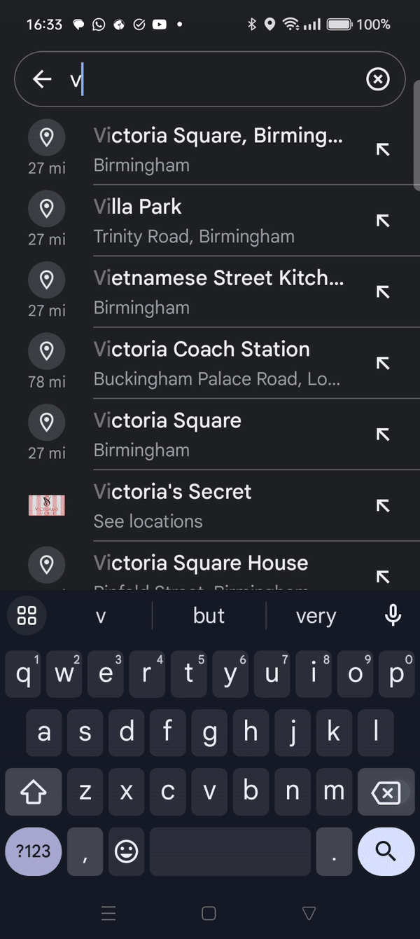
Using navigation apps
Search for a place
Tap directions
Choose your mode of transport
Explore route options
Tap start
Follow the instructions
Notes:
Now that we've talked about some apps that can help you while you're on the move, let's dive a bit deeper into one example – the navigation app. One popular app for this purpose is Google Maps. There are other apps like Citymapper (for all modes of transport) and walking-related examples like Plotaroute /MapMyWalk, you could use too
TRAINER NOTES –
Load Google Maps (and encourage participants to open Google Maps on their devices)
Ask if anyone has used a navigation app before and if they have specific questions
Mention real-life situations where these tools really help – such as meeting friends in a café you haven't been to before, finding alternative routes due to traffic issues or road closures, etc.
Now, let's get hands-on with Google Maps. Here's how you can plan a journey:
TRAINER NOTE – Show how to enter a destination
Search for a place
On your device, open Google Maps
Tap the search bar at the top
Type in the place you want to go
Tap directions
Choose your mode of transport
Look at the map. It shows you various routes. Explore your route options. Want to see more options? Swipe through them
TRAINER NOTES –
Demonstrate the different route options available
Explain how to start turn-by-turn navigation
See a route you like? Tap ‘start’ As you travel, Google Maps gives you turn-by-turn directions
Follow the on-screen instructions
There’s lots of times where these apps can help. Like when you need to get to a job interview tomorrow at 9am in a part of town you don’t know. You’ll need to know not just how to get there but when to leave and how long it will take. Maybe you’re visiting family in an area you’ve not been to before. Taking your friend to a hospital appointment. Looking for a car park close to the beach. Or you just want to find somewhere local to eat – maybe a restaurant that you can walk back from.
Imagine you're planning a trip using public transport. Tools like Citymapper and Google Maps can guide you through the entire journey, including which bus or train to catch and where to get off. It's like having a personal navigator in your pocket
TRAINER NOTE – If there is time and interest from the group, demo apps like What3Words or Citymapper and encourage learners to follow along
Feel free to try this out on your own device. If you encounter any bumps along the way or have questions, let us know

Slide 11
Today you've seen how to:
Use online tools to plan your journey
Book travel tickets online
Use mobile apps and tools to help when you're out and about
Notes:
Fantastic! We've covered a lot today. Let's take a moment to reflect on today’s journey
You've gained skills to plan and manage your travels online
Whether it's booking transportation (trains, buses, etc.) or using travel apps, you now know how
Time to put your skills into action. Try what you've learned, and remember, we're here for any questions or feedback. If you want to explore more, our Academy site has a range of resources. Specifically, check out our ‘Introduction to online services' lesson. Dive in and keep mastering your digital skills!
TRAINER NOTE – Remind them of the practicality of applying these skills to their upcoming travels (getting home or to work after this lesson)
Now try it for real - see what Google Maps or CityMapper say about how to get back home from here – how long it will take, and what options are available to you
MODERATOR NOTE – Share in chat: https://www.bankofscotlandacademy.co.uk/learn-for-life-new/get-started-online/introduction-to-online-services/

Slide 12
Any questions?
Notes:
Trainer NOTE – Ask if they have any questions, comments or feedback that you can help with. You could consider this as an opportunity to check level of confidence in doing these in future, ask what they found most useful, anything they’d like to know more about (or to go through again before the lesson ends) and where they think they’ll need more practice.

Slide 13
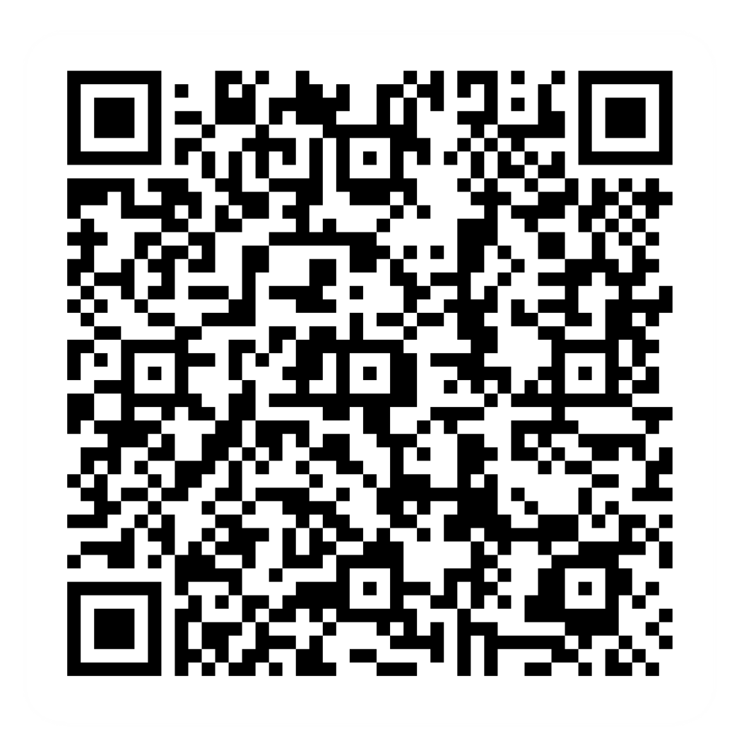
Post-session survey
Notes:
Encourage learners to scan the QR code here and complete our short post-session survey around levels of confidence now they have completed the training, plus any other comments or feedback about the session

Slide 14

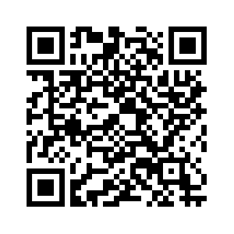
Notes:
Trainer notes
Signpost related content on the Academy website https://www.bankofscotlandacademy.co.uk/learn-for-life/get-started-online/
Alternatively, they could use their phone cameras to scan the QR code here.
If they don’t feel comfortable using this yet, then suggest they take our other lessons: “Connecting to the internet” and “ Stay safe online”, if you don’t know the next dates for these or how to help them sign up then speak to the Academy team before your session.
If part of a programme, share the date and topic of the next session

